Slide 1
Ledipasvir and sofosbuvir fixed-dose combination with and without ribavirin for 12 weeks in treatment-naive and previously treated Japanese patients with genotype 1 hepatitis C: an open-label, randomised, phase 3 trial
The Lancet. Infectious diseases. June 2015, PMID: 25863559
Isabel Bartella, Bern 15.07.2015

Slide 2
Background
Patients in Japan
older
advanced liver diseases
treatment experienced
Guidlines: simeprevir + peg. interferon alfa + ribavirin (daclatasvir+asunaprevir)
→ reduced SVR rates in patients with previous non- response to treatment
→ high rate of side effects

Slide 3
Methods
Randomised, open-label
study (n=341)
166 treatment-naive
175 previously treated
L-S
(n=83)
L-S +R
(n=81)
L-S
(n=88)
L-S + R
(n=87)
SVR12
→ Stratified by
presence/absence of cirrhosis
previous treatment category

Slide 4
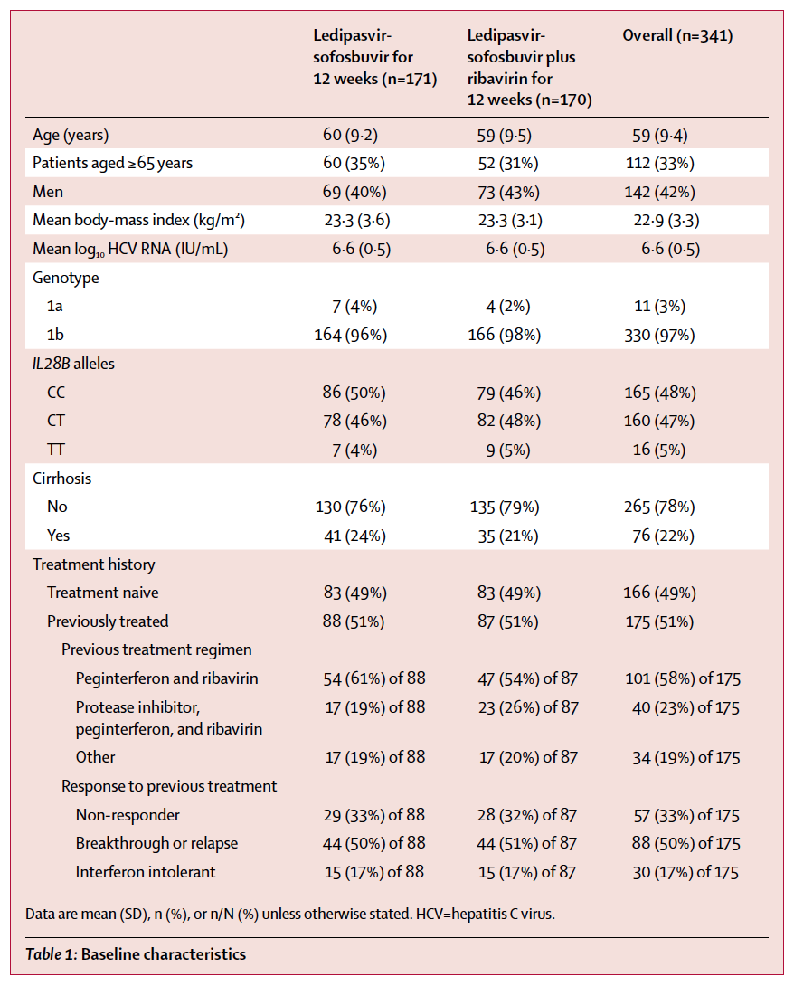
Methods

Slide 5
Results
SVR12 achieved in 99%
ledipasvir-sofosbuvir group: 100%
ledipasvir-sofosbuvir + ribavirin group: 98%
patients with baseline NS5A resistant variants: 99%
patients previously treated: 100%

Slide 6
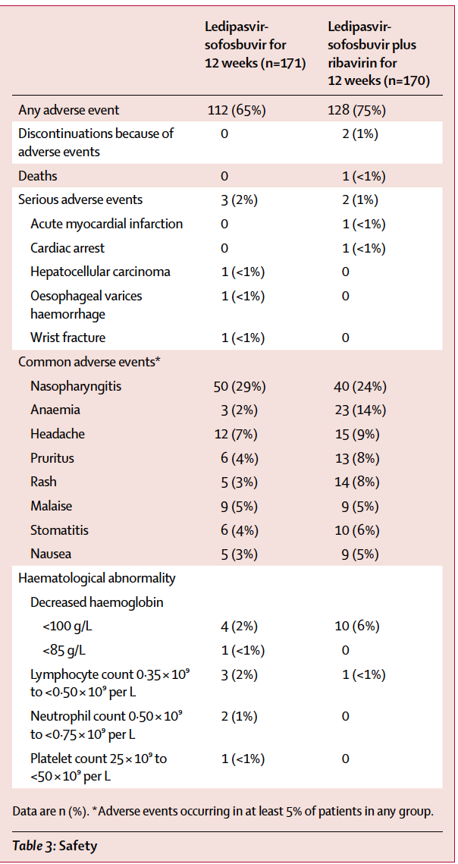
Results
At least one treatment-emergent
adverse event: 70%
→ 84% mild events
0.6% discontinued treatment
because of adverse events
→ ribavirin group
Hb reduction was significant higher
in ribavirin group

Slide 7
Conclusion
Ribavirin increased the rate of adverse events
Many of the host and viral factors (e.g. cirrhose status)
are not clinically relevant for the outcome
High nasopharyngitis rate may be attributed to the season
Limitations
Open-label design
Absence of an active comparator

Slide 8
Thank you for your attention!

