Slide 1
Statins are associated with a decreased risk of decompensation and death in veterans with hepatitis C-related compensated cirrhosis prepared by Paulina Sypniewska
Gastroenterology 2016;150: 430-440
Mohanty A et al

Slide 2
Statins’ effect on decompensation and survival times in compensated cirrhosis
AIM
to assess the effects of statins on decompensation and survival times in patients in hepatitis-C related compensated cirrhosis

Slide 3
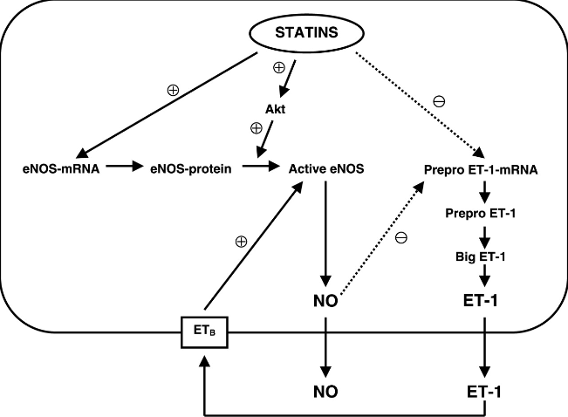
Statins’ effect on decompensation and survival times in compensated cirrhosis
Background
Portal hypertension
increased intrahepatic vascular resistance due to sinusoidal endothelial dysfunction with NO
Statins
increase NO availability
at the intahepatic level
decrease portal pressure
Statin effects beyond lipid lowering—are they clinically relevant?
P.O Bonetti, L.O Lerman, C Napoli, A Lerman
Notes:
Simvastatin enhances Akt-dependent endothelial nitric oxide synthase phosphorylation→ may increase hepatic NO release and decrease hepatic resistance in patients with PH

Slide 4
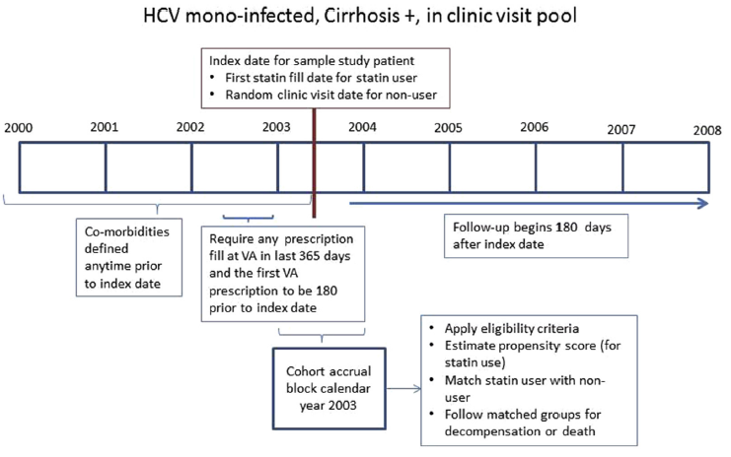
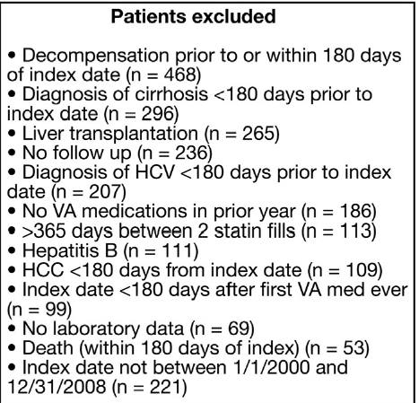
Statins’ effect on decompensation and survival times in compensated cirrhosis
Methods
Retrospective cohort
study using
nationwide data
from veterans infected
with HCV

Slide 5
Statins’ effect on decompensation and survival times in compensated cirrhosis
Methods
Propensity score development
to minimazie confounding by indication, to imitate RCT
Balancing score, distribution of measured baseline covariates was similar between statin users and nonusers
Matching
Statin users with the same propensity score were matched by propensity score to non-users

Slide 6
Statins’ effect on decompensation and survival times in compensated cirrhosis
Study Outcome
Death
Decompensation:
esophageal varices with bleeding
esophageal varices in diseases classified elsewhere, with bleeding
ascites
SBP

Slide 7
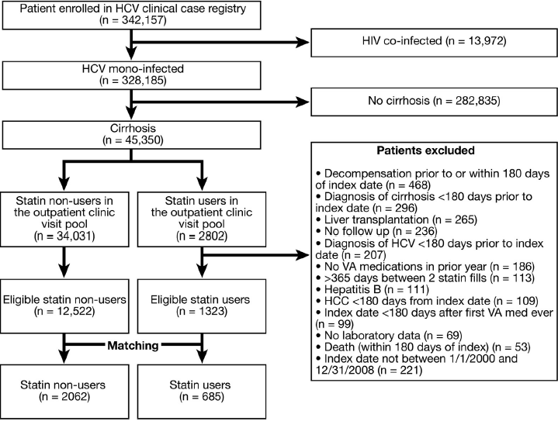
Statins’ effect on decompensation and survival times in compensated cirrhosis
Results
685 statin users
matched with 2062
statin nonusers
(1 user : up to 5 nonusers )
Simvastatin (85%),
lovastation (10%),
pravastatin (3%)
Notes:
Weighted average of every set of nonusers was used to represent 1 user

Slide 8
Statins’ effect on decompensation and survival times in compensated cirrhosis
Results
Cirrhosis Decompensation
In the matched cohort : median follow-up period for decompensation was 2.3 years for statin user and 1.7 years for statin nonusers
220 decompensation events (39 statin users vs 181 nonusers); HR 0.55, 95% CI; similar events after adjustement for antiviral therapy

Slide 9
40% lower risk of decomepnsation and death with statin use among HCV-related compensated cirrhosis
Death
In the unmatched cohort, statin use associated with risk of death (HR 0.39, 95% CI)
In the matched cohort, median follow-up for death 2.4 y for user and 1.9 y for nonusers
667 deaths (121 users vs 549 nonusers)
Statin use was associated with a risk of death (HR 0.56; 95% CI)
HCC and OLT
Statin use associated with a significant risk of development of HCC and lower rate of OLT

Slide 10
40% lower risk of decomepnsation and death with statin use among HCV-related compensated cirrhosis
Discussion
Simvastatin reduces portal pressure both in experimental animals and in patients with cirrhosis (RCT)
Statins also have important anti-inflammatory properties in hepatocytes and in vascular cells
Placebo-controlled study(2010-2013): in cirrhotic patients who bled from varices simvastatin improved survival without an effect on variceal bleeding

Slide 11
40% lower risk of decomepnsation and death with statin use among HCV-related compensated cirrhosis
Limitations
ICD-9 codes used for diagnosis→ possibility that patients without cirrhosis were included (although small chances as cirrhosis more likely to be underdiagnosed)
All subjects had HCV, but concomitatnt etiologies cannot be excluded (50% had OH dependence)
Study cohort was predominantly male
Next step
Placebo-controlled RT and stratification of patients by etiolgy of cirrhosis

