Slide 1
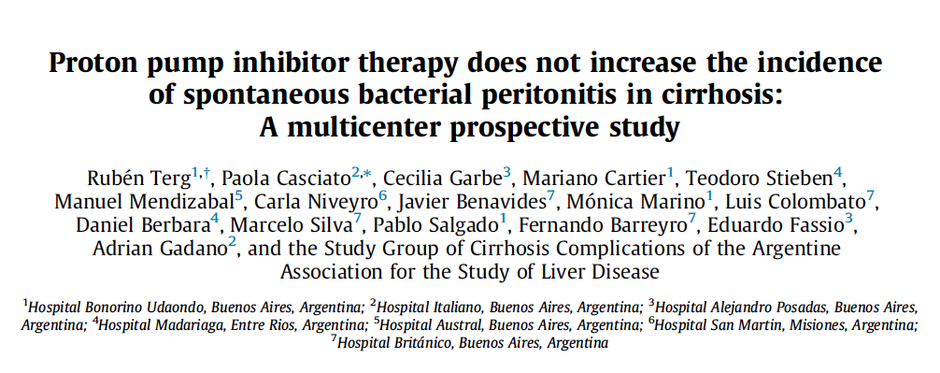
Journal Club – Hepa Visite
10.02.2016
Catharina Zeuzem

Slide 2
Patients and methods
770 patients with decompensated cirrhosis
23 hospitals in Argentina
From March 2011 to April 2012
519 patients included
Diagnosis of cirrhosis
? PPI in the 3 months prior to hospitalisation
Classified as PPI-users or non-PPI-users
251 patients excluded
Active GI bleeding
Antibiotic treatment
HIV positive
Immunosuppressive therapy
226 patients received PPI therapy within the last 3 month
293 patients did not receive PPI therapy

Slide 3
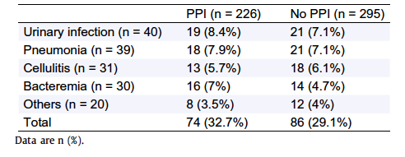
No difference in the rate of PPI consumption between infected and non-infected patients
519 patients
255 with bacterial infections
→ 114 (44,3%) w/ PPI consumption
264 without bacterial infections
→ 112 (42,8%) w/ PPI consumption
→ PPI consumption has no impact on bacterial infections in cirrhotic patients

Slide 4
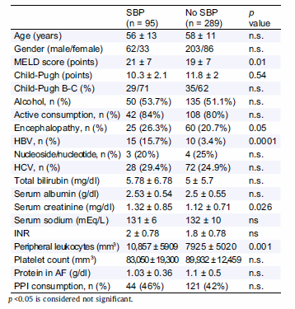
No difference in PPI consumption between patients with or without SBP
384 patients had ascites at admission
95 with SBP
289 without SBP
Patients with SBP have
Higher MELD Score
More Enzephalopathy
More HBV
Higher Serum Creatinine
Higher peripheral leukocyte count
No significant difference in PPI consumption rate.

Slide 5
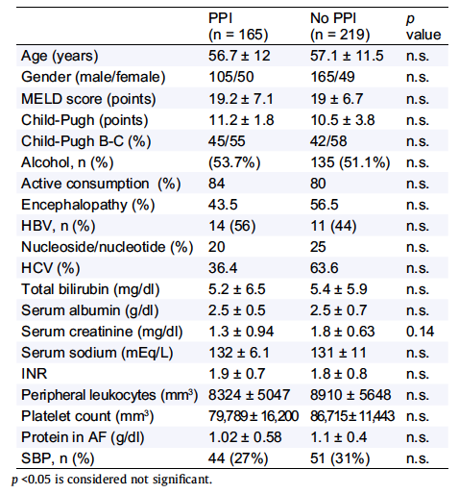
SBP rate is similar in PPI-users and non-PPI-users
384 patients with ascites
165 with PPI consumption
219 without PPI consumption

Slide 6
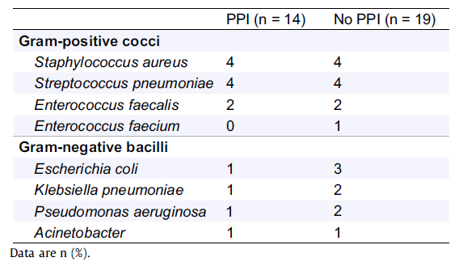
No significant difference of the bacteria in SBP patients with or without PPI use
95 patients with SBP
Positive cultures in 33 patients

Slide 7
Discussion
Result: PPI use does not increase the incidence of SBP in decompensated cirrhotic patients
Controversial results in previous studies (6 + 1 meta-analysis)
Design of all these studies was identical
Retrospectively reviewed the list of medications
heterogeneity in the inclusion criteria

