Slide 1
Liver Imaging Reporting and Data System with MR Imaging: Evaluation in Nodules 20 mm or Smaller Detected in Cirrhosis at Screening US
Radiology 2015; 275:698-707
Anna Darnell, MD, Alejandro Forner, MD, PhD, Jordi Rimola, MD, PhD, María Reig, MD, PhD,
Ángeles García-Criado, MD, PhD, Carmen Ayuso, MD, PhD, Jordi Bruix, MD, PhD
B. Taskin, Bern 12.08.2015

Slide 2
Background
Diagnosis of HCC: if nodule ≥10 mm exhibits a specific vascular profile -> imaging criteria relies on experienced radiologists together with state-of-the-art hardware and software for CT and MRI and standardized dynamic contrast material-enhanced imaging protocols
False HCC diagnosis (by heterogeneous reporting) in 21% of patients given priority for liver transplantation
Aim: Evaluation of diagnostic accuracy of the Liver Imaging Reporting and Data System (LI-RADS) with MRI for hepatic nodules ≤20 mm during ultrasonographic surveillance in patients with cirrhosis with high risk for developing HCC
B. Taskin, Bern 12.08.2015

Slide 3
Materials and Methods
Study 2003-2010
patients with newly detected solitary nodule underwent MRI and fine-needle biopsy
Nodules without pathologic confirmation were followed up with MRI every 6 months
a LI-RADS category was retrospectively assigned to nodules seen at MRI:
-> category 1 (definitely benign), 2 (probably benign), 3 (intermediate probability of HCC), 4 (probably HCC), 5 (definitely HCC), category "other malignancies" (other than HCC)
Diagnostic accuracy for each LI-RADS category described by sensitivity, specificity, and positive and negative predictive values with 95% confidence intervals
B. Taskin, Bern 12.08.2015

Slide 4
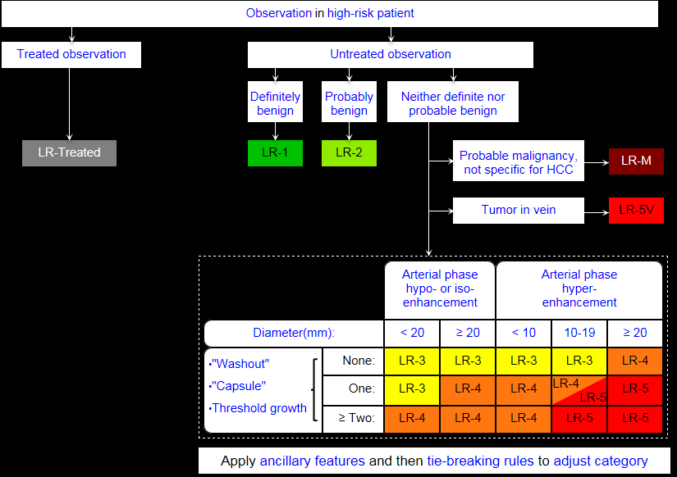
B. Taskin, Bern 12.08.2015

Slide 5
In/exclusion criteria
Inclusion criteria:
Patients with cirrhosis (CHILD A or B) and no history of HCC and:
newly US-detected solitary hepatic nodule ≤20 mm
Nodules ≤10 mm rarely malignant -> cutoff was set at 10 mm
Eclusion criteria:
Patients with contraindications to MRI or fine-needle biopsy
B. Taskin, Bern 12.08.2015

Slide 6
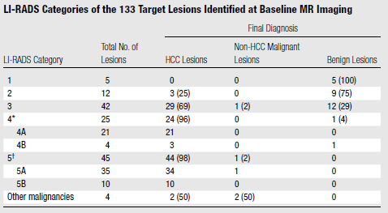
Results
Final diagnosis of 133 nodules in 159 patients: 102 HCCs, 3 ICCs, 1 metastasis of NET, 27 benign lesions (median 95 months follow-up)
133
102
4
27
B. Taskin, Bern 12.08.2015

Slide 7
Results
LI-RADS category 4 criteria as effective as category 5 criteria for HCC diagnosis
Combining both categories would improve sensitivity without impairing specificity or positive or negative predictive value for HCC diagnosis
B. Taskin, Bern 12.08.2015

Slide 8
Conclusions
in patients with cirrhosis with US-detected nodules ≤20 mm, both LI-RADS category 4 and category 5 have high specificity for HCC
relevant proportion of lesions categorized as LI-RADS category 2 or 3 or as other malignancies were HCCs
-> active diagnostic work-up, including biopsy to allow prompt treatment, is recommended in such patients
B. Taskin, Bern 12.08.2015

Slide 9
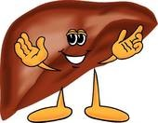
Thank you for your attention!
B. Taskin, Bern 12.08.2015

