Slide 1
Increasing Utilization and Excellent Initial Outcomes Following Liver Transplant of Hepatitis C Virus (HCV)-Viremic Donors Into HCV-Negative Recipients: Outcomes Following Liver Transplant of HCV-Viremic Donors.
Journal Club - 19.09.19
Thomas G. Cotter, Sonali Paul, Burhaneddin Sandıkçı, Thomas Couri, Adam S. Bodzin,
Ester C. Little, Vinay Sundaram and Michael Charlton.
Hepatology (2019)
Dr. Chiara Becchetti
Research Fellow – Resident in Training
Gastroenterology and Liver Unit
University of Padua, Italy

Slide 2
Background
Direct-acting antiviral (DAA) therapy has changed the landscape of hepatitis C virus (HCV) management and the epidemiology of the indication to liver transplantation (LT).
In the pre-DAA era HCV recurrence after LT severely affected the prognosis of transplanted patients and its impact on allograft function and survival greatly limited the utilization of organs from donors with HCV overall and essentially precluded their use in HCV-negative recipients.
Considering the opioid epidemic and the ongoing liver allograft shortage, the pool of HCV-positive livers looks particularly attractive, although little is known whether HCV status of a liver graft affects patient and graft survival in the post-DAA era.

Slide 3
Hypothesis and Aims
To assess the use of
HCV anti-body positive donors (DAb+) in the pre and post-DAA era and to compare the graft survival rate beetween the different mismatched gruops
Consider the effectiveness of DAA therapy and the ongoing opiate epidemic
increase in HCV antibody-positive/nucleic acid testing (NAT)+ donors into negative recipients with acceptable outcomes.
To assess the use of
HCV-RNA positive donors (DNAT+)
in the post-DAA era and to compare the graft survival rate beetween the different mismatched gruops

Slide 4
Study design
Type of study: retrospective multicentric observational cohort study
Data source: Scientific Registry of Transplant Recipients (SRTR)
Study period: January 1, 2008 to January 31, 2018
Population: Liver transplanted patients
Definition of HCV status:
RECIPIENTS (R+) with HCV as a primary or secondary transplant indication were identified. Diagnoses were assigned by transplant centers without diagnostic or confirmatory test.
DONORS were identify as HCV anti-body positive (DAb+) in the first analysis and in the second as HCV-RNA positive (DNAT+).
Exclusion criteria:
Paediatric population
Multi-organ transplant
Living donor
Super urgent transplant (UNOS Status 1)
Re-transplant

Slide 5
Study profile
HCV antibody donors cohort
HCV-RNA donors cohort
DAb-/R+
DAb-/R-
DAb+/R+
DAb+/R-
DNAT-/R+
DNAT-/R-
DANT+/R+
DANT+/R-
Pre-DAA era
(Jan 2008 – Nov 2013)
Post-DAA era
(Dec 2013 – Jan 2018)
Post-DAA era
(Apr 2014 – Jan 2018)
Primary outcome: graft survival (no graft failure, re-transplantation or death) among DAb+/R– vs. DAb+/R+.
Secondary outcome: comparison of the two groups between pre-DAA era and post-DAA era.
Primary outcome: graft survival (no graft failure, re-transplantation or death) among DNAT-/R– vs. DNAT+/R- and DNAT+/R+ vs. DNAT-/R+.

Slide 6
Results: prevalence
Ab-HCV status donors | Total number of LT
DAb+/R+ | 2378
DAb+/R- | 257
RNA-HCV status donors | Total number of LT
DNAT+/R+ | 753
DNAT+/R- | 87
DNAT-/R- | 11270
DNAT-/R+ | 4748
148
385
7
107

Slide 7
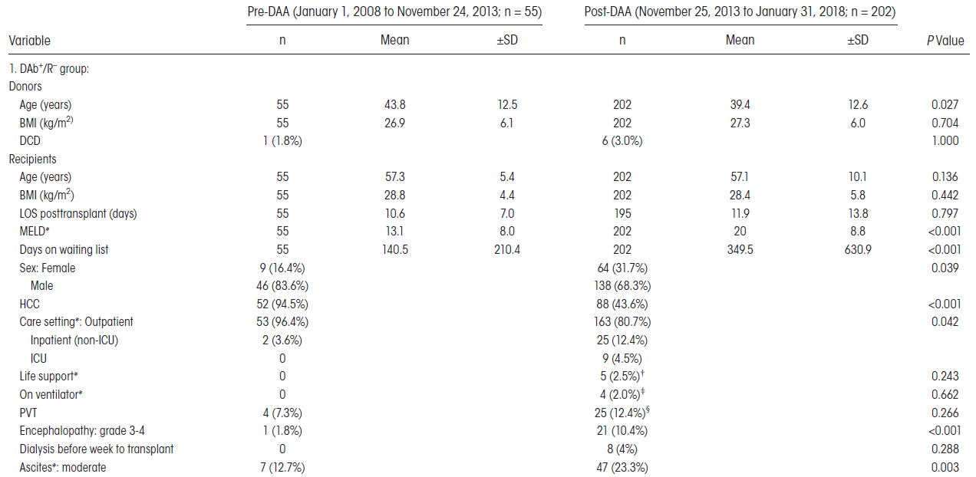
Results: anti-HCV cohort
Age: 39.4 vs. 42.3 years DAb-/R-; P=0.021
BMI: 27.3 vs. 28.3 kg/m2 DAb-/R-; P=0.034

Slide 8
Results: anti-HCV cohort
90 days post-LT analysis: in the pre-DAA era DAb+ vs. DAb –was 78.1% vs. 81.2%, P<0.001; while in the post-DAA era DAb+ vs. DAb– was 85.1% vs. 84.5%, P=0.169.
In the post-DAA era there were no cases of de novo hepatitis in DAb+/R– group and 5 (4.4%) cases of recurrent hepatitis in the DAb+/R+ group.
There was no difference in causes of graft failure between DAb+/R– and DAb–/R– and between DAb–/R+ and DAb+/R+ (all P values >0.05).

Slide 9
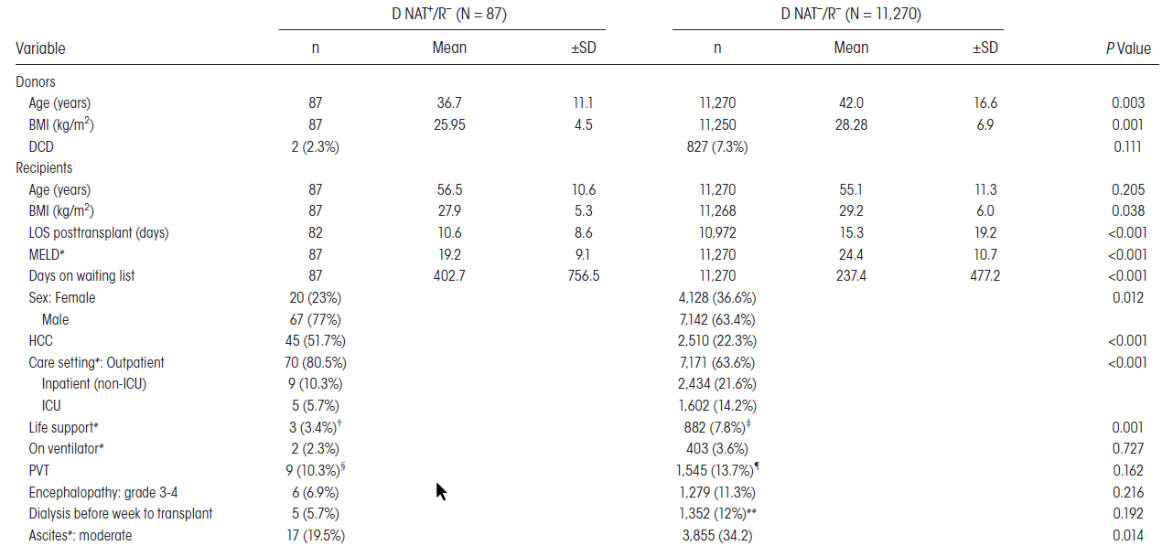
Results: HCV-RNA cohort
DNAT+/R+ vs. DNAT-/R+ group:
Donor age (36.6 vs. 41.9 years; P < 0.001)
Donor BMI (26.4 vs. 28.4 kg/m2; P < 0.001)
Waitlist time (253 vs. 368 days; P < 0.001)

Slide 10
Results: HCV-RNA cohort
Similar results were observed when patients who died up to 90 days post-transplant were excluded.
There were no cases of de novo hepatitis and 1 (2.3%) case of recurrent hepatitis in the DNAT+/R+ group.
There was no difference in causes of graft failure between all the four groups (DNAT-/R- vs. DNAT+/R- and DNAT-/R+ vs. DNAT+/R+, all P values >0.05).
RNA-HCV status donors | 1-year survival rate | 2-year survival rate
DNAT+/R+ | 94% | 90%
DNAT+/R- | 93% | 86%
DNAT-/R- | 93% | 88%
DNAT-/R+ | 93% | 88%

Slide 11
Results: predictors of graft failure
HCV anti-body donors cohort
HCV-RNA donors cohort
Groups of patients | Variables* | HR | CI (95%)
Post-DAA DAb+/R- | DCD donor | 1.08 | 1.97-2.39
 | Creatinine | 1.08 | 1.02-1.15
 | Male recipient | 1.22 | 1.04-1.44
 | PVT | 1.28 | 1.10-1.48
 | DM II | 1.15 | 1.07-1.55
Post-DAA DAb+/R+ | Male donor | 1.29 | 1.07-1.55
 | DCD donor | 1.64 | 1.27-2.11
 | PVT | 1.31 | 1.09-1.57
 | DM II donor | 1.16 | 1.01-1.38
 | Post-LT dyalisis | 1.46 | 1.09-1.95
 | Disability | 1.54 | 1.08-2.18
Groups of patients | Variables* | HR | CI (95%)
DNAT+/R- | DCD donor | 1.93 | 1.53-2.45
 | Male recipient | 1.39 | 1.13-1.70
 | PVT | 1.32 | 1.10-1.58
 | DM II | 1.22 | 1.04-1.42
DNAT+/R+ | DCD donor | 1.67 | 1.18-2.35
 | PVT | 1.39 | 1.08-1.80
 | Disability | 1.39 | 1.05-1.84
* P value <0.05
* P value <0.05
There were no statistically significant differences in predictors of graft failure in the DNAT+ donor groups when compared to DNAT-.
There were no statistically significant differences in predictors of graft failure when compared to their respective DAb- group.

Slide 12
Discussion
Utilization of allografts from DAb+ livers has increased in LT, with improving outcomes for post-DAA vs. pre-DAA era. Graft survival is now similar between recipients of DAb– and DAb+ livers.
Utilization of allografts from DNAT+ in R- has increased with at 1 and 2-year graft survival rates similar to DNAT–/R-.
Only DAAs to thank?
Significantly shorter waitlist time was observed when DNAT+ graft were utilized for R+.
Recipients of DNAT+ were younger, had lower MELD and were less frequently inpatient/ICU staying → DNAT+ used in less-sick recipients.
DNAT+ and DAb+ were found to be younger and leaner when compared to D-.

Slide 13
Limitations and strenghts
Strenghts
Limitations
Large cohort.
First study considering the outcome of DAb+/DNAT+ livers in R- in the liver transplant setting.
Sensitization of medical community to be willing to offer or accept HCV-positive organs.
Retrospective design of the study.
Definition of HCV recipients status was determined by the transplant center and no serological profiles were required by the SRTR.
Missing data were not taking into account for the analysis.
Noncomparable groups due to selection mismatch bias in the pre-DAA era vs. post-DAA era.
SRTR lacks from the data on DAAs therapy and SVR. No information of the use of DAAs was available.

Slide 14
Conclusion
The post-DAA era has seen an increase in the utilization of HCV+ donor livers (DAb+/DNAT+) even in HCV-negative recipient, suggesting an increase in confidence by medical providers in using HCV positive donors.
From this preliminary data the utilization of HCV+ donors seems safe, with a 2-year outcome overlapping that of HCV- donors.
Further prospective studies are needed to address some unmet issues to firmly establish a direct relationship with DAAs therapy and this successful outcome and that the organs from HCV-viremic donors should no longer be considered high risk.
Probably the selection of the recipients still remain the key point in the allocation of these grafts in order to achieve the best outcome.

Slide 15
Increasing Utilization and Excellent Initial Outcomes Following Liver Transplant of Hepatitis C Virus (HCV)-Viremic Donors Into HCV-Negative Recipients: Outcomes Following Liver Transplant of HCV-Viremic Donors.
Journal Club – 19.09.19
Thomas G. Cotter, Sonali Paul, Burhaneddin Sandıkçı, Thomas Couri, Adam S. Bodzin,
Ester C. Little, Vinay Sundaram and Michael Charlton.
Hepatology (2019)
Thank you for your attention

