Slide 1
Efficacy of Obeticholic Acid in Patients with PBC and Inadequate Response to Ursodeoxycholic Acid
Gastroenterology 2015, 148:751-761
Gideon M. Hirschfield, Andrew Mason, Velimir Luketic, Keith Lindor, Stuart C. Gordon, Marlyn Mayo, Kris V. Kowdley, Catherine Vincent, Henry C. Bodhenheimer Jr, Albert Parés, Michael Trauner, Hanns-Ulrich Marschall, Luciano Adorini,Cathi Sciacca, Tessa Beecher-Jones, Erin Castelloe, Olaf Böhm, and David Shapiro

Slide 2
Background
PBC is a chronic, progressive autoimmune cholestatic liver disease
Associated with increased mortality
Charakterized by lymphocytic cholangitis and intralobular bile duct desctructing
Development of fibrosis, cirrhosis and liver failure
Therapy: ursodeoxycholic acid, but: up to 40% have a inadequate biochemical response
Primary Endpoint: relative change in ALP values from baseline (day 0) to end of the study (85) for each group
Secundary Endpoint: ITT of complete population

Slide 3
Obeticholid Acid
Activates selectively the nuclear hormone receptor farnesoid X receptor (FXR)
OAC has shown anti-cholestatic, anti-inflammatory and anti-fibrotic effects
(mediated by FXR activation)
Notes:
.

Slide 4
Methods
Doubled-blind study of 165 (95% women, 5% men) patients with PBC
Randomly assigned to groups given 10mg, 25mg, or 50mg doses of OCA or placebo
Duration: once daily for 3 months
Patients maintained their existing dose of ursodeoxycholic acid

Slide 5
In/exclusion criteria
Inclusion criteria:
Stable dose of UCDA for at least 6 months
Diagnosed by: history of increased ALP levels, positive anti-mitochondrial antibody titer or liver biopsy
Exclusion criteria:
Use of colchicine, methrotrexate, azathioprine or systemic corticosteroides
History of presence or hepatic decompensation

Slide 6
Results
Subjects given OCA had statistically significant relative reductions in ALP (p< 0,0001 all OCA groups vs. placebo)
Levels of ALP decreased 21-35% on average in the OCA groups (3% in placebo group)
ALP normalization was only achieved in 7% of OCA-treated patients, but in no placebo patients

Slide 7
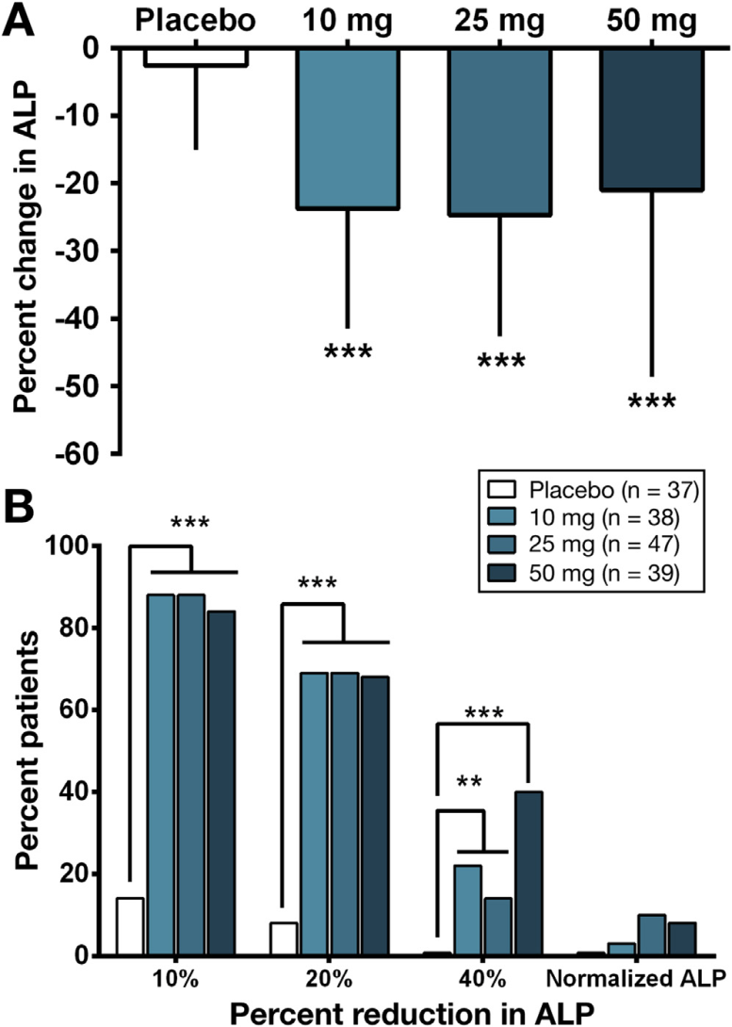
Graphic presentation

Slide 8
Conclusions
Daily dose of OCA ranging vom 10-50mg, significantly reduced levels of ALP, Gamma-GT, ALAT
The incidence of pruritus were lowest among patients who received 10mg/d OCA
In this study 10mg once daily dose of OCA was the most effective dose and has formed the basis for additional studies

Slide 9
Thank you for your attention!

