Slide 1
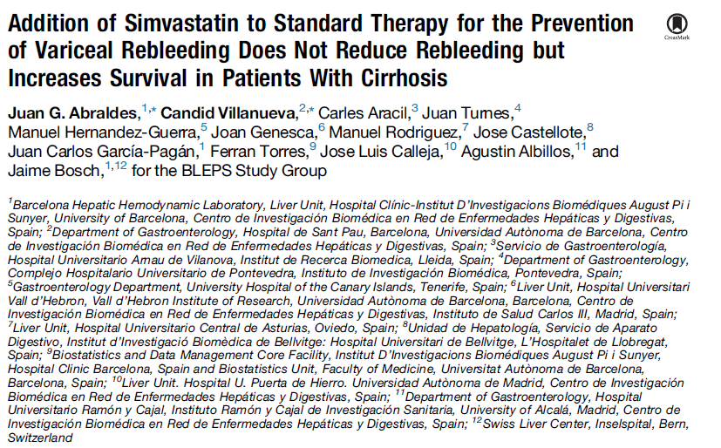
Journal Club 11.05.2016
Leona Isabella von Köckritz

Slide 2
BLEPS Study (Bleeding Prevention With Simvastatin) Methods
Study Design - multicenter, randomized (1:1), stratified by Child-Pugh class (A/B vs. C),
placebo-controlled, double-blind, 10/10-10/13 14 Spanish academic centers
Participants - patients with cirrhosis, who recovered from a variceal bleeding
Inclusion criteria | Exclusion criteria
Age between 18-80 years | Pregnancy or lactation
Liver cirrhosis | Multifocal HCC or a single nodule >5cm in diameter
Index variceal bleeding within the previous 5-10 days | Creatinine >2mg/dL
Plan to start standard treatment for the prevention of variceal rebleeding | Child Pugh score > 13 points
In woman: documented absence of pregnancy and commitment to use adequate contraception, if applicable | Contraindications for statins
 | HIV infection on protease inhibitors
 | Pretreatment with portosystemic shunt
 | Index bleeding due to gastric varices
 | Complete portal vein thrombosis or portal vein cavernomatosis
 | Previous treatment with the combination of endoscopic banding ligation and NSBB
 | Previous treatment with statins within 1 months of randomization

Slide 3
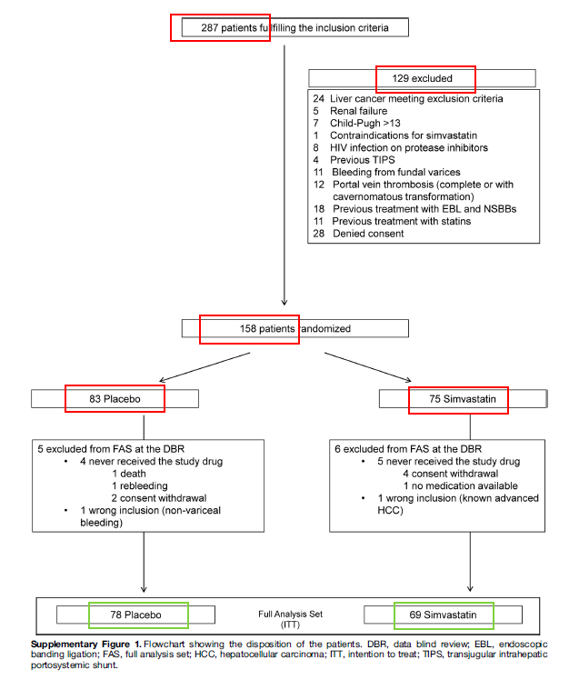
BLEPS Study (Bleeding Prevention With Simvastatin)

Slide 4
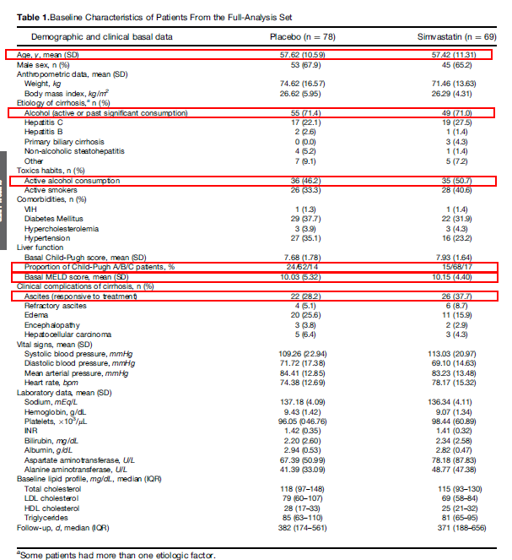
BLEPS Study (Bleeding Prevention With Simvastatin)

Slide 5
BLEPS Study (Bleeding Prevention With Simvastatin) Methods
Interventions – all patients started with endoscopic variceal ligation and NSBB
NSBB: initiated day 5/6 from admission, propanolol or nadolol up to maximum tolerated dose (Median 80mg)
Ligation: first to treat acute bleeding, repeated at 2- to 4 weeks intervals until variceal eradication (Median 3)
→ Between day 5 and 10: Randomization 1:1, stratified by Child-Pugh A/B vs. C
Simvastatin 40mg/d → Placebo

Slide 6
BLEPS Study (Bleeding Prevention With Simvastatin) Methods

Slide 7
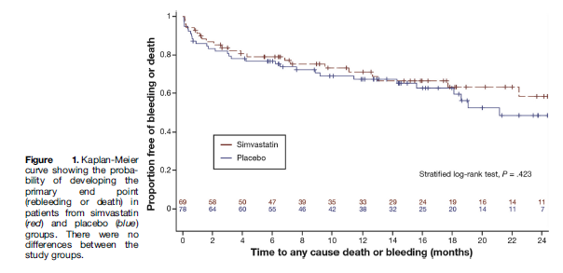
BLEPS Study (Bleeding Prevention With Simvastatin) Results
Primary Outcome –
Primary end-point (rebleeding or death):
Placebo: 30 of 78 (39%)
Simvastatin: 22 of 69 (32%)
Addition of Simvastatin to standard therapy was not statistically superior to
placebo in preventing rebleeding or death after a variceal bleeding epsisode

Slide 8
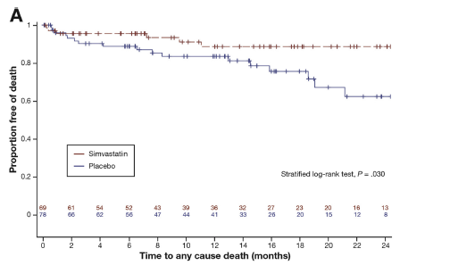
BLEPS Study (Bleeding Prevention With Simvastatin) Results
Key Secondary Outcomes –
Mortality
Placebo: 17 patients died (22%)
Simvastatin: 6 patients died (9%)
Treatment with Simvastatin associated with 61% reduction in the relative risk
of death as compared with placebo

Slide 9
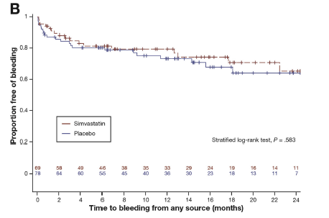
BLEPS Study (Bleeding Prevention With Simvastatin) Results
Key Secondary Outcomes –
Rebleeding
Placebo: 22 patients (28%)
Simvastatin: 17 patients (25%)
Rebleeding rate was not significantly decreased by addition of simvastatin

Slide 10
BLEPS Study (Bleeding Prevention With Simvastatin) Discussion
BLEPS showed:
Additional treatment with Simvastatin resulted in longer survival for patients with Child Pugh A or B cirrhosis than placebo administration, but failed to show superiority over placebo in decreasing the rate of rebleeding or other complications of cirrhosis
Limitations:
No generalization, because patients with advanced liver dysfunction (Child >13points) or with creatinine >2mg/dL and patients with complete portal vein
thrombosis were excluded
chance of type 1 error increased because survival was not primary end point
11 patients excluded from efficacy analysis→ study might have been
underpowered to assess study hypothesis
lack of data on the potential impact of alcohol abstinence on study outcomes

Slide 11
BLEPS Study (Bleeding Prevention With Simvastatin) Conclusion
→ Further validation for results of increased survival in new randomized controlled trials, because survival was not primary end-point
→ Additional: The incidence of rhabdomyolysis in patients receiving 40mg/d Simvastatin was higher than expected → close monitoring for muscle enzymes and further studies

