Slide 1
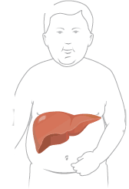
Simple Noninvasive Systems Predict long-term Outcome of Patients With NAFLD
Angulo P, Bugianesi E, Bjornsson ES, Charatcharoenwitthaya P, Mills PR, Barrera F, Haflidadottir S, Day CP, George J

Slide 2
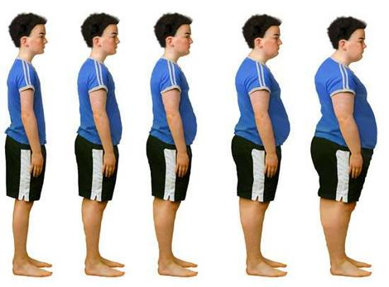
NAFLD
Prevalence 20-30% in Europe
2nd - 4th most common indication for transplantation in the US

Slide 3
Predictive value of scoring systems for NAFLD
→ <1% progression to cirrhosis → 7-11% progression to cirrhosis

Slide 4
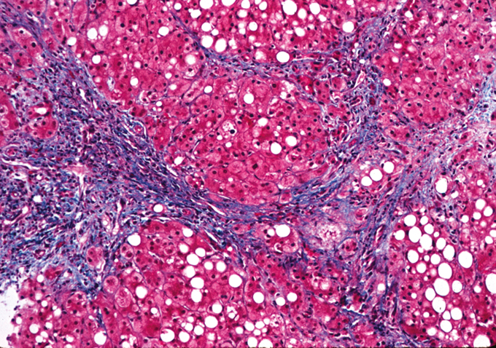
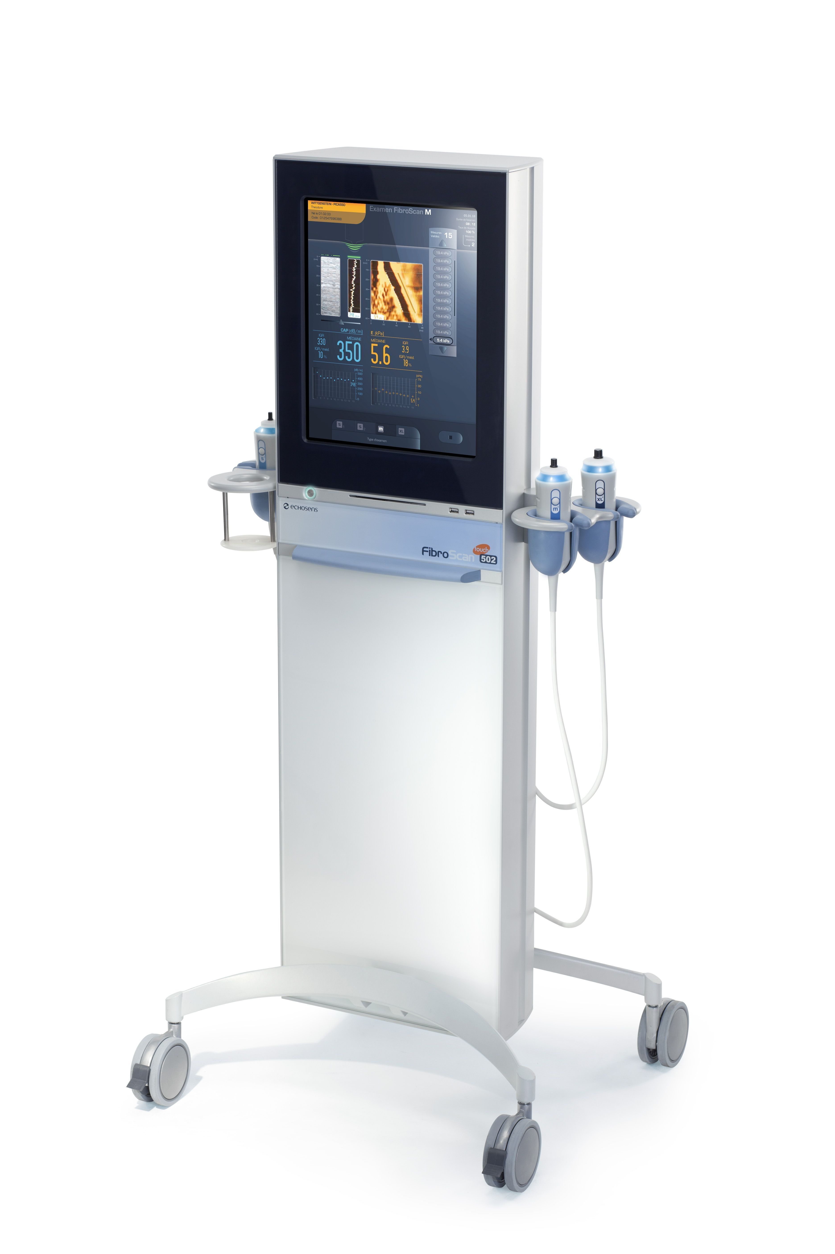
Scoring systems for fibrosis in NAFLD
NAFLD fibrosis score
APRI-Score
FIB-4 Score
BARD Score

Slide 5
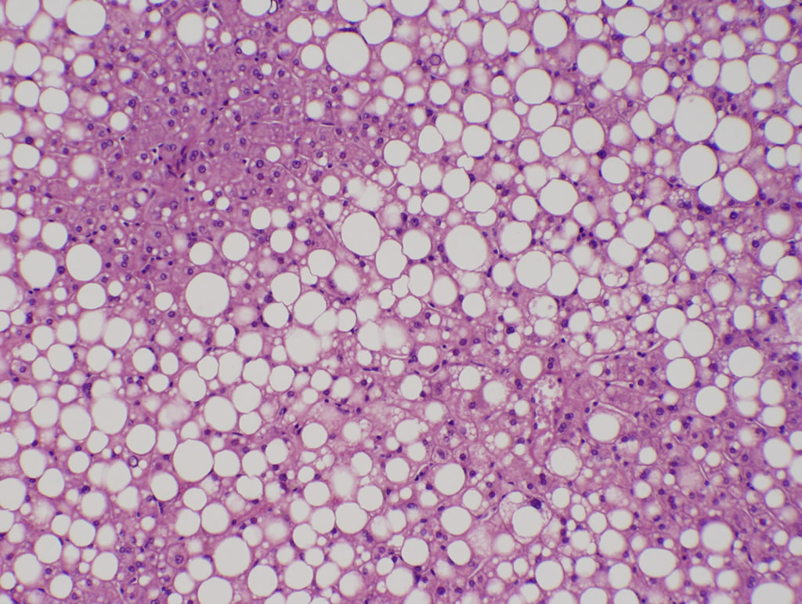
Study design
- Multicenter cohort study
- 320 patients
- NAFLD based on liver biopsy
- Follow up 2002-2011 (mean 104 months)

Slide 6
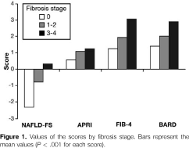
Correlation of scores with fibrosis

Slide 7
Outcome
Liver-related events
Death/
Tx

Slide 8
Assignment of patients to risk groups
Low intermediate high
→ According to pre-described cut-off values
NAFLD fibrosis score
age, BMI, diabetes, AST/ALT, platelets, albumin
APRI
AST, platelets
FIB-4
age, AST, ALT, platelets
BARD
BMI, AST/ALT, diabetes

Slide 9
Correlation outcome- risk groups
Low intermediate high
NAFLD fibrosis score
1,6% (2/125) 10,4% (12/115) 42% (29/69)
BARD-Score
1,7% (2/119) 19,3% (23/119) 25,4% (18/71)
APRI-Score
1,1% (1/90) 13% (21/162) 36,8% (21/57)
2,7% (3/111) 3,6% (4/112) 41,9% (36/86)
FIB-4 Score
Liver-related events

Slide 10
Correlation outcome- risk groups
Low intermediate high
NAFLD fibrosis score
4% (5/125) 16,7% (20/120) 21,3% (16/75)
BARD-Score
4,2% 16,9% 19,5%
APRI-Score
9,7% 10% 25%
FIB-4 Score
5,4% 12% 22,8%
Death/
Tx

Slide 11
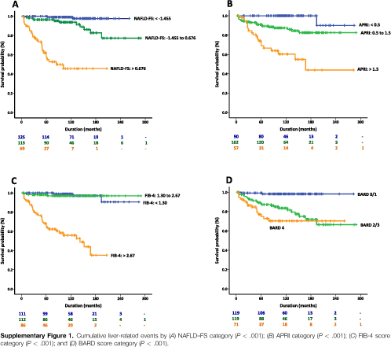
Cumulative probability Kaplan-Meier analysis

Slide 12
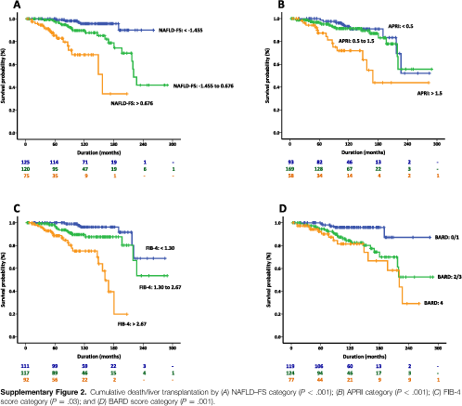
Cumulative probability Kaplan-Meier analysis

Slide 13
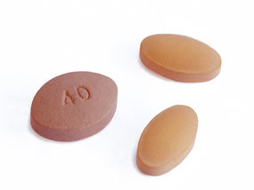
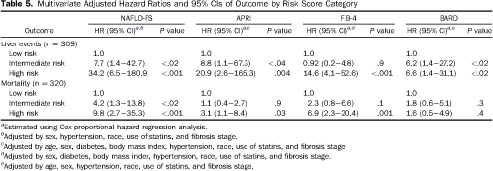
Adjusted Hazard Ratios Cox proportional harzard regression analysis
Adjustment by
sex, hypertension, race, statin use, fibrosis, (age, diabetes, BMI)

Slide 14
Adjusted Hazard Ratios
Low intermediate high
Risk for Liver- events
NAFLD FS
1
7,7
34,2
BARD
1
6,2
6,6
APRI
1
8,8
20,9
FIB-4
1
0,92
14,6
Risk for Death/
Tx
1
4,2
9,8
1 1,8
1,6
1 1,1
3,2
1 2,3
6,9
- Confidence intervals not shown

Slide 15
Study design evaluation
Large population
Long follow up
Diagnosis by biopsy
Adjustment of other risk factors
Selection bias
No standardized monitoring
No standardized treatment
Large CI
Likeliness of developping cirrhosis?

