Slide 1
Sarcopenia is an independent risk factor for non-alcoholic steatohepatitis and significant fibrosis (Journal of Hepatology, article in Press 2016)
Journal-Club 09.11.2016
Natalie Geider

Slide 2
Background
Objective
To explore whether sarcopenia is associated with the histological severity of non-alcoholic fatty liver disease (NAFLD), especially non-alcoholic steatohepatitis (NASH) and significant fibrosis in a prospective cohort study.
Previous studies suggested an association between sarcopenia and NAFLD.
None however used biopsies to define the NAFLD.
Notes:
They tried to make association between Sarcopenia and NASH/Fibrosis without biopsy
Liver biopsy remains necessary for diagnosis of Nash and fibrosis.

Slide 3
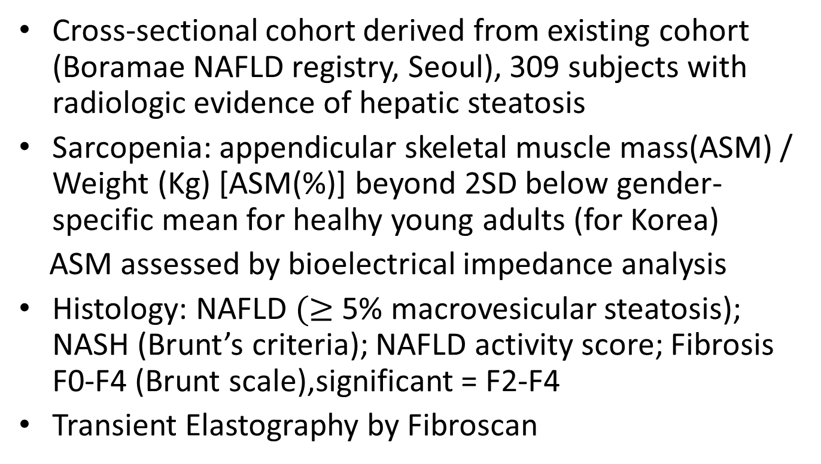
Patients and Methods
Cross-sectional cohort derived from existing cohort (Boramae NAFLD registry, Seoul), 309 subjects with radiologic evidence of hepatic steatosis
Sarcopenia: appendicular skeletal muscle mass(ASM) / Weight (Kg) [ASM(%)] beyond 2SD below gender-specific mean for healhy young adults (for Korea)
ASM assessed by bioelectrical impedance analysis
Histology: NAFLD $(≥$ 5% macrovesicular steatosis); NASH (Brunt’s criteria); NAFLD activity score; Fibrosis F0-F4 (Brunt scale),significant = F2-F4
Transient Elastography by Fibroscan
Notes:
Inclusion older than 18, bright echogenic liver, unexplained ALT elevation in the last 6 months
Exclusion Hep B-C, autoimmune, Drug induced liver injury, Wilsons/hemochromatis, malignancy
Brunt criteria (13) include the following parameters: Amount of fat: graded 1 to 3 according to the percentage of fatty droplets (1, 0%-33%; 2, 34-66%; 3, 67-100%). Fibrosis: graded 0 (absent) to 4 (1, perisinusoidal/pericellular fibrosis; 2, periportal fibrosis; 3, bridging fibrosis; 4, cirrhosis). Necroinflamation: graded 0 (absent) to 3 (1, occasional ballooned hepatocytes and no or very mild inflammation; 2, ballooning of hepatocytes and mild to moderate portal inflammation; 3, intra-acinar inflammation and portal inflammation).

Slide 4
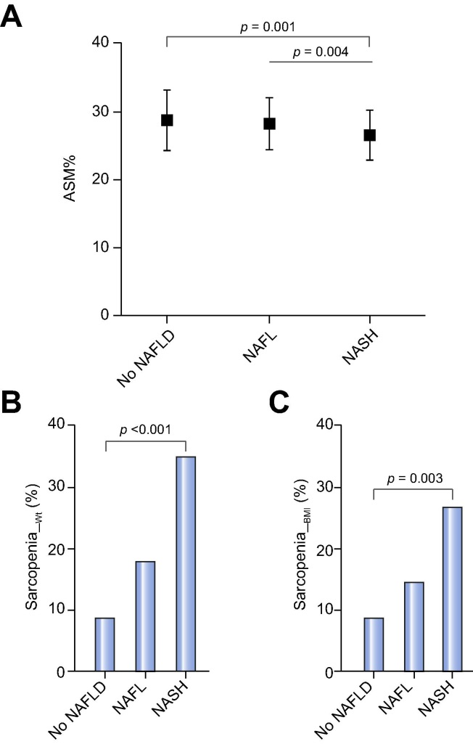
Results
309 subjects were histologically classified as: 69 no NAFLD, 117 NAFLD, 123 NASH
Subjects with NASH show significantly lower ASM% compared to those with no NAFLD or NAFL
Patients with sarcopenia were more metabolically unfavorable (BMI, Waist Cirucumf., ASAT, GGT, CRP and HOMA-IR)
Sarcopenic patients had more severe histological grades of steatosis and hepatocellular ballooning and a higher fibrosis stage on histology
ASM% was significantly inversely correlated with liver stiffness
Notes:
Multivariate model 1 was adjusted for age, gender, body mass index, smoking,
hypertension, and diabetes.
Multivariate model 2 was adjusted for the total cholesterol, triglyceride, HDLcholesterol
and ALT levels in addition to the factors included in model 1.
Multivariate model 3 was adjusted for hsCRP in addition to the factors included in
model 2.
Appendicular skeletal muscle mass relative to body weight (ASM%) and the prevalence of sarcopenia according to the histological classification of NAFLD. Mean ASM% significantly decreased as the histological severity of NAFLD increased (A). Subjects with NASH showed a significantly lower ASM% than subjects without NAFLD or with NAFL (p=0.001 and p=0.004, respectively from post hoc analysis for the ANOVA; p<0.001 from the ANOVA). The prevalence of sarcopenia, defined according to a cut-off value obtained from Korean population data (B; sarcopenia_Wt) or from multi-ethnic population data (C; sarcopenia_BMI), increased as the histological severity of NAFLD increased. The bars represent standard deviations. ASM%, appendicular skeletal muscle mass/body weight; NAFLD, non-alcoholic fatty liver disease; NAFL, non-alcoholic fatty liver; NASH, non-alcoholic steatohepatitis.

Slide 5
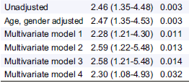
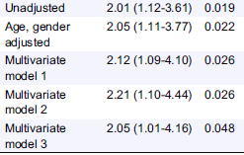
Results
Among pt with NAFLD : sarcopenia was associated with an increased risk of NASH and significant fibrosis (F2-F4)
After multivariate analysis, the association between sarcopenia NASH and Fibrosis is confirmed
Among NAFLD, OR for NASH
Among NAFLD, OR for sign. fibrosis
Notes:
Multivariate model 1 was adjusted for age, gender, body mass index, smoking,
hypertension, and diabetes.
Multivariate model 2 was adjusted for the total cholesterol, triglyceride, HDLcholesterol
and ALT levels in addition to the factors included in model 1.
Multivariate model 3 was adjusted for hsCRP in addition to the factors included in
model 2.
This association persisted after adjustment for age, gender, BMI, hypertension, diabetes, and smoking status (Model 1). The addition of the total cholesterol, triglyceride, HDL-cholesterol, and ALT levels did not significantly reduce the OR for this association. Because inflammation was closely associated with the sarcopenic index, a multivariate analysis adjusted for the hsCRP level showed that the significant association was slightly attenuated but remained.
Appendicular skeletal muscle mass relative to body weight (ASM%) and the prevalence of sarcopenia according to the histological classification of NAFLD. Mean ASM% significantly decreased as the histological severity of NAFLD increased (A). Subjects with NASH showed a significantly lower ASM% than subjects without NAFLD or with NAFL (p=0.001 and p=0.004, respectively from post hoc analysis for the ANOVA; p<0.001 from the ANOVA). The prevalence of sarcopenia, defined according to a cut-off value obtained from Korean population data (B; sarcopenia_Wt) or from multi-ethnic population data (C; sarcopenia_BMI), increased as the histological severity of NAFLD increased. The bars represent standard deviations. ASM%, appendicular skeletal muscle mass/body weight; NAFLD, non-alcoholic fatty liver disease; NAFL, non-alcoholic fatty liver; NASH, non-alcoholic steatohepatitis.

Slide 6
Discussion
Superior to previous studies because of liver biopsy
The importance of visceral obesity has been implicated in the pathogenesis of NAFLD and NASH.
Other mechanism beyond visceral obesity might account for advanced liver damage.
Notes:
1. Skeletal muscle mass was associated with not only the histological grades of steatosis and hepatocellular ballooning but also the stage of
fibrosis. Non invasif markers = risk of misclassification of NASH/fibrosis.

Slide 7
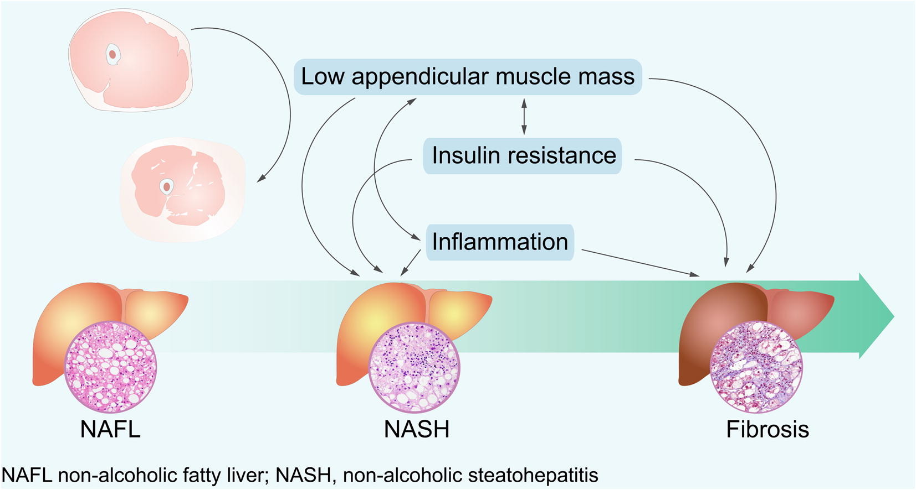
Journal of Hepatology DOI: (10.1016/j.jhep.2016.08.019) )
1. Lim et al. Sarcopenic obesity: prevalence and association with metabolic syndrome in the Korean Longitudinal Study on Health and Aging (KLoSHA). Diabetes Care 2010;33:1652–1654.
2. Lee et al. Appendicular skeletal muscle mass and insulin resistance in an elderly korean population: the korean social life, health and aging project-health examination cohort. Diabetes Metab J 2015;39:37–45.
3. Skov-Jensen . Contraction-mediated glucose uptake is increased in men with impaired glucose tolerance. Appl Physiol Nutr Metab 2007;32:115–124.
Notes:
Because the skeletal muscle is the primary tissue responsible for insulin mediated
glucose disposal [9–11] low skeletal muscle mass
reduces insulin-mediated glucose disposal, independent of obesity,
and might explain the association between NAFLD and insulin
resistance, which cannot be explained by fat mass. confirmed by
epidemiological [9,10] and experimental [11] studies
Inflammation not strongly significant associated with NASH/Fibrosis

Slide 8
Conclusion
Patients with sarcopenia exhibited approximately twofold increased odds of suffering from NASH or significant fibrosis.
In particular sarcopenia was a risk factor of biopsy proven NASH and significant fibrosis, independent of obesity and insulin-resistance.
Notes:
The main limitation of this study is that the results regarding the causality of the observed relationships should be interpreted with caution due to the cross-sectional nature of the study design. Second, we estimated the skeletal muscle mass using BIA. Imaging using CT, magnetic resonance imaging and dual energy X-ray absorptiometry (DXA) have been used for in vivo measurements of the skeletal muscle mass in humans. Although BIA has been reported to provide an accurate estimate of DXA derived ASM in a population with various clinical disorders [24,57], there might be a difference between fat-free mass measured by BIA and muscle mass according to the body water content [58]. Furthermore, BIA cannot provide information on muscle quality. Third, HOMA-IR was used to determine insulin resistance in the current study. Although HOMA-IR is an indirect measure of insulin resistance, this index has been validated using the hyperinsulinemic-euglycemic clamp technique [59,60] and is thus currently used in various epidemiologic studies. Finally, because this study included only subjects of East Asian ethnicity, the conclusions might not be generalizable to other ethnic populations.

Slide 9
Conclusion-clinical impact
Aging population = more sarcopenia = more risks for Insulin-resistance
Resistance training is effective in reducing steatosis, independant of weight reduction in NAFLD patients

Slide 10
References
Sarcopenia is an independent risk factor for non-alcoholic steatohepatitis and significant fibrosis Koo, Bo Kyung et al. Journal of Hepatology , article in press

Slide 11
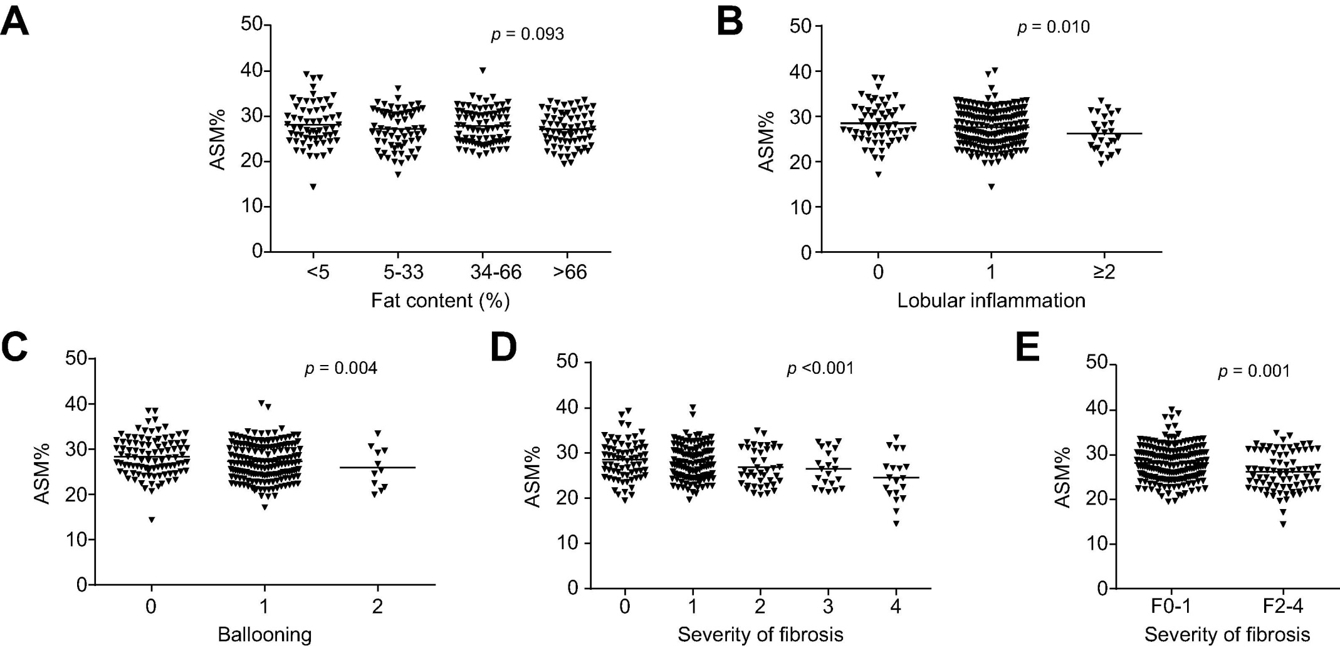
Appendix 1
Notes:
Appendicular skeletal muscle mass relative to body weight (ASM%) according to histological grade (A, B, and C) and fibrosis stage (D and F). Bars represent mean values of ASM% for each histological category. ASM%, appendicular skeletal muscle mass/body weight.

