Slide 1
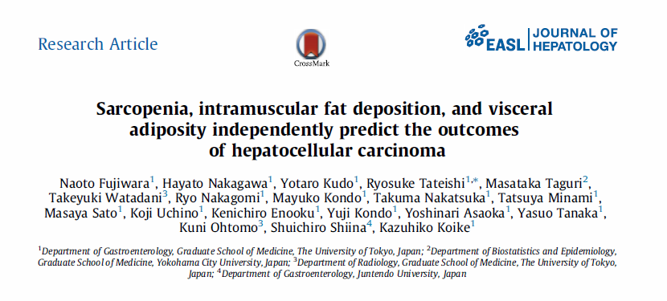
Journal Club 10.10.2017
Leona von Köckritz

Slide 2
Methods
Patients: retrospective analysis of 1257 patients diagnosed with HCC from 01/2004-12/2009, at the Department of Gastroenterology, University of Tokyo hospital (single center)
Inclusion: see above
Exclusion: poorly controlled ascites
Clinical and anthropometric variables: age; gender; BMI (<20 underweight, 20.0-24.9 normal, ≥25 obese), hepatitis infection state (HBV; HCV;HBV+HBV; none); daily alcohol consumption; smoking status; diabetes; chronic kidney disease; cardiovasc. or cerebrovasc. Disease, lung disease; Child Pugh class; ASAT; total Bili; Alb; platelet count; treatment methods for patientes with HCC in BCLC 0 or A; history of previous HCC treatment; AFP (<100 vs. ≥ 100ng/ml)

Slide 3
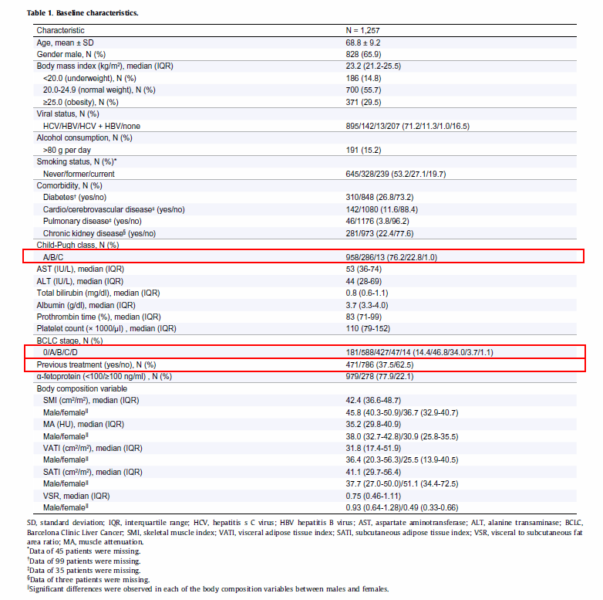

Slide 4
Methods
CT analyses of body composition variables:
CT scans (1 months before or soon after first admission) at L3
using Slice-o-Matic software to determine:
Skeletal muscle index (SMI) (Mm. psoas, erector spinae, quadratus lumborum, transversus abdominis, external and internal obliques, rectus abdominis) (HU: -29 to 150)
Visceral adipose tissue index (VATI) (HU: -150 to -50)
Subcutaneous adipose tissue index (SATI) (HU: -190 to -30)
Visceral to subcutaneous adipose tissue area ratio (VSR)
Muscle attenuation (HU: -29 to 29)
Statistical analyses / End-points
Survival time: interval between first admission for HCC and death or December 31, 2012
Liver related death/ all cause death

Slide 5
Results

Slide 6
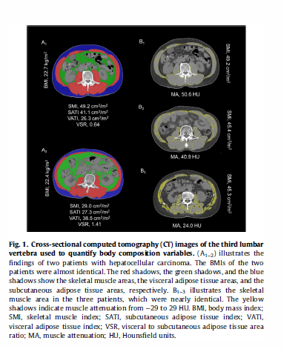

Slide 7
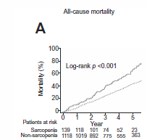
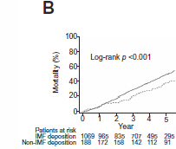
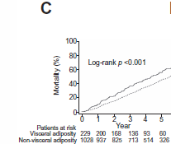
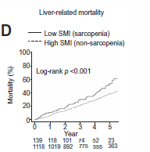
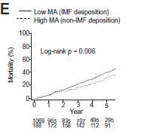
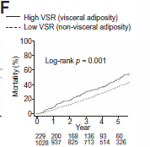

Results

Slide 8
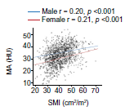
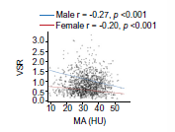
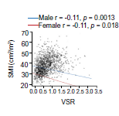
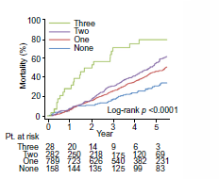
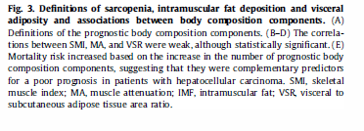
Results

Slide 9
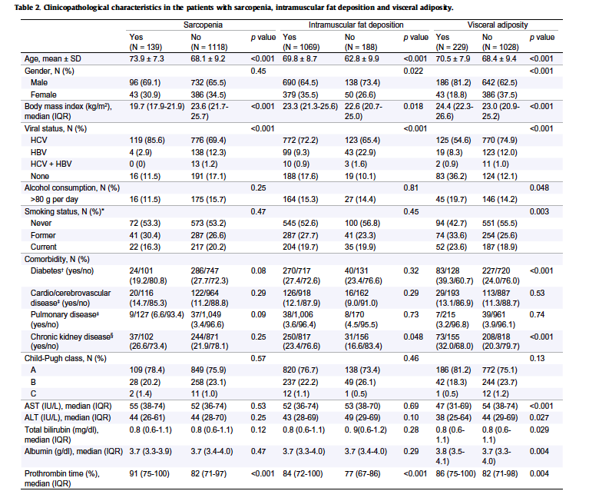
Results

Slide 10
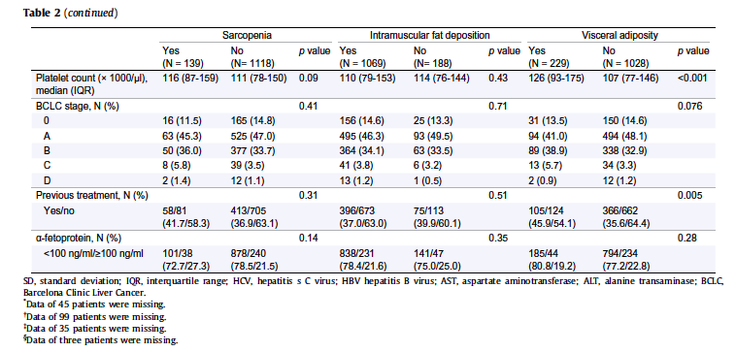
Results

Slide 11
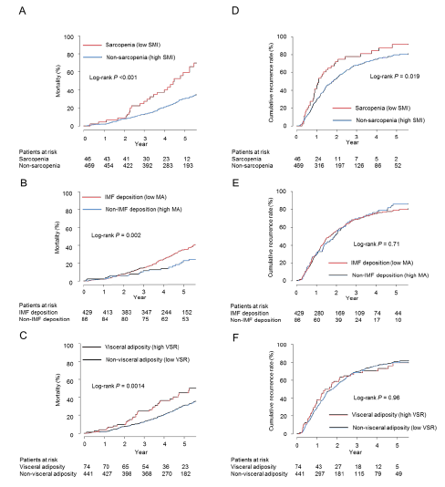
Results
Supplementary Figure 5. Impacts on body composition on cumulative mortality (A-C) and recurrence rate (D-F) in naïve patients with BCLC 0/A hepatocellular carcinoma who were treated with percutaneous radiofrequency ablation therapy

Slide 12
Results

Slide 13
Results

Slide 14
Discussion & Conclusion
Quantity (low SMI, Sarcopenia) and quality (low MA, Intramuscular fat deposition) of muscle and distribution of adipose tissue rahter than absolute value (high VSR, not BMI, VATI, SATI)
Sarcopenia, IMF deposition and visceral adiposity are associated with a poor prognosis (rather than BMI), independently of liver function reserve and cancer stage
in underweight or obese patients the proportion of patients with two or three poor prognostic body composition components are significantly higher

Slide 15
Discussion & Conclusion
Strength: large sample size
Limitations: underlying disease in >83 % viral infection, no correlation with treatment options except RFA, only one measurement at first diagnosis
→ Further studies investigating causalities and interventios with nutrional support, excercise therapy and the use of drugs to optimize the body composition and improve the survival of HCC patients are needed

Slide 16
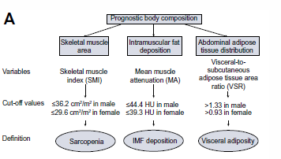

Methods

