Slide 1
Journal club Hepatology 30.07.2020
“Safety and feasibility of transjugular intrahepatic portosystemic shunt in elderly patients with liver cirrhosis and refractory ascites”
Stockhoff et al. Publishes 06/2020 in Plos one
Luisa Mathieu-Levin

Slide 2
Background I
Challenging management of liver cirrhosis with refractory ascites, specially at higher age
Mortality can reach up to 50% in one year
Only curative treatment option is transplantation. Not always realistically available
TIPS is an established (non curative) treatment option
What is TIPS: artificial channel within the liver that establishes communication between the inflow portal vein and the outflow hepatic vein.
Endovascular procedure, insertion via jugular vein. First successful TIPS 1988.

Slide 3
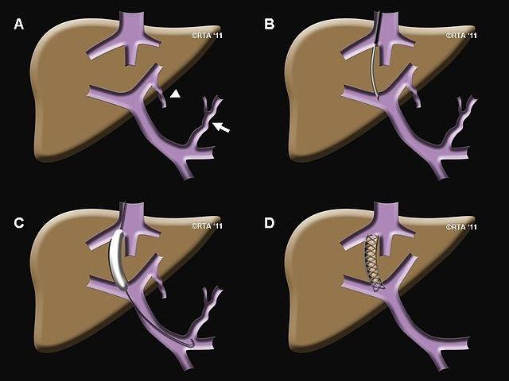
Steps in a TIPS procedure:
initial situation with portal hypertension
B) a needle has been introduced (via the jugular vein) and is passing from the hepatic vein into the portal vein
C) the tract is dilated with a balloon
D) after placement of a stent, portal pressure is normalized
Goal of TIPS: reduce immediately the portal hypertension and the complications from portal hypertension.
R. Torrance Andrews, 2011

Slide 4
Background II
Indications for TIPS:
Refractory ascites, variceal bleeding (2nd prevention/2nd line for acute bleeding), portal vein thrombosis , Budd-Chiari , (hepatic-veno-occlusive disease, hepatic hydrothorax, portal hypertensive gastropathy, hepatopulmonary syndrome, HRS)
Absolute Contraindications:
Severe congestive heart failure, tricuspid regurgitation, severe pulmonary hypertension, sepsis, multiple hepatic cysts, unrelieved biliary obstruction
Relative CI:
HE, significant PVT, > INR 5, Tc < 20, moderate pulmonary hypertension, HCC, obstruction of all hepatic veins
Possible periinterventional complications:
Operative mortality <1%, Acute bleeding and direct liver injury (rare), transient HE, hepatic ischemia (acute liver failure secondary to hepatic ischemia), acute kidney failure, heart failure, Infection (Endotipsitis), Closure (Clotting)

Slide 5
Background III
Risks of TIPS long term:
hepatic encephalopathy, aggravation of hyperdynamic circulatory state (up to short term cardiac failure)
Careful selection of patients is crucial
EASL Guidelines: Age is not mentioned as a parameter. In many centers, higher age is considered a contraindication, specially because of increased risk of hepatic encephalopathy in patients of higher age. Not in Bern.
Only few safety and feasibility data for elderly patients. In most studies either older patients were excluded / small retrospective studies with controversial outcome / no paracentesis control group.
To sum up:
The management of patients with liver cirrhosis and refractory ascites is challenging, particularly at higher age. TIPS is an established treatment for refractory ascites, but safety data in elderly patients are rare.

Slide 6
Question and aim of the study
Evaluate safety and feasibility of TIPS in elderly patients with cirrhosis and refractory ascites.
Studydesign and methods
Single centre Study at Hannover Medical School in Germany
Retrospective Analysis 2012-2018
Comparison between groups :
Young vs older TIPS patients
Older TIPS patients vs older paracentesis patients
non-randomized

Slide 7
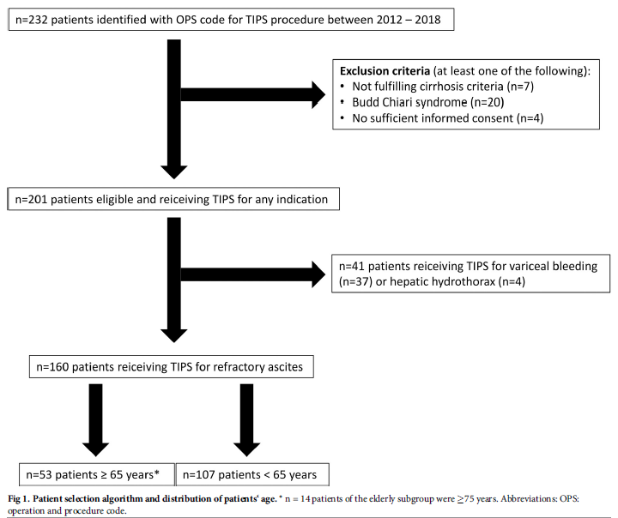
> 2.2 million patients with German operation and procedure code for TIPS surgical procedure.
TIPS Group
Inclusion criteria: TIPS at Hannover Medical school 2012-2018, liver cirrhosis and refractory ascites

Slide 8
Paracentesis group:
Hannover Ascites cohort (> 600 patients with decompensated liver cirrhosis and ascites)
Inclusion criteria: >= 65 years old, refractory ascites
Exclusion: TIPS contraindications like pulmonary hypertension, Hepatic encephalopathy (>= 2/chronic) , HCC, cardiac failure and also acute clinical deterioration, Budd Chiari, ongoing infection
Goal: minimize bias between the two groups
n=85

Slide 9
Primary endpoints: mortality/surival 28 days, 90 days and 1 year after TIPS insertion
Secondary endpoints:
periinterventional complications (Infections, HE, AKI , ACLF,) duration of hospital stay
ascites control, changes of creatinine levels after TIPS insertion
Adjustment for degree of portal hypertension (PSG), severity of liver disease (MELD), sex, etiology of cirrhosis
1:1 Propensity score matching between elderly TIPS patients and elderly paracentesis patients (Matching covariates: MELD, sex, age, bilirubin, Tc, Sodium)
Drop outs: liver transplantation, end of follow up
Baseline time of tips insertion or time of first paracentesis

Slide 10
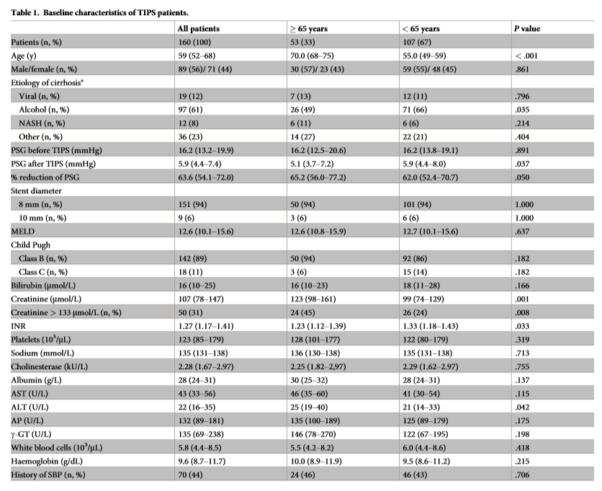
Baseline characteristics of TIPS patients
61% alcohol related liver cirrhosis. In the younger patients the amount of alcohol-related liver disease was higher (p= 0.035)
Median MELD of 12.6. MELD, Bili and Tc about the same between younger and elderly. Elderly higher creatinine levels, lower INR at baseline
No difference in CHILD between age groups
Hemodynamic success ( finals PSG <= 12 mmHg) achieved in 99.4%. Median preinterventional PSG 16.2mmHg. Median postinterventional PSG 5.9 mmHg
Final PSG significantly lower in patients >= 65 y (p=0.037)

Slide 11
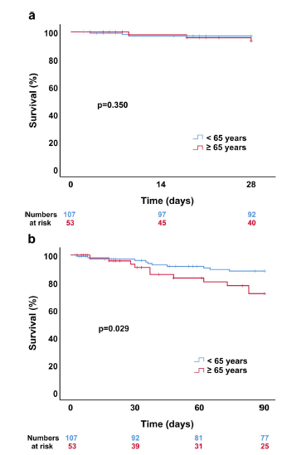
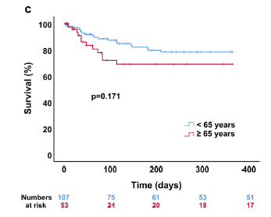
Primary endpoints: mortality 28 days, 90 days and 1 year after TIPS insertion.
Mortality after 28d of TIPS placement was similar between < 65 and >= 65 y (p= 0.35)
In contrast, survival of younger patients was significantly higher at 90d (p= 0.029)
the 1 year survival was again very similar
no difference between medium old 65-74 and very old > 75

Slide 12
Overall 19% died in 1 year (18% < 65y, 23% >= 65y)
Proportion of death related to impaired liver function higher in younger cohort (Supplements; liver, cardiac, infection, other/unknown)
Adjustments (Table 3b)
Age > = 65 y remained a predictor for 90d mortality. Age >= 65 y not a predictor for 28d or 1 year mortality.
MELD score associated with survival at all three times (p= 0.001)
Sex, degree of portal hypertension and cirrhosis etiology insignificant predictors
Other article: „ Is 70 the new 50? Complication and outcomes of transjugular intrahepatic portosystemic shunt in older versus younger patients“ (Bisht et al. 2020) -> Age does not matter (All TIPS indications, complication rather than survival)

Slide 13
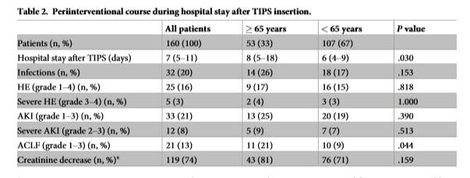
Results: secondary endpoints
In older patients hospital stay was significantly longer (8 vs 6 days, p=0.03).
Elderly patients has significantly more ACLF episodes 21% vs 9% (p= 0.044).
No difference for HE, AKI or Infection
Sufficient ascites control after 2 to 6 month after TIPS insertion was achieved in 68%. Ascites persisted in a significantly higher proportion of younger patients (37% vs 12% in elderly, p= 0.048)

Slide 14
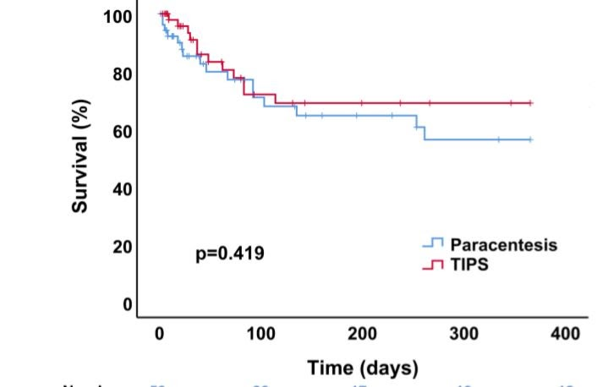
Comparison TIPS vs paracentesis
53 matched pairs (all >= 65 y)
no large imbalances between groups, no significant differences in the covariates (e.g. similar MELD Score)
No significant difference in 28 d mortality (p= 0.196), 90d mortality (p=0.808) or 1 year survival (p=0.419 ) between elderly TIPS and matched paracentesis group.

Slide 15
Main results
Periinterventional course in those >= 65 years appears to be slightly more complicated than in < 65 years as reflected by a significant longer hospital stay ( p=0.03) and more ACLF -episodes (21% vs. 9%; p= 0.44).
28-day mortality was similar between both groups (p= 0.350), whereas survival of the younger patients was significantly higher at 90 days (p= 0.029).
In the multivariate analysis age >= 65 years remained an independent predictor for 90-days mortality (p= 0.028), while it was not a associated with 28-day mortality and 1-year survival.
After matching for potential confounders 1-year survival was similar in elderly patients if treated with TIPS or paracentesis ( p= 0.419)

Slide 16
Limitations
Retrospective, non randomized
inherent selection bias regarding TIPS vs Paracentesis allocation
small sample size
single institution
Dysfunction of TIPS for survival?
Nutritional status of patients?

Slide 17
Conclusions
TIPS placement in elderly patients with refractory ascites appears to be slightly more complicated compared to younger individuals, but overall feasible and at least not inferior to paracentesis.

