Slide 1
New Diagnostic Criteria and Management of Acute Kidney Injury
Florence Wong, Paolo Angeli
Journal of Hepatology 2016

Slide 2
New Diagnostic Criteria and Management of Acute Kidney Injury
Renal dysfunction in cirrhosis: 50% increase in serum creatinine (SCr) with a final SCr > 1.5mg/dL (133μmol/L)
Smaller rises in SCr have a negative prognostic impact in decompensated cirrhosis (infection)
SCr in patients with cirrhosis is not completely reliable
International Club of Ascites adapted the term acute kidney injury (AKI) to represent renal dysfunction in cirrhosis
Arroyo V. Hepatology 1996
Salerno F. Gut 2007
Wong F. Gastroenterology 2013
Angeli P. Gut 2015
Notes:
Decreased creatinine production, interference of high bilirubin levels, muscle depletion, increased tubular excretion
KDIGO (kidney disease improving global outcome)

Slide 3
New Diagnostic Criteria and Management of Acute Kidney Injury
AKI
Change in SCr of 0.3mg/dL (26.5μmol/L) in 48 hour
or
50% increase in SCr from baseline* (occurred in 7 days)
Stage 1: SCr ≥26.5μmol/L in 48h or ≥1.5-2-fold from baseline*
Stage 2: ≥ 2.1-3-fold from baseline*
Stage 3: ≥3.1-fold from baseline* or SCr ≥ 353.6 μmol/L with acute increase ≥26.5μmol/L or Initiation of RRT
*Baseline SCr : SCr assessed within the previous 3 months (or on admission)
No threshold of SCr for the diagnosis of AKI
Angeli P. Gut 2015

Slide 4
New Diagnostic Criteria and Management of Acute Kidney Injury
Hepatorenal syndrome
Type 1 hepatorenal syndrome (HRS-1): prototype of acute renal dysfunction in cirrhosis
Criteria
Cirrhosis and ascites
≥ stage 2 AKI
No improvement of sCr after ≥ 48h of diuretic withdrawal and volume expansion with albumin
Absence of hypovolemic shock or infection that require vasoactive drugs to support blood pressure
Proteinuria < 500 mg/day and hematuria < 50 RBC/high power field
Re-named: AKI-HRS
Angeli P. Gut 2015

Slide 5
AKI
Change in SCr of 26.5μmol/L in 48 hour
or
50% increase in SCr from baseline (in 7 days)
*
Volume depletion
Infections
Nephrotoxic drugs
NSBB?
Stage 1
≥26.5μmol/L in 48h
or
≥1.5-2-fold from baseline
Stage 2
≥ 2.1-3-fold from baseline
Stage 3
≥3.1-fold from baseline or
SCr ≥ 353.6 μmol/L with increase ≥26.5μmol/L or
Initiation of RRT
Progression
Remove and treat precipitating factors *
Progression
Remove and treat precipitating factors
(if not done already)
Volume expansion with albumin
(1gm/kg, max 100gm/day)
AKI
regression
Stable
Close monitoring
Further therapy at physician discretion
Response?
No or Progression
Yes
AKI-HRS criteria?
No
Treat according to etiology
Yes
Vasoconstrictors & albumin

Slide 6
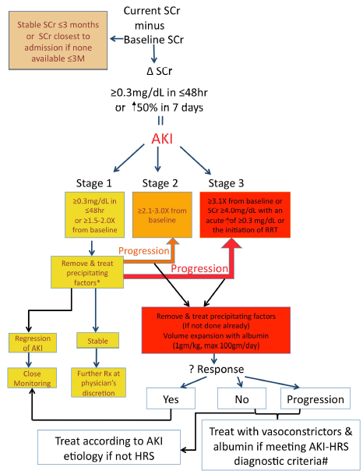

Slide 7
Royal Free Hospital (RFH) cirrhosis Glomerular Filtration Rate (GFR) equation
Development and validation of a mathematical equation to estimate GFR in cirrhosis : the RFH cirrhosis GFR
Kalafeteli M. Hepatology 2016
MDRD and CKD-EPI overestimate kidney function in cirrhosis
RFH Cirrhosis GF was developed and validated
Performance of this equation should be validated in other populations
The incorporation of this cirrhosis-specific GFR equation instead of creatinine in prognostic scores (i.e. MELD) may increase their overall performance
GFR:
Variables:
- Creatinine
- Urea
- INR
- Age
- Sodium
- Gender
- Ascites
Notes:
Decreased creatinine production, interference of high bilirubin levels, muscle depletion, increased tubular excretion

