Slide 1
A Protein-Truncating HSD17B13 Variant and Protection from Chronic Liver Disease
The New England Journal of Medicine (378;12) March 22, 2018

Slide 2
Background
Chronic liver disease and cirrhosis are leading causes of illness and death (1.5% of total death in the US)
prevalence of nonalcoholic fatty liver disease is between 19% and 46%2-4 and is rising over time in conjunction with increasing rates of obesity, its primary risk factor.
Genom sequence variations associated with an increased risk of chronic liver disease have been identified (PNPLA3, TM6SF2)

Slide 3
Background
Elucidation of the genetic factors underlying chronic liver disease may reveal new therapeutic targets.

Slide 4
Aim
To identify genetic variants associated with serum levels of alanine aminotransferase (ALT) and aspartate aminotransferase (AST)

Slide 5
Method
Study Design
Multi cohort study:
DiscovEHR study populations
GHS bariatric-surgery cohort
Dallas Heart Study (DHS) Penn Medicine BioBank
evaluated data from a total of 37.173 patient

Slide 6
Method
exome sequencing to identify variants associated with serum levels of (ALT) and (AST) as markers of hepatocyte injury
evaluated the associations between implicated genetic variants and chronic liver disease and the histopathological severity of liver disease

Slide 7
Results
A total of 35 variants in 19 genes were found to be associated with ALT or AST levels

Slide 8
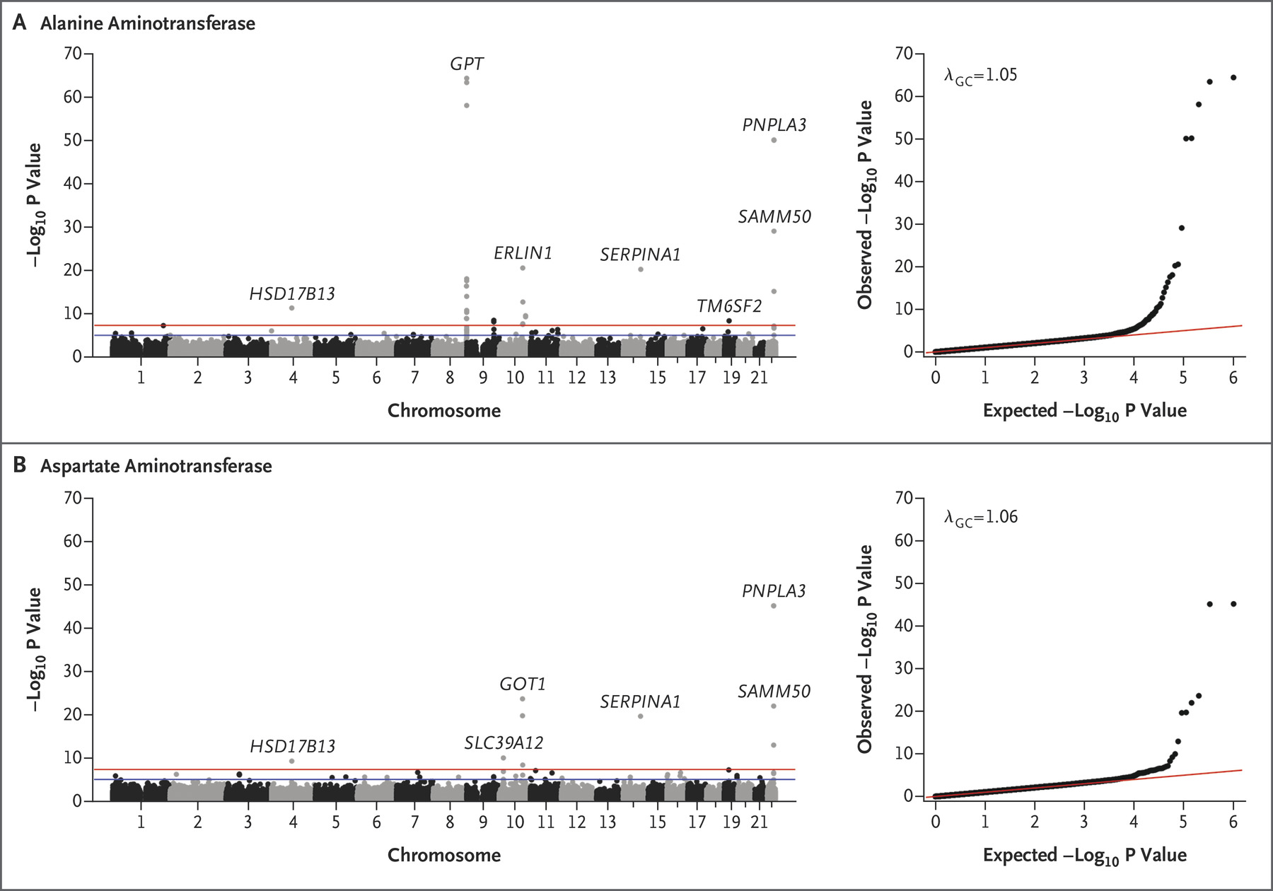
Results

Slide 9
Results
A splice variant (rs72613567:TA) in HSD17B13, encoding the hepatic lipid droplet protein hydroxysteroid 17-beta dehydrogenase 13, was found to be associated with reduced levels of ALT and AST
Notes:
hydroxysteroid 17-beta dehydrogenase 13: catalyzing enzyme in steroid metabolism and fatty acids

Slide 10
Results
HSD17B13 has enzymatic activity against several bioactive lipid species (e.g., leukotriene B) that have been implicated in lipid-mediated inflammation.
HSD17B13 is expressed primarily in the liver, where it localizes to lipid droplets

Slide 11
Results
HepG2 cells stably overexpressing HSD17B13
Notes:
A shows the expression of HSD17B13 transcripts A and D
Panel B shows the results of Western blot analysis
C shows levels of HSD17B13 isoform A (isoA) and isoform D (IsoD) protein in human liver samples
D: HepG2 cells stably overexpressing HSD17B13
transcripts A or D were labeled with boron-dipyrromethene (BODIPY

Slide 12
Results
The HSD17B13 rs72613567:TA allele was not associated with simple steatosis but was associated with a reduced risk of nonalcoholic steatohepatitis (NASH) and fibrosis
that suggest that this variant allele protects against PROGRESSION to more clinically advanced stages of chronic liver disease

Slide 13
Results

Slide 14
Results
associated with a reduced risk of
alcoholic liver disease (42% -53%)
nonalcoholic liver disease (17% -30%)
alcoholic cirrhosis (42% -73%)
nonalcoholic cirrhosis (26% -49%)

Slide 15
Results

Slide 16
Results
HSD17B13 rs72613567:TA allele also mitigated the risk of liver injury in persons who were genetically predisposed to steatotic liver disease by the PNPLA3 p.I148M variant
associated with reduced PNPLA3 mRNA expression

Slide 17
Results

Slide 18
Discussion

