Slide 1
L-Ornithine L-Aspartate in Bouts of Overt Hepatic Encephalopathy
Sandeep Singh Sidhu, Barjesh Chander Sharma, Omesh Goyal, Harsh Kishore, and Navpreet Kaur
HEPATOLOGY, VOL. 67, NO. 2, 2018

Slide 2
Hepatic encephalopathy (HE)
Definition: HE is a brain dysfunction caused by hepatic insufficiency and/or portosystemic shunting.
Symptoms: wide range of neurological or psychiatric abnormalities (ranging from subclinical alterations to coma)
Clinical landmark in cirrhotic patients that marks the decompensated stage of the disease (like ascites, or variceal bleeding)
High recurrence rate after first bout of HE
High mortality due to severe overt HE

Slide 3
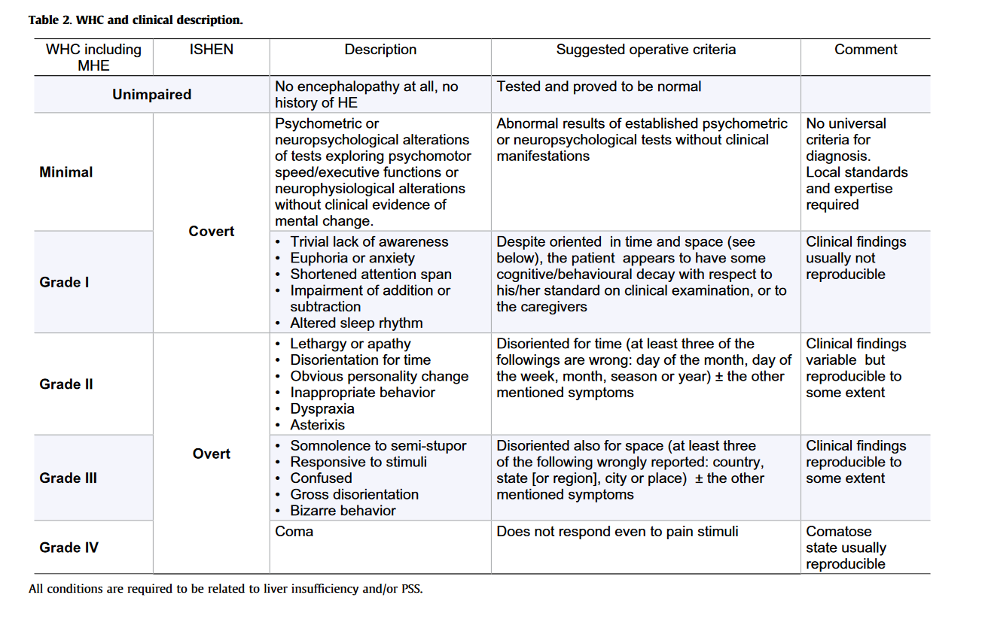

Slide 4
Pathophysiology
Main neurotoxine: ammonia
Colonic urease bacteria and small intestine brush border mucosal enzymes convert intaken proteins into ammonia (enters the liver via portal venous system)
deficient detoxification of ammonia in cirrhotic patients (mechanisms: urea cycle in periportal hepatocytes and/or synthesis of glutamin from glutamate in perivenous hepatocytes)
ammonia enters directly (or via PSS) into the systemic circulation
ammonia crosses the blood-brain barrier and enters astrocytes
→ Release of ROS / RNS, accumulation of glutamine
→ leads to swelling / edema in astrocytes
→ disturbance in neurone transmission
Possible inflammatory component: gut microbiota induce activation of hepatic Kupffer cells and hepatic macrophages (profinflammatory response: production of interleukins and TNF-α)

Slide 5
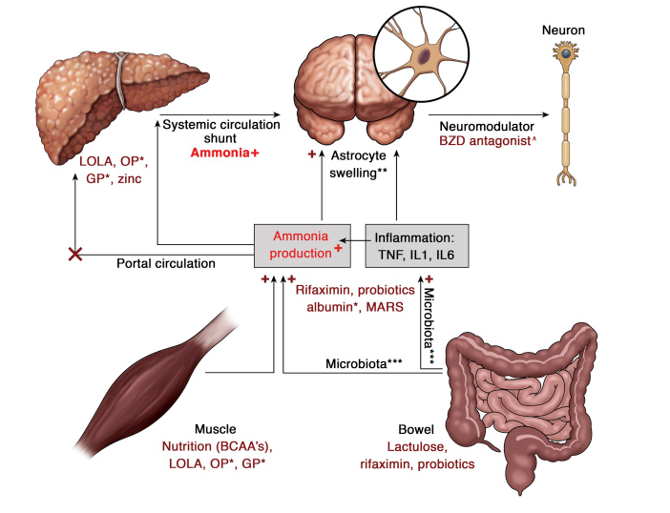

Slide 6
HE treatment
Nonabsorbable disaccharides (i.e. lactulose)
→ metabolized by colonic bacteria to acetic and lactic acids (lowering pH)
→ impaired survival of colonic urease bacteria
→ facilitated conversion from NH3 to NH4+
Nonabsorbable antibiotics (rifaximin)
→ targeting colonic microbiota
Intravenous L-ornithin L-aspartat (LOLA)
→ enhancing the metabolism of ammonia to glutamine.
Oral or intravenous branched-chain amino acids
→ altered ratio of aromatic amino acids to branched-chain amino acids

Slide 7
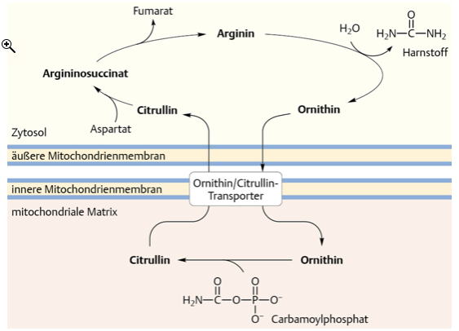

Slide 8
Aim of the study
Evaluation of the efficacy of intravenous LOLA (as an additional treatment to the standard of care treatment) in the reversal of overt HE in patients with cirrhosis referring to:
→ resolution of HE or decrease in HE grade
→ time taken for recovery of HE
→ decrease in venous ammonia
→ duration of hospitalisation
→ alteration in proinflammatory response (interleukin- and TNF-α-levels)

Slide 9
Patients
Study type: Prospective, double-blind, randomized, controlled trial
Enrollment of patients from 12/2013 to 11/2016 in two tertiary care centers in India (in Ludhiana and New Delhi)
Inclusion criteria: patients with cirrhosis aged 18-75 years with bouts of OHE grade 2-4, with or without precipitating factors
Exclusion criteria: terminally ill patients, advanced cardiac or pulmonary disease, presence of underlying chronic renal failure, neurodegenerative disease (incl. head injury and drug intoxication), psychiatric illness, use of sedatives or antidepressants, pregnancy, HCC, acute-on-chronic liver failure
Screening of 370 patients, after exclusion 193 patients (52,16%)

Slide 10
Study intervention
Randomisation into two groups to receive either i.v.-LOLA or placebo for 5 days
→30g LOLA i.v. over 24 h (in 60ml clear solution and 440ml dextrose 5%)
→placebo (60ml of sterile water in 440ml dextrose 5%)
Standard of care treatment
exclusion of other causes for altered mental state (i.e. head injury, drugs)
identification and treatment of precipitating causes (i.e. sepsis, GI bleeding, constipation, hypokaliaemia, hyponatraemia, metabolic alkalosis, diuretics, dehydration)
administration of lactulose syrup orally or lactulose retention enemas
no other ammonia lowering agents (rifaximin or probiotics)
prophylactic parenteral antibiotic treatment after cultures

Slide 11
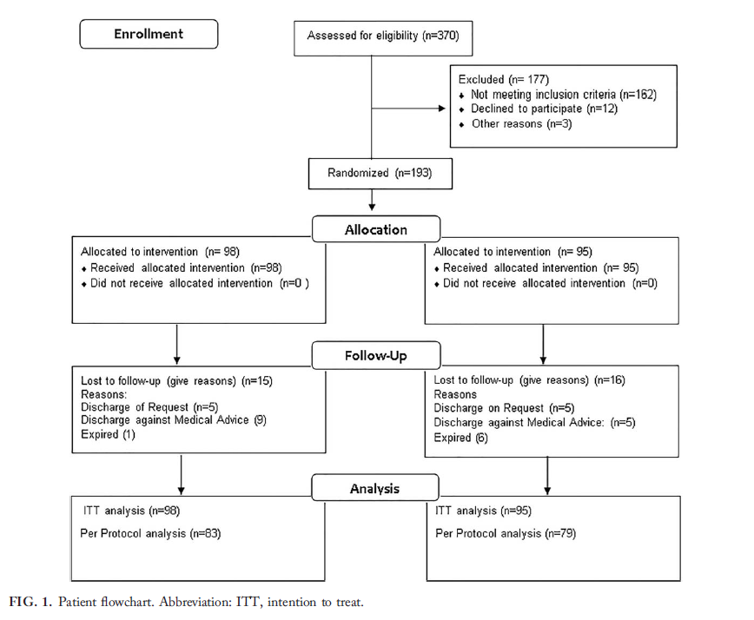

Slide 12
Clinical monitoring
Monitoring of all OHE patients grade 2-4 intially on ICU, after on ward
continuous monitoring of vital signs, neurological monitoring twice daily and mental state by modified West Haven criteria
Clinical responses:
→ resolution of encephalopathy
→ improvement: decrease in HE by one grade
→ No improvement: no improvement in HE
→ failure: shift to higher grade of HE

Slide 13
Primary outcomes
Primary analysis (Intention-to-treat, Nges=193, n1=98, n2=95) on grade of HE at 5 days: no significant difference between the two groups at 5-day follow-up (OR 1.44, 95%CI, 0.81-2.56, P=0.21)
Per protocol primary analysis (includes only patient stayed eligible for treatment, Nges=162, n1=83, n2=79): no significant difference between the two groups at 5-day follow-up (OR 1.73, 95%CI, 0.87-3.42, P=0.12)
but: significantly lower grade of HE during days 1-4 in LOLA group

Slide 14
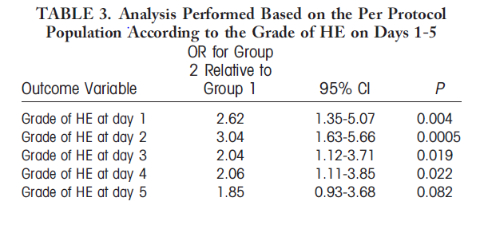

Slide 15
Secondary outcomes
significant decrease in venous ammonia levels in LOLA group compared to placebo (referring to baseline and day 5)
significant reduction of length of hospital stay (8.41±4.41 days in LOLA group, 11.45±5.25 days in placebo group, OR 3.08, 95% CI 1.77-4.40, P<0.0001)
significant shortening of recovery time from OHE in LOLA group (1.92±0.93 days vs. 2.50±1.03 days)
no significant difference in inflammatory response (no significant alteration in interleukin and TNF-α-levels)
no significant difference in mortality rate or failure rate between the two groups
no significant difference in adverse events between the two groups
Similar mortality rate after 1 month follow-up (baseline MELD-Score 21 for both groups)

Slide 16
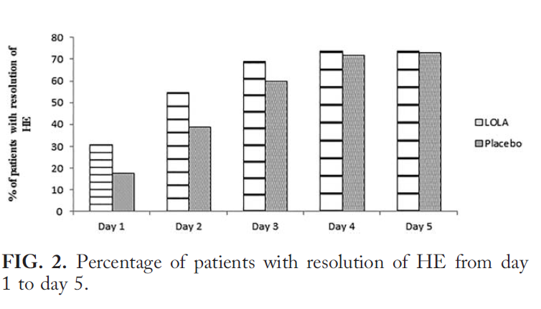

Slide 17
Discussion and conclusion
LOLA has a significant effect on resolution of OHE, lowering of ammonia and shortening of hospital stay on days 1-4 but not on day 5
→recomendation to i.v.-LOLA for 4 days
No effect of LOLA on inflammatory component of HE was found in this study. However increase of IL-1β, IL-6 and TNF-α-levels in patients with bouts of HE has been demonstrated in other studies with a significant difference in arteriovenous concentrations.
→ suggests a neuroinflammatory component of HE with brain cytokine efflux
Significant effect of LOLA on urea synthesis and ammonia levels
→ protein restriction in HE patients is not recommended
Most recent studies demonstrated a superiority of LOLA compared to placebo and its safety

