Slide 1
Risk of cirrhosis-related complications in patients with advanced fibrosis following hepatitis C virus eradication
Van der Meer AJ, Feld JJ, Hofer H
J. Hepatol. 2016 Oct 22

Slide 2
Background and aims
HCC risk in patients with HCV-related cirrhosis is markedly reduced by achievement of SVR
However, the risk is not eradicated
Risk factors of HCC following SVR are largely unknown
How can we do the surveillance?

Slide 3
Methods
Individual patient data study: data from Western cohort studies
HCV-patients with bridging fibrosis (F3) or cirrhosis (F4) with SVR 24
Therapy: interferon-based medications
Primary endpoint: HCC
Secondary endpoint: clinical disease progression (liver failure, liver transplantation or death)
Notes:
Patient: Europa and canadian-based, not us american , also nicht nur aus einem geograpischen bzw, genetischen Pool!
Follow up beginnt ab SVR 24 ( nicht vorher++)
Histologisch geprüft
HCC: - Histo
- 2 imaging > 2cm
- 1 imaging > 2cm and AFP> 400

Slide 4
Results
1000 patients
Median age: 52,2 years
678 (68%) were male
843 (84%) had cirrhosis
Median follow-up: 5,7 years
51/1000 patients developed HCC (8-year HCC incidence was 7.6%)
Time-intervall between SVR and HCC: 0,2 to 11,8 (!) years (median: 5,8 years)
101/1000 had a clinical disease progression

Slide 5
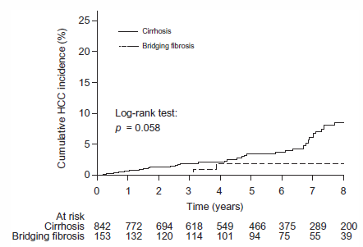
Results: Bridging fibrosis and cirrhosis
8-year HCC incidene was 1,8 % with bridging fibrosis
8-year HCC Incidence was 8,7% with cirrhosis
Notes:
Importan trend, but not statistifically signifikant (inzidenz für HCC bei bridging fibrosis or Cirrhosis)

Slide 6
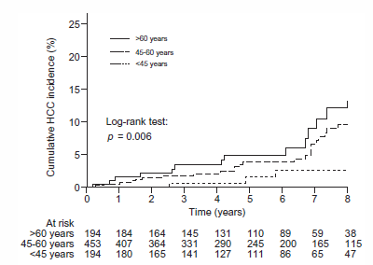
Results: Age and risk of HCC after SVR
8 year HCC-incidence: patients < 45 y: 2,8%
8 year HCC-incidence: patients 45-60 y: 9,7%
8 year HCC-indicence: patients >60 y: 12,2%
Notes:
Kaplan meier kurve liefert Überlebenskurve
Signifikant: drei Altersgruppen sind statisch signifikant für das auftreten des HCC nach SVR mit Interferon Therapie

Slide 7
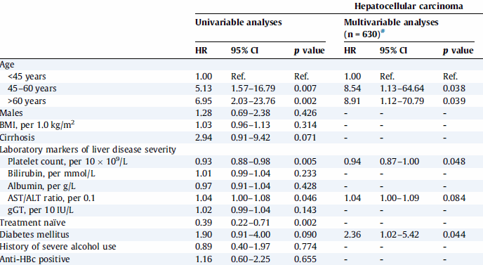
Results: age and risk-factors
In Multivariable Cox analyses
Higher age
Lower platelet count
Diabetes mellitus
Lower albumin levels
Independently associated with development of HCC
Notes:
Alter diabetes and thrombozyten sind statistisch signifikant!!

Slide 8
Conclusions
Patients with HCV-induced cirrhosis and SVR :
- 1 % annual risk for HCC
- 2% annual risk for cirrhose related morbidity/mortality
AASLD-guidelines: HCC-surveillance cost-effective in HCV patients >1,5% annual risk of HCC
BUT: HCC increased with age, population is aging
People < 45<: will risk of HCC increase with age?
To prevent HCC surveillance → chronic HCV infection should be treated before cirrhosis
Notes:
The annual risk of cirrhosis risk-related morbidity and mortality was twice as high!!
Annual risk of ZIRRHOSE und nicht mit bridging fibrosis
Grenzen der studiue: es sind nur interferon based regimen, also nur patienten mit niedriggradigem child wurden in die Studie eingeschlossen, aktuell bei den DAA behandeln wir auch Patienten mit Child B und C. inwieweit sich dort das Risiko für HCC nach SVR ausweitet bleibt unklar

Slide 9
Boarders of this study
Interferon-based therapy were only used in compensated patients
More predictive markers and their kinetics will be needed to detect the individual risk factors
Data were combined from multiple countries → heterogenity

Slide 10
Summary
After successfull eradication patients with cirrhosis remain at risk of HCC
The risk increases with:
Higher age
Laboratory markers suggesting more severe liver diease
Presence of diabetes mellitus

