Slide 1
Journal Club
Gerard Angeles, 21.09.2023

Slide 2
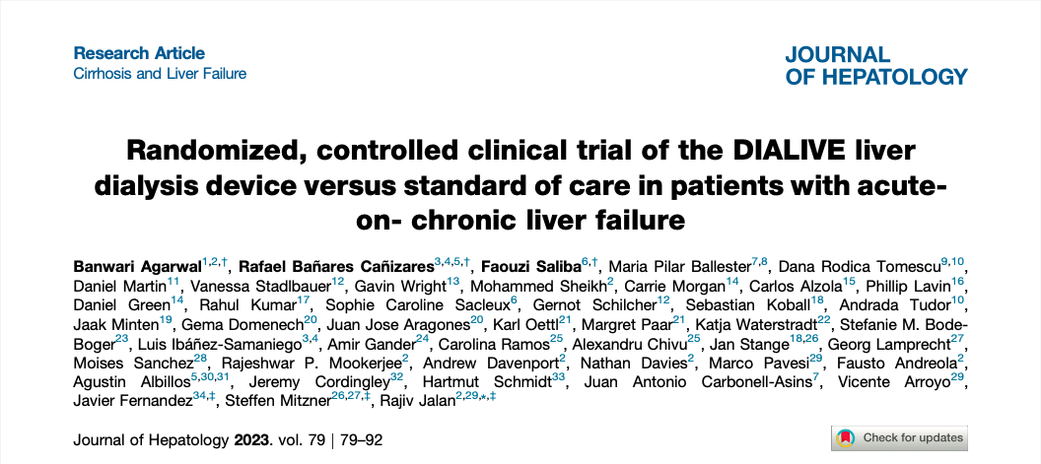

Slide 3
Background

Slide 4
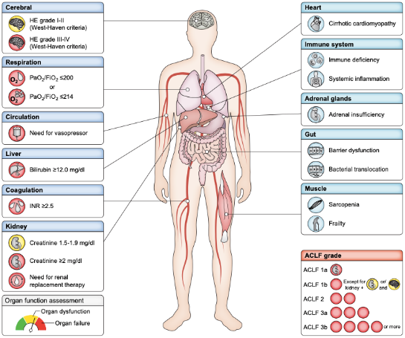
Acute-on-chronic liver failure (ACLF) (EASL-CLIF Definition)
- clinical syndrome with systemic inflammation and multiorgan failure
- in patients with decompensated liver cirrhosis
- following an hepatic/extrahepatic precipitating event
- high mortality rate
- no specific therapy
Moreau R, Jalan R, Ginès P, et al. Acute-on-chronic liver failure is a distinct syndrome that develops in patients with acute decompensation of cirrhosis. Gas- troenterology 2013;144(7):1426-37.
Moreau, Richard, et al. "EASL Clinical Practice Guidelines on acute-on-chronic liver failure." Journal of Hepatology (2023).
Notes:
Asia Pacific Association for the Study of the Liver (APASL): restricted to patients with acute liver dysfunction triggered by acute intrahepatic precipitants; either patients with cirrhosis and no prior decompensation or those with non-cirrhotic chronic liver disease
North American Consortium for the Study on End-Stage Liver Disease (NACSELD): based on expert opinión, only captures most severe patients receiving organ support
- Chinese Group on the Study of Severe Hepatitis B (COSSH): very similar, in patients with hepatitis B virus (HBV)-related chronic liver diseas

Slide 5
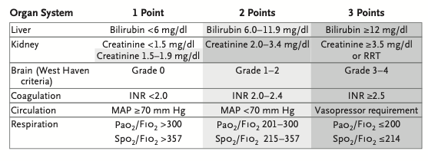
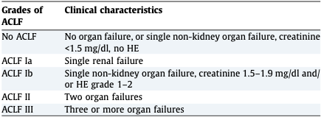
CLIF-C OF scoring system (diagnostic and grading)
Jalan R, Saliba F, Pavesi M, Amoros A, Moreau R, Ginès P, et al. Development and validation of a prognostic score to predict mortality in patients with acute-on-chronic liver failure. J Hepatol 2014 Nov;61(5): 1038–1047.
Angeli, Paolo, et al. "EASL Clinical Practice Guidelines for the management of patients with decompensated cirrhosis." Journal of hepatology 69.2 (2018): 406-460.

Slide 6
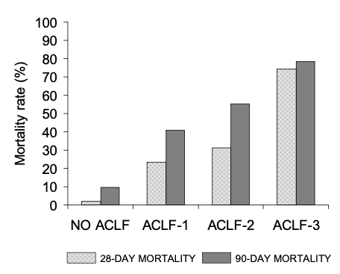
Mortality according to ACLF grade
Moreau R, Jalan R, Ginès P, et al. Acute-on-chronic liver failure is a distinct syndrome that develops in patients with acute decompensation of cirrhosis. Gastroenterology 2013;144(7):1426-37.

Slide 7
Management of ACLF
Treat the precipitating event / cause
Management of complications (infections, bleeding, AKI-HRS)
Organ support
Refer to transplant center if suitable for LT
Liver support systems (MARS, Prometheus...): no benefit on survival
Angeli, Paolo, et al. "EASL Clinical Practice Guidelines for the management of patients with decompensated cirrhosis." Journal of hepatology 69.2 (2018): 406-460.

Slide 8
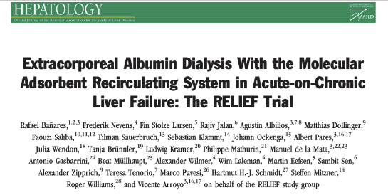
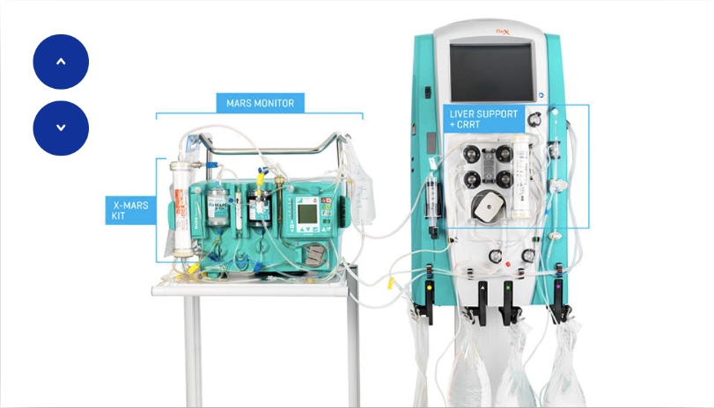
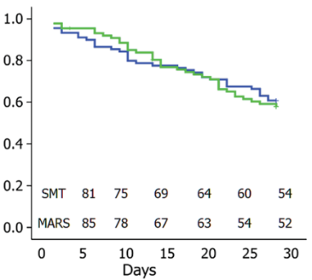
Liver support system
MARS
→ removes protein-bound substances, bilirrubin, ammonium and creatinin
CVVHDF
albumin diaysate
anion exchanger
+
charcoal column
Banares R, Nevens F, Larsen FS, Jalan R, Albillos A, Dollinger M, et al. Extracorporeal albumin dialysis with the molecular adsorbent recircu- lating system in acute-on-chronic liver failure: the RELIEF trial. Hepatology 2013;57:1153–1162.
Notes:
“Molecular adsorbent recirculating system (MARS)” circuit.
Patient connected to circuit containing the MARS membrane. → Albumin containing dialysate circulates in a closed loop. → Albumin is on-line regenerated by passage over the charcoal column and anion exchanger.
A dialysis/hemofiltration module is incorporated into the secondary circuit to add all the benefits of transfer of water-soluble toxins (low molecular weight sub-stances), as in conventional hemodialysis/hemofiltration. (Reproduced with permission from Teraklin, Rostock, Germany.)
Study; Multicenter (19 centers)
- Patients with AD: known cirrhosis, triggering event and increase in Bilirrubin >5mg/dl +:
- HRS / HE Grade II / radid progressive hyperbilirrubinemia
n= 189 (MARS =95, SMT =94).
10 rounds (min. 5h) within 21d.
Primary endpoint 28-d-mortality. Results: no differencies in mortality. Greater improvement in bilirrubin, creatinine and improvement in HE.

Slide 9
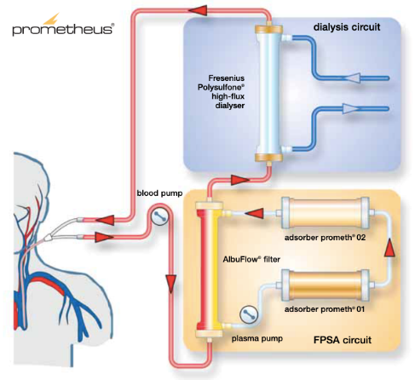
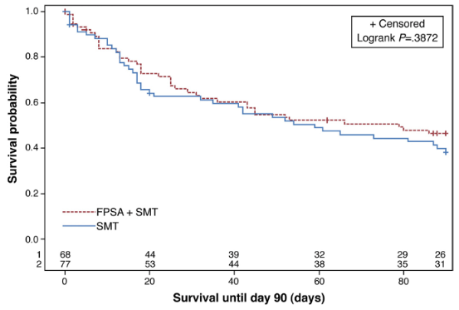
Liver support system
Prometheus
→ removes protein-bound substances, bilirrubin, ammonium and creatinin
high-flux dialyser
anion exchanger
+
resin adsorber
albumin dialysate
Kribben A, Gerken G, Haag S, Herget-Rosenthal S, Treichel U, Betz C, et al. Effects of fractionated plasma separation and adsorption on survival in pa- tients with acute-on-chronic liver failure. Gastroenterol 2012;142:782– 789 e783.
Notes:
“Fractionated plasma separation and adsorption (FPSA)”: direct adsorption of albumin-bound toxins + removal of water-soluble substances (low and middle molecular weight)
Albumin filter (AlbuFlow AF 01)
neutral resin adsorber (prometh 01)
adsorber for anion exchange (prometh 02)
high-flux dialyser
Patients with AOCLF
n= 145 (FPSA =77; SMT =68)
8-11 rounds of FPSA (min 4h) for 3 weeks
Primary endpoint survival at 28-d and 90-d, irrespective of liver transplantation. No differences in survival. Billirrubin significantly decrease

Slide 10
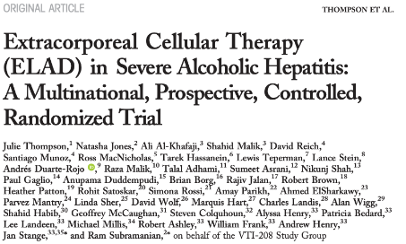
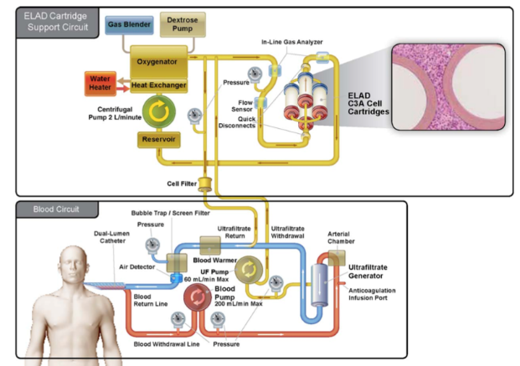
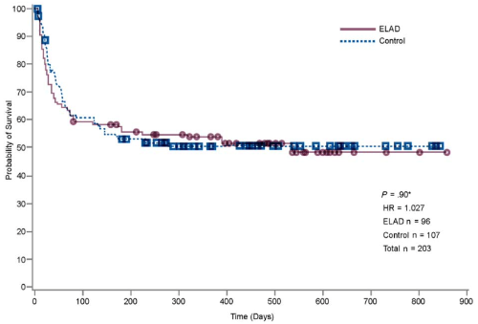
Liver support systems
Extracorporeal Cellular Therapy (ELAD)
Thompson J, Jones N, Al-Khafaji A, Malik S, Reich D, Munoz S, et al. Extracorporeal cellular therapy (ELAD) in severe alcoholic hepatitis: a multinational, prospective, controlled, randomized trial. Liver Transpl 2018;24:380–393.
Notes:
Extracorporeal cellular therapy used hepatoblastoma-derived cells in the dialysis circuit
ELAD Study
Sever alcoholic hepatitis (Maddrey >/= 32, Bili >8mg/dl (136 umol/l), MELD <35)
n= 203, ELAD =96 and SOC =107
ELAD continuously for 120 hours (5d)
Primary endpoint: evaluate safety and efficacy. No differences in SAE.
Secondary: survival. No differences in survival.

Slide 11
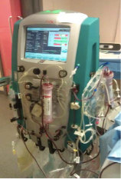
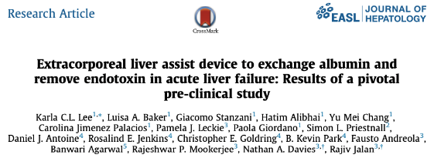
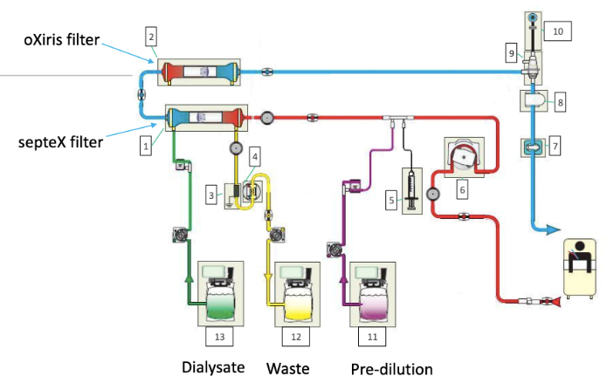
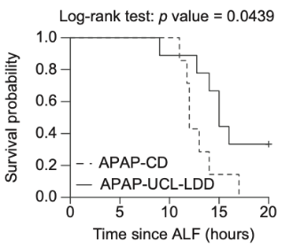
Liver support systems
DIALIVE
adsorption of PAMPs and DAMPs
ultrafiltration of dysfunctional albumin and cytokines
UCL-LDD: University College London-Liver Dialysis Device
CD: Control Device (=standard CRRT)
Lee KC, Baker LA, Stanzani G, Alibhai H, Chang YM, Jimenez Palacios C, et al. Extracorporeal liver assist device to exchange albumin and remove endotoxin in acute liver failure: results of a pivotal pre-clinical study. J Hepatol 2015;63:634–642.
Notes:
DIALIVE: extracorporeal liver dialysis device: incorporates a dialysis machine (Prismaflex, Baxter) and uses a dual filtration system connected in series: 1) SepteX filter = ultrafiltration of albumin and cytokines; 2) OXiris filter = adsorption of PAMPs (endotoxin) and DAMPs (genomic DNA).
In a pig model of APAP-induced ALF, we have shown that UCL-LDD, a novel extracorporeal liver assist device, in combination with HSA infusion, results in a decrease in circulating irreversibly oxidised albumin (HNA2) and a reduction in the overall severity of endotoxaemia. This attenuated the severity of multi-organ dysfunction, resulting in prolonged survival and an estimated 67% reduced risk of death compared to controls, associated with a delay in systemic activation of the TLR4 signalling pathway. No adverse effect of the device or compatibility issues were observed providing rationale for clinical trials of this device.

Slide 12
Back to the trial...

Slide 13
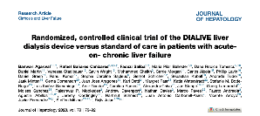
Design
Multicenter: 8 hospitals in 6 European countries
Randomized-controlled: DIALIVE vs. ”Standard of care (SOC)”
Open-label

Slide 14
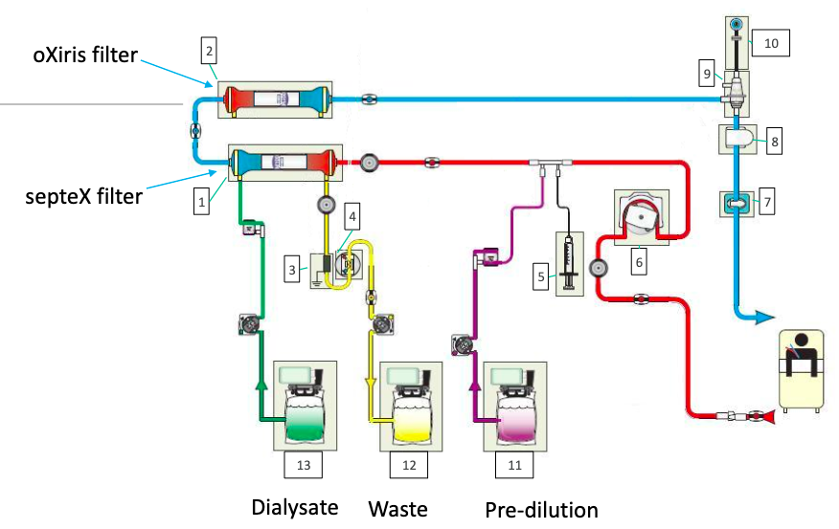
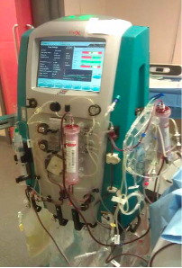
Intervention = DIALIVE
Albumin reposition
adsorption of PAMPs and DAMPs
ultrafiltration of dysfunctional albumin and cytokines

Slide 15
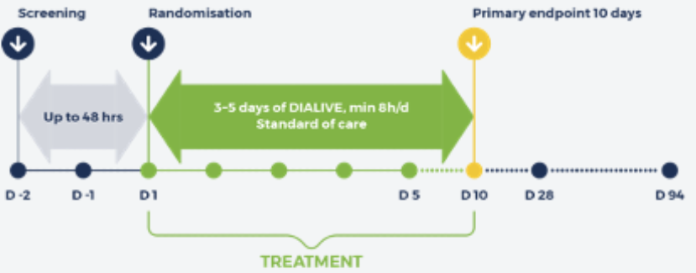
Intervention = DIALIVE
Notes:
Cohorts 1-3 followed for 28 days
Cohorts 4-5 followed for 90 days

Slide 16
Inclusion/exclusion criteria
Main inclusion criteria:
$≥$ 18 y.o.
History indicative of alcohol-related cirrhosis
History of an acute decompensation event (<6 w)
ACLF Grade 1-3a
steroid non-responder or steroids not used/ contraindicated
Main exclusion criteria:
INR >3 /Platelets < 40’000
uncontrolled infection
respiratory organ failure / haemodynamic instability
ACLF Grade 3b (>3 OF)

Slide 17
Endpoints
Secondary endpoints:
plasma endotoxin level
albumin function
individual organ function
CLIF-C OF score
ACLF Grade
CLIF-C ACLF score
28-day mortality
ICU /hospital stay
Main endpoint:
% of patients experiencing $≥$1 serious adverse event* between day 1 and day 10
*Medical occurrence leading to death, injury, permanent impairment or serious deterioration in the health
laboratory
organ function / prognostic scores
Exploratory endpoints: markers of inflammation

Slide 18
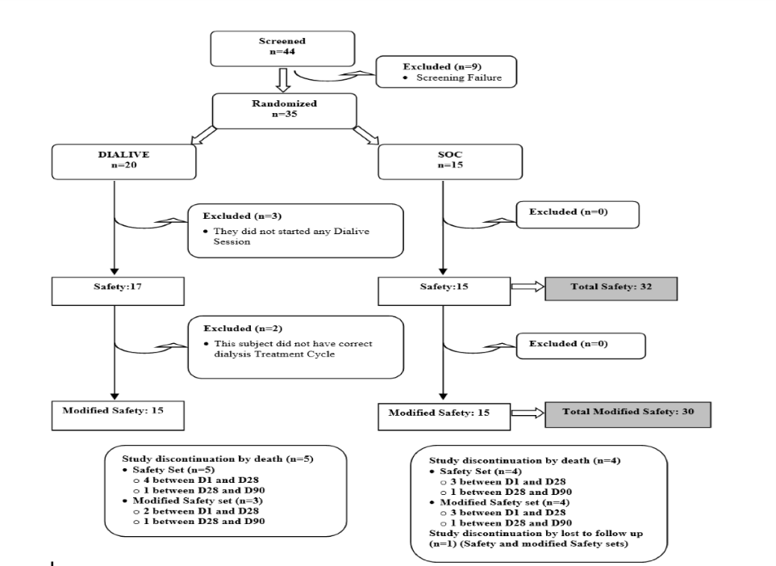
Results
$≥$1 session of DIALIVE
2 deaths after 1st session (hypotension/sepsis)
all biomarkers available
2 deaths after 1st session (hypotension/sepsis),
2 more deaths within 28 d (AMI and prog. liver failure)
3 deaths within 28 d (due to prog. liver failure)

Slide 19
Results
Patient characteristics (both groups):
mean age 49 yo
75% male
100% alcohol-related cirrhosis with alcohol-related hepatitis
35% / 40% received steroids
25% superinfection

Slide 20
Results
Patient characteristics (DIALIVE-group n=17):
DIALIVE therapy administered for 8-12 h during:
1 day in 2 patients
3 days in 11 patients
4 days in 1 patient
5 days in 3 patients

Slide 21
Results
Primary endpoint: % of patients with $≥$1 adverse events
DIALIVE: 11 patients of n=17 (64,7%)
vs.
SOC: 8 patients of n=15 (53,3%)
→ no significant difference (p=0,77)
Notes:
7 patients of n=17 (41,2%) related to treatment SAE

Slide 22
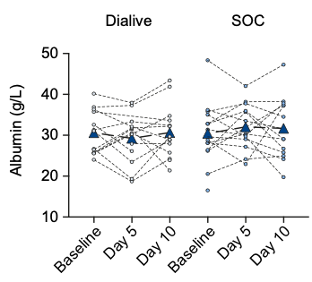
Results
Secondary endpoints: Albumin function
Albumin concentration:
no significant difference between groups (p=0.77)

Slide 23
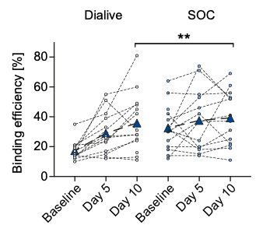
Results
Secondary endpoints: Albumin function
Binding efficiency:
significanly increased at 10d in DIALIVE (p<0.01)

Slide 24
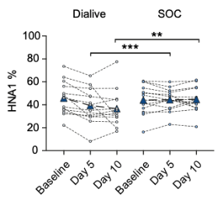
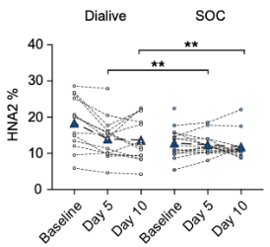
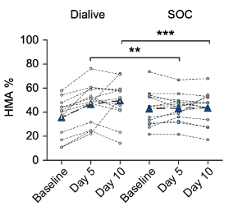
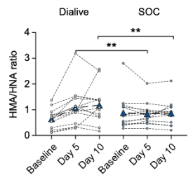
Results
Secondary endpoints: Albumin function
↓ oxidized albumin
(HNA 1 and 2)
↑ reduced albumin (HMA)
significant advantage for DIALIVE (p<0.01 and p<0.001)
Notes:
HMA = human mercapt albumin = reduced form of albumin
HNA = human non-mercapt albumin = oxidized form of albumin

Slide 25
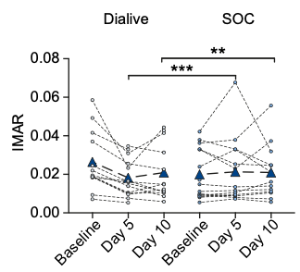
Results
Secondary endpoints: Albumin function
Ischaemia-modified albumin ratio (oxydative stress):
significantly reduced in DIALIVE (p<0.01 and p<0.001)

Slide 26
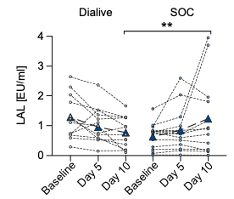
Results
Secondary endpoints: Plasma endotoxin level
→ significant advantage for DIALIVE at day 10 (p<0.01)

Slide 27
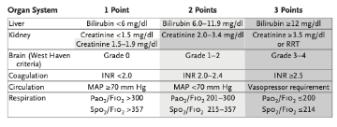
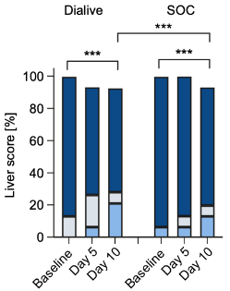
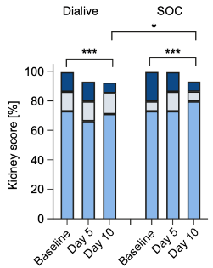
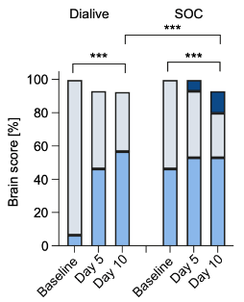
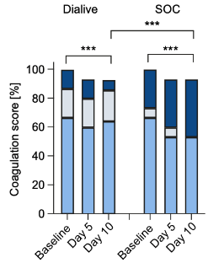
Results
Secondary endpoints: change in organ function (CLIF-C OF)
→ Significant improvements in organ function subscores at day 10 in both groups, but significantly greater for DIALIVE (p<0.001)

Slide 28
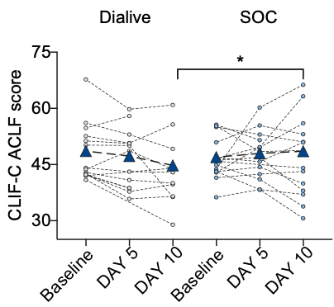
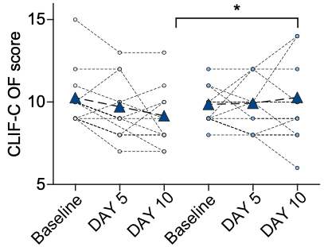
Results
Secondary endpoints: change in prognostic scores (CLIF-C OF / CLIF-C ACLF)
CLIF-C OF Score
→ Significantly greater improvements in CLIF-C OF and CLIF-C ACLF scores at day 10 for DIALIVE (p<0.001)

Slide 29
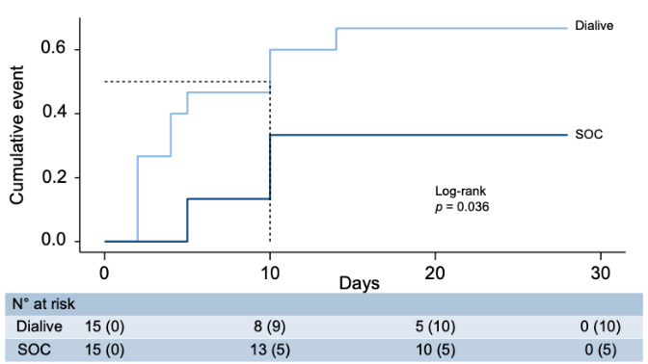
Results
Secondary endpoints: ACLF
→ Time to resolution of ACLF significantly faster in patients on DIALIVE (log rank test, p=0.036)

Slide 30
Results
Exploratory endpoints: pathophysiological markers
Resolution of ACLF in the DIALIVE-group associated with significant changes in Factor VIII (endotelial dysfuntion), IL-18 (systemic inflammation), M30 and RIPK3 (DAMPs).
Reduction in F VIII, IL-7, IL-18, RIPK3 and INR associated with resolution of ACLF in both groups.
Increase in CCL5/Rantes associated with resolution of ACLF in both groups

Slide 31
Discussion
Limitations:
first-in-man study
multicenter study → SOC difficult to establish
unblinded study
small sample size
study designed to “evaluate safety”
analyses post hoc
only patients with alcohol-related cirrhosis

Slide 32
Discussion
First sudy of extracorporeal liver assist device in patients with ACLF using validated diagnostic and prognostic criteria
Restricted population of severe alcohol hepatitis unresponsive or contraindications for corticoids

Slide 33
Discussion
- Similar proportion of patients with AEs in both groups indicates safety
- 2 early deaths in haemodynamically unstable patients
→ management in high dependency areas + replacement of albumin during treatment (not at the end)
- Greater incidence of thrombocytopenia, bleeding and hypotension in DIALIVE-arm
- Less incidence of infection in DIALIVE-arm (attenuation of endotoxemia)

Slide 34
Discussion
Significant effect of DIALIVE on albumin function and endotoxemia suggests evidence of device performance
Reduction of the oxidized albumin (pro-inflammatory) and improved albumin functionality in DIALIVE-arm
→ anti-inflammatory effect
Reduction of endotoxemia → better neutrophil function
→ lower risk of infection?

Slide 35
Discussion
DIALIVE results in a faster resolution of ACLF and greater improvement in organ function (OF subscores, CLIF-OF Score and CLIF-ACLF Score
→ potential improvement in survival
(discharge from ICU / bridge to transplantation?)

Slide 36
Discussion
MARS / Prometheus = albumin dialysis (removes protein-bound substances)
ELAD (extracorporeal cellular therapy) = “hepatic cells” in dialysis circuit
DIALIVE = albumin exchange + removal inflammatory mediators
(cytokines, PAMPs and DAMPs)
→ impact on known pathophysiological mechanisms

Slide 37
In conclusion
DIALIVE is safe if applied with careful patient management and monitoring
DIALIVE improves albumin function and endotoxin levels in plasma
DIALIVE impacts positively on organ function
DIALIVE accelerates the recovery from ACLF

Slide 38
Thank you for your attention

