Slide 1
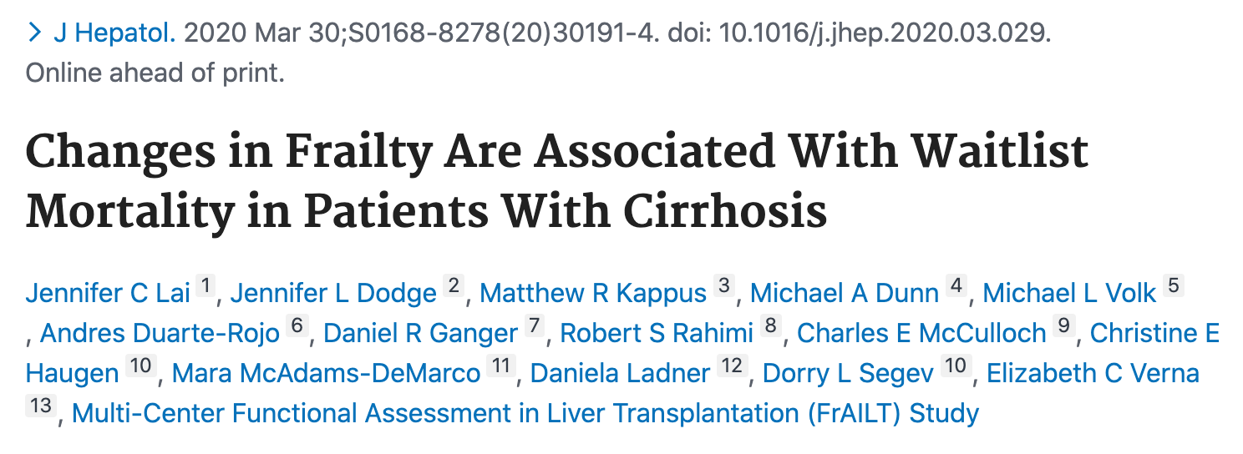
VIRTUAL
Journal Club
28.05.2020
Élise Vuille-Lessard
Clinical Research Fellow

Slide 2
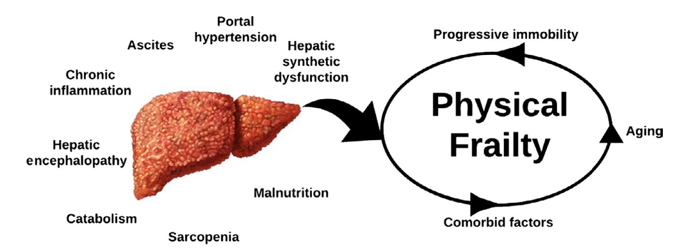
Introduction
Frailty = a clinical state of decreased physiologic, cognitive and functional reserve and increased vulnerability to health stressors
Liver Frailty Index (LFI), as measured at a single time point, predicts mortality among patients with cirrhosis awaiting liver transplantation
MELDNa + LFI better than MELDNa alone (3- and 12-month waitlist mortality)
Takes into account risk factors not captured by bilirubin, INR, creatinine, Na
Lai et al. Hepatology 2017
Lai et al. Am J Transplant 2019

Slide 3
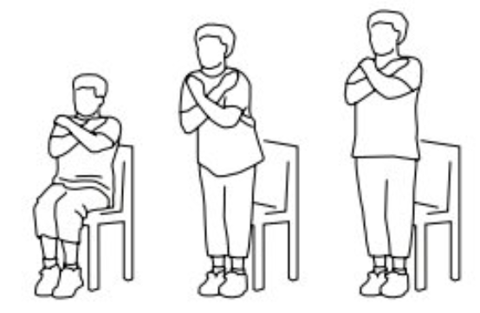
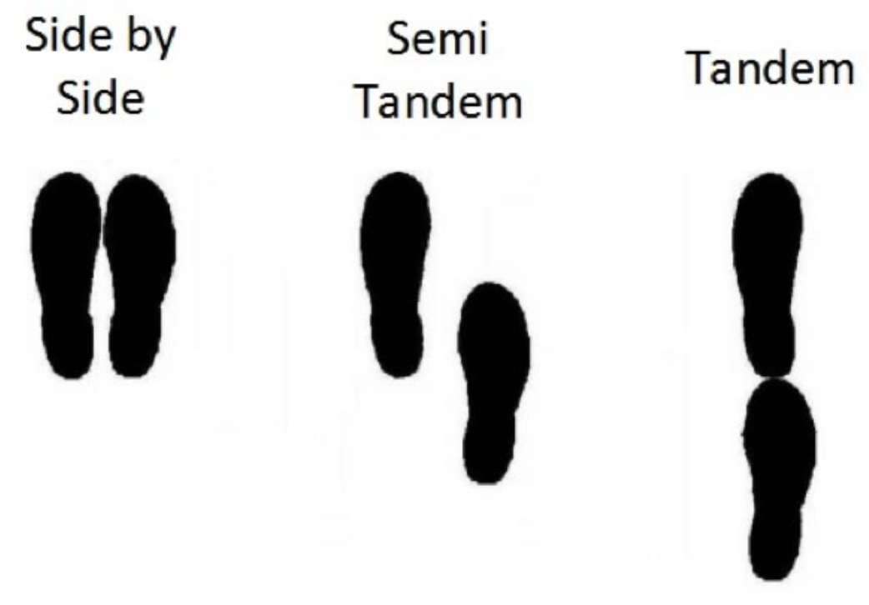
https://liverfrailtyindex.ucsf.edu/
Lai et al. Hepatology 2017
Notes:
Position balance: max 10 s each

Slide 4
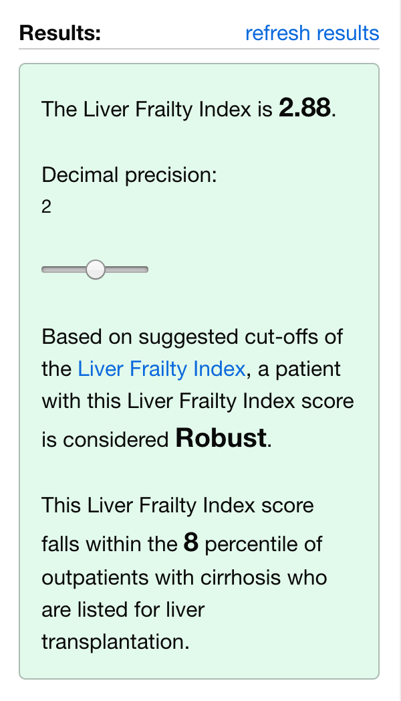
LFI = (-0.330 * gender-adjusted grip strength) + (-2.529 * number of chair stands per second) + (-0.040 * balance time) + 6

Slide 5
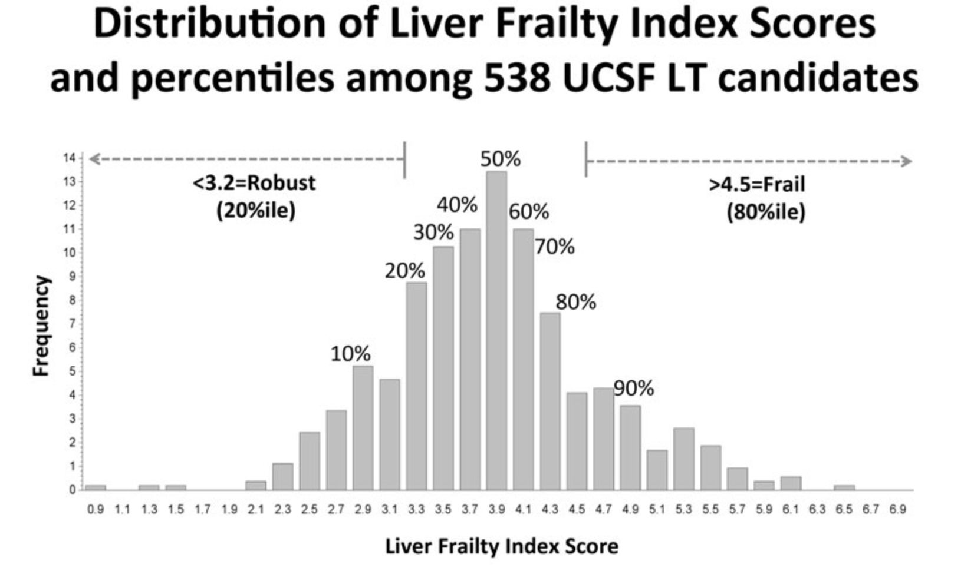
https://liverfrailtyindex.ucsf.edu/
Pre-frail
HIGH SCORE = MORE FRAIL
Average = 4

Slide 6
Aim of the study
Frailty at a single time point predicts mortality, but whether change in frailty over time is associated with death is unknown
Describe trajectories of frailty (∆LFI) among patients with cirrhosis and evaluate its association with mortality.

Slide 7
Methods
Data from 8 liver transplant centres in the United States from the Functional Assessment in Liver Transplantation (FrAILT) Study
Demographics, MELD-Na, ascites, HE…
… to January 2019
Inclusion criteria:
Cirrhosis
Listed or eligible for listing for liver transplantation
Seen as an outpatient for clinical care
Exclusion criteria: listed with MELD-Na exception point

Slide 8
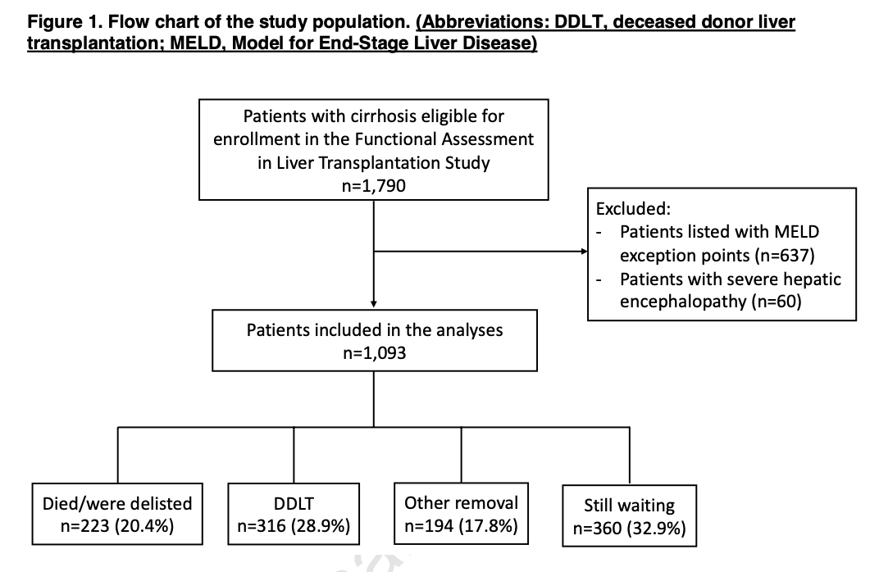
Median f/u: 11 months

Slide 9
Methods
Primary outcome: waitlist mortality
Death + delisting for being too sick for OLT
Statistical analysis:
Multilevel mixed-effects linear regression to model longitudinal data from each clinic visit and predict ∆LFI per 3 months
4 categories of ∆LFI: improved, stable, moderate worsening, and severe worsening
Estimation of the cumulative incidence of waitlist mortality within 3-, 6-, and 12-months of study entry by ∆LFI category
Competing risk regression (DDLT = competing risk)
Censored: LDLT and removed for other reason
MELDNa kept in final model
Notes:
Baseline age, gender, MELDNa, ascites, HE = fixed effects (do not vary)
Participants (random intercepts) and f/u time (random slopes) = random effects

Slide 10
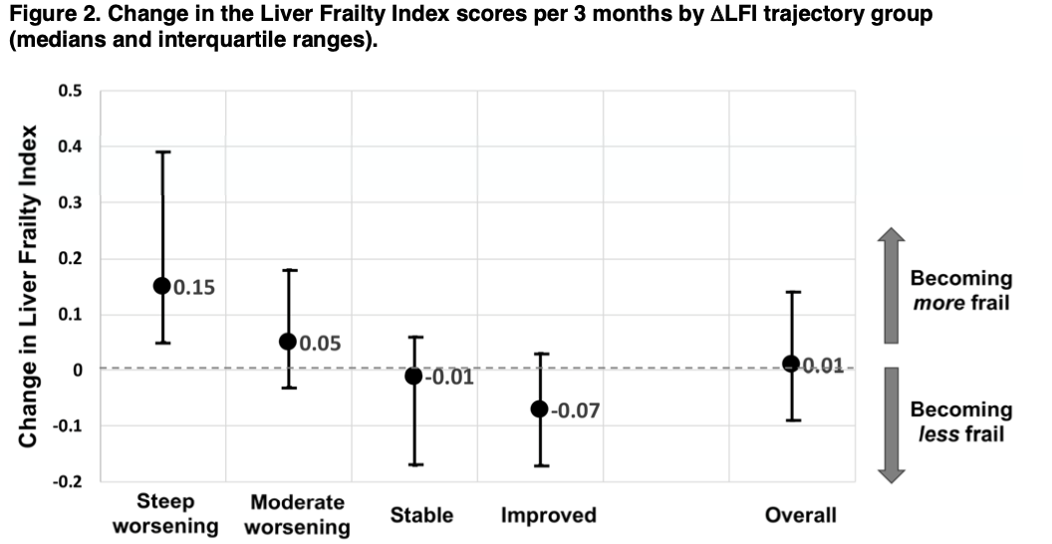

Slide 11
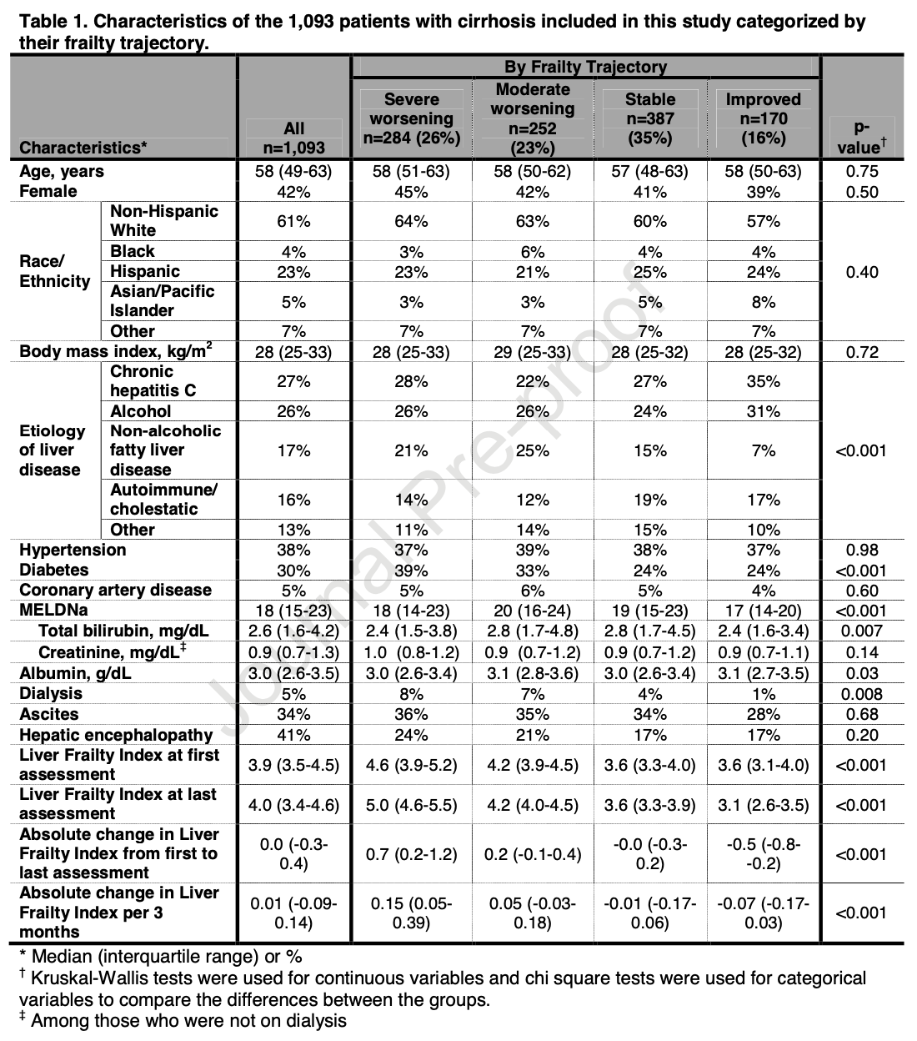

Slide 12
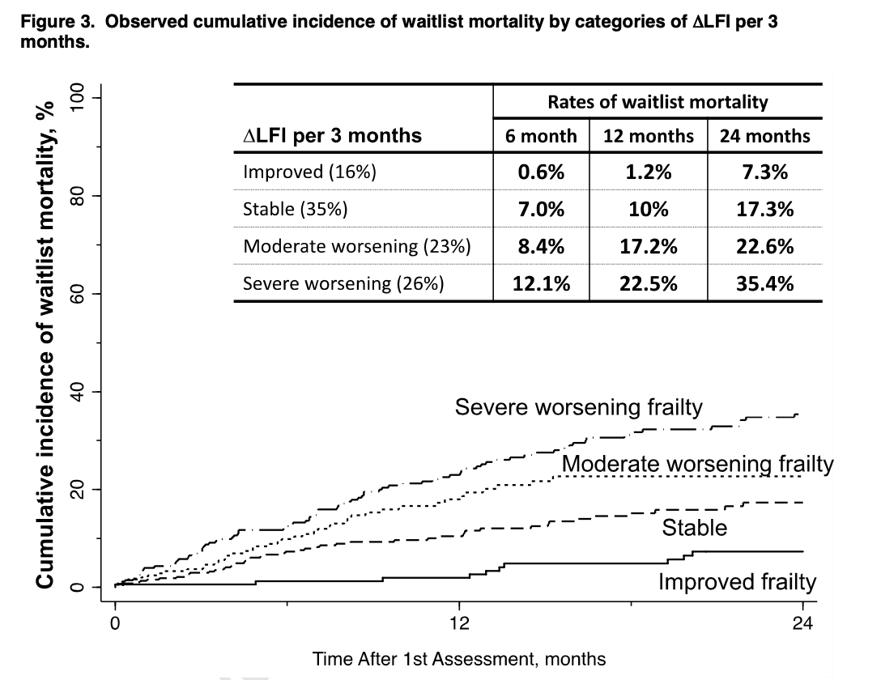

Slide 13
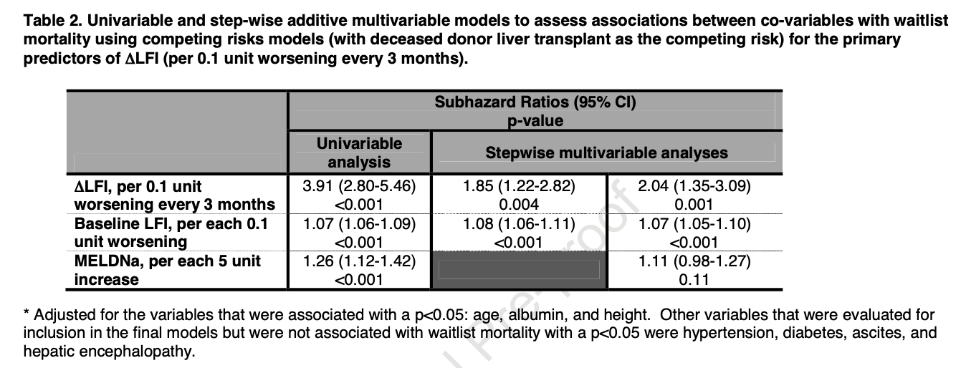

Slide 14
Discussion & conclusion
Worsening of frailty is associated with a significantly increased risk of waitlist mortality, independent of baseline frailty and baseline MELDNa, and in a dose-dependent manner
Supports longitudinal objective frailty measurement in clinical practice
Justifies interventions aimed at reversing frailty
Patients who’s frailty improved were different
Less frail at baseline (lower LFI) (but adjusted for in multivariate analysis)
Less likely to have NAFLD, diabetes, or dialysis-dependent

Slide 15
Discussion & conclusion
Strengths:
Shows again the prognostic value of frailty measurement
Quantifies the longitudinal impact of frailty on mortality risk
Statistical analysis accounted for variations/confounders
Limitations:
Observational study, no proof of causation, confounders/bias
Assumption that reversing frailty will necessarily improve survival
Did not look at mechanisms for various trajectories: potential positive interventions such as alcohol cessation, DAAs, nutrition/exercise, or negative factors such as hospitalizations, decompensation

Slide 16
References
Jennifer C Lai, Jennifer L Dodge, Matthew R Kappus, Michael A Dunn, Michael L Volk, Andres Duarte-Rojo, Daniel R Ganger, Robert S Rahimi, Charles E McCulloch, Christine E Haugen, Mara McAdams-DeMarco, Daniela Ladner, Dorry L Segev, Elizabeth C Verna, Multi-Center Functional Assessment in Liver Transplantation (FrAILT) Study. Changes in Frailty Are Associated With Waitlist Mortality in Patients With Cirrhosis. J Hepatol. 2020 Mar 30;S0168-8278(20)30191-4.
Jennifer C Lai, Christopher J Sonnenday, Elliot B Tapper, Andres Duarte-Rojo, Michael A Dunn, William Bernal, Elizabeth J Carey, Srinivasan Dasarathy, Binita M Kamath, Matthew R Kappus, Aldo J Montano-Loza, Shunji Nagai, Puneeta Tandon. Frailty in Liver Transplantation: An Expert Opinion Statement From the American Society of Transplantation Liver and Intestinal Community of Practice. Am J Transplant. . 2019 Jul;19(7):1896-1906. doi: 10.1111/ajt.15392. Epub 2019 May 8.
https://liverfrailtyindex.ucsf.edu/
Dynamometer image: https://www.banggood.com/198lb90kg-Electronic-Hand-Grip-Strength-Dynamometer-Meter-Measuring-Abdominal-Muscle-Trainer-p-1299141.html?ID=236&cur_warehouse=CN
Chair stands image: https://www.hqsc.govt.nz/assets/Falls/PR/005-falls-toolkit-chair-stand-test.pdf

