Slide 1
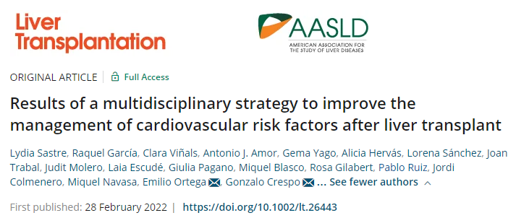
Hepatology Journal Club
Élise Vuille-Lessard – 03.03.2022

Slide 2
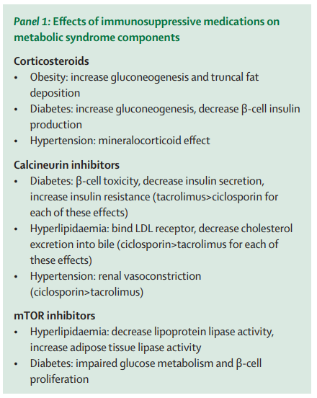
Introduction
Liver transplant recipients are at high cardiovascular risk, especially now that MAFLD is a growing indication for LT.
Prevalence of metabolic syndrome: 40-60%, rising in the first year post LT
Cardiovascular events are among the most frequent causes (3rd) of both early and long-term post-LT death.
Fatourou & Tsochatzis Lancet Gastro Hep 2019

Slide 3
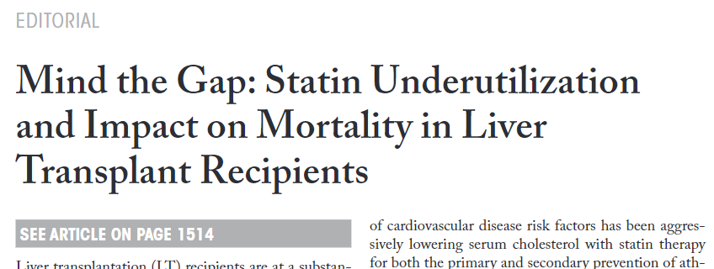
Introduction
The management of cardiovascular risk factors after LT is currently suboptimal.

Slide 4
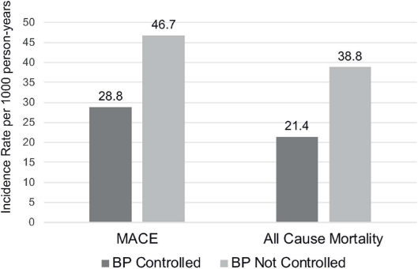
Introduction
Achieving blood pressure control according to the guidelines within the first post-LT year is associated with a lower incidence of CVE and higher survival.
Van Wagner Am J Transplant 2020

Slide 5
Introduction
Several barriers:
Lack of awareness of cardiovascular risk
Lack of confidence to provide high-quality CV care
Difficulties in establishing multidisciplinary teams
Multidisciplinary protocols can help standardizing the care of complex patients:
Identification of post LT-metabolic comorbidities and risk stratification
Management including treatment targets

Slide 6
Methods
Comparing the grade of identification and control of CVRF 12 months after LT and the incidence of CVE up to 2 years post LT
2017
No protocol
Multidisciplinary protocol
Control cohort LT 7/2015 - 12/2016 n=100
Post-intervention cohort LT 1/2018-1/2020 n=150
vs.
Notes:
No protocol group: as per physician discretion (+/- APN), not standardized

Slide 7
Methods: Multidisciplinary protocol
Developed by 3 transplant hepatologists, 2 endocrinologists and 1 post-LT advanced-practice nurse (APN)
LT-adapted from general population guidelines
Standardizing diagnosis, risk-stratification and treatment of post-LT CVRF
Referral criteria (after discussion with referral specialists)
Disseminated to the rest of the physicians involved in the care of patients

Slide 8
Methods: Multidisciplinary protocol
LT
6 months post LT
12 months post LT
CVD-oriented visit with APN
CVRF evaluation: arterial hypertension / diabetes mellitus / dyslipidemia / metabolic syndrome / 10-year ASCVD Risk Score
Physical examination incl. BP, height, weight and waist circumference
ECG
Blood test (including lipid panel, renal function, carbohydrate metabolism)
Therapeutic education on CVRF and healthy lifestyle including nutrition, exercising, advice on smoking cessation
Educational sessions every 3-4 months directed by the post-LT APN and involving a nutritionist and a physiotherapist
+
Medical visits
Treatment and targets for each CVRF and criteria for referral to other specialists as per protocol
Notes:
Arterial hypertension (AHT): office BP≥140/90 mmHg in at least two measurements or use of BP lowering drugs.
Diabetes mellitus (DM): anytime glycemia ≥200 mg/dl or fasting glycemia ≥126 mg/dl or HbA1c ≥6.5%, or use of antidiabetic drugs.
Dyslipidemia (DL): total cholesterol levels ≥240 mg/dl, or triglycerides levels ≥150 mg/dl, or use of lipid-lowering drugs.
Complete physical examination including BP, height, weight and waist circumference, and an ECG and a blood test comprising a complete lipid panel, renal function, and carbohydrate metabolism
Educational sessions directed by the post-LT APN and involving a nutritionist and a physiotherapist were offered to patients in groups of less than 10 patients and caregivers. These sessions were held every 3-4 months and focused on practical tips on exercising and Mediterranean diet for LT recipients.
Standard: monthly for the first 3 months post-LT and every 2 months until month 12

Slide 9
Methods: Risk stratification
Very high risk: Previous CVE DM with CKD or other CVRF Significant RF(total cholesterol >310 mg/dl and/or sBP>180 mmHg and/or dBP >110 mmHg) CKD with eGFR <30 ml/min/1.73 m2 Severe preclinical atherosclerosis.
High risk: DM without other CVRF Presence of one or more of: AHT, DL, active smoking CKD with eGFR 30-60 ml/min/1.73 m2 Moderate preclinical atherosclerosis
Moderate/low risk: Absence of CVRF, previous CVE and preclinical atherosclerosis.
Notes:
The presence of preclinical atherosclerosis was based in the pre-LT coronary artery calcium score (CACS) in coronary computed tomography angiography (CCTA), which was performed in pre-LT evaluation as per
clinical protocol in LT candidates with DM/MAFLD and any other CVRF (age >45 in men/50 in women, AHT, dyslipidemia, obesity, current or previous smoking habit, personal or family history of coronary artery disease [CAD]) and in patients without diabetes/MAFLD but 3 or more of the rest of the CVRF.
In patients who had not undergone CCTA before LT, a carotid and femoral arteries ultrasound was performed 6 months after LT.
Severe preclinical atherosclerosis was defined as a CACS >300 HU at CCTA, or as the presence of plaques (defined as intima media thickness ≥1.5 mm) in 2 or more territories (total number of territories n=4, right and left carotid and femoral), 3 or more plaques, or at least one plaque with >40% stenosis in carotid-femoral ultrasound.
Moderate preclinical atherosclerosis was defined as a CACS 10-300 in CTCA, or as the presence of plaques in a single territory and/or 2 or less plaques with <40% stenosis in carotid-femoral ultrasound.

Slide 10
Methods: Follow-up
New-onset CVE registered up to 2 years post-LT, or until death or retransplantation.
Acute coronary syndrome Myocardial infarction Stable or unstable angina Cerebrovascular disease Transient ischemic attack Peripheral arterial disease Heart failure Arrythmia

Slide 11
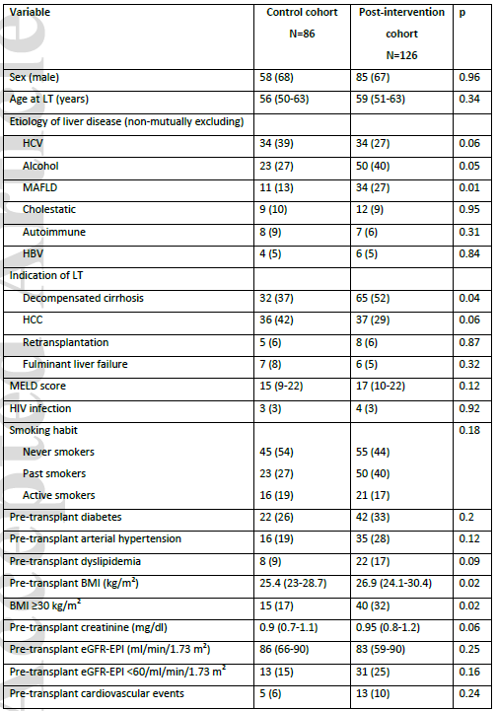
Results
BMI ”using weight in dry conditions”
Still affected by fluid retention?
Notes:
After excluding double Tx and died/retransplanted

Slide 12
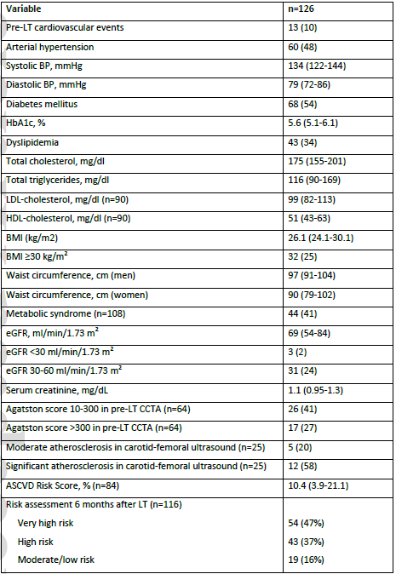
Post intervention cohort
(evaluation performed in 92% of patients)
i.e. Severe preclinical atherosclerosis
84% very high or high risk
Notes:
The presence of preclinical atherosclerosis was based in the pre-LT coronary artery calcium score (CACS) in coronary computed tomography angiography (CCTA), which was performed in pre-LT evaluation as per
clinical protocol in LT candidates with DM/MAFLD and any other CVRF (age >45 in men/50 in women, AHT, dyslipidemia, obesity, current or previous smoking habit, personal or family history of coronary artery disease [CAD]) and in patients without diabetes/MAFLD but 3 or more of the rest of the CVRF.
In patients who had not undergone CCTA before LT, a carotid and femoral arteries ultrasound was performed 6 months after LT.
Severe preclinical atherosclerosis was defined as a CACS >300 HU at CCTA, or as the presence of plaques (defined as intima media thickness ≥1.5 mm) in 2 or more territories (total number of territories n=4, right and left carotid and femoral), 3 or more plaques, or at least one plaque with >40% stenosis in carotid-femoral ultrasound.
Moderate preclinical atherosclerosis was defined as a CACS 10-300 in CTCA, or as the presence of plaques in a single territory and/or 2 or less plaques with <40% stenosis in carotid-femoral ultrasound.

Slide 13
Arterial hypertension
Notes:
BP was measured in 48 (56%) controls and 111 (88%) post-intervention (p<0.001) patients
Almost twice more patients in the post-intervention group had a BP on target at 12 months
HTN was better treated

Slide 14
Diabetes
76% insulin in both groups
Notes:
Diabetes better assessed in the post-intervention group (HbA1c)
Tendency to better control

Slide 15
Dyslipidemia
Total cholesterol
Triglycerides
Notes:
Dyslipidemia better assessed
Cyclosporin = more hypercholesterolemia
Despite intervention, targets not reached
The proportion of patients achieving non-HDL-cholesterol levels in target was 86% in the moderate/low risk, 44% in the high risk and 19% in the very-high risk groups respectively (p<0.001).
More (double) patients on everolimus in the post-intervention cohort so more hyper TG
(why if less HC`C? more switch because of kidney injury?)
No change in ASCVD Risk Score between 6 ans 12 months post LT in the intervention group

Slide 16
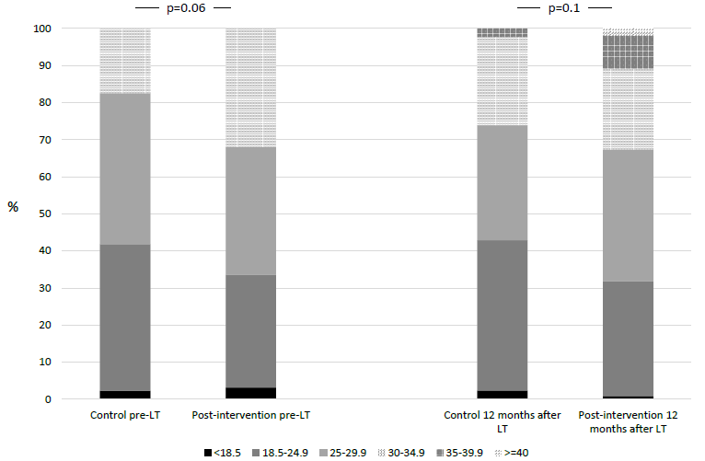
BMI
Notes:
BMI more assessed
No difference between groups at 12 months (but were different pre-LT)
No change pre-post LT (paired): loss of fluid, gain of muscle/fat?
Only taking compensated patients with LT for HCC: difference remains significant
Use of BMI simplistic, does not take into account change in fluid retention, gain/loss of muscle and fat mass

Slide 17
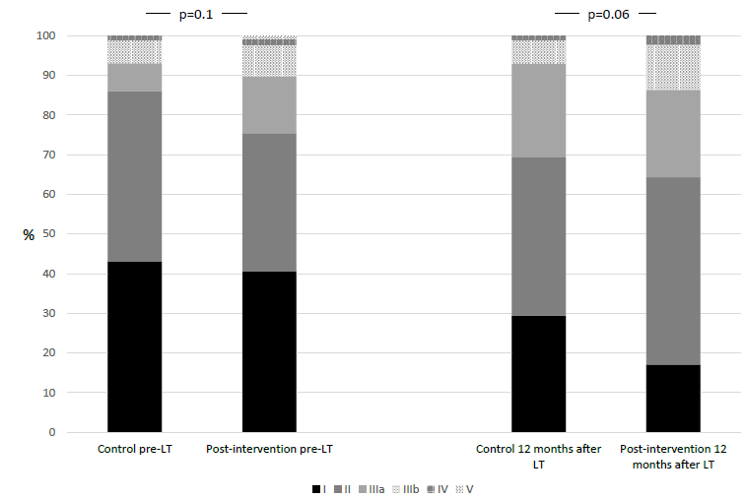
Renal function (KDIGO CKD classification)
Notes:
Renal function deteriorated overall post LT with more patients in higher KDIGO classes
Smoking:
Control group: 19% -> 17%
Intervention group: 17% -> 9%
Also more referrals to non transplant specialists in the intervention group

Slide 18
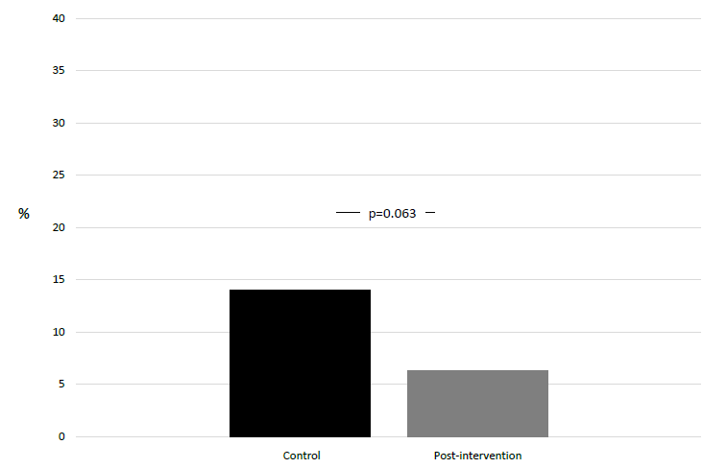
Cardiovascular events
14%
6%
Notes:
ASCVD risk Score could be calculated in 22 (26%) controls and 80 (65%) post-intervention patients (p<0.001), being, respectively, 9.2% (4.2-19.5) and 10.3% (4.1-19.8) (p=0.85).

Slide 19
Discussion
A multidisciplinary, multi-professional standardized strategy can achieve higher grade of assessment and management of post-LT cardiovascular risk despite a worsening metabolic profile of LT recipients.
How?
Not relying on «physician discretion»
Centralization of care (here: APN)
Multidisciplinary educational sessions may have contributed to patient empowerment to improve lifestyle habits
Notes:
AENOR Spain 1986
Northwestern Method©: mixed-methods approach that consists in adaptation of practice guidelines by a multidisciplinary panel of experts, identification of barriers for guidance adherence and implementation and dissemination of the guidance
Not rely on HA
The OLT SS format may affect continuity of care

Slide 20
Discussion
Potential confounding factors since patients in the post-intervention cohort had:
Different clinical characteristics at baseline (more MAFLD, more CVRF, more decompensated)
Different immunosuppressor regimens (less CsA, more everolimus)
Could partially explain some of the outcomes (incl. worse kidney function)
Should not influence the identification of risk factors and achievement of treatment targets

Slide 21
Limitations
Different baseline characteristics of the two cohorts
Low small sample size to detect CVE
Adherence to protocol suboptimal (dyslipidemia) -> led to changes
Use of classical clinical risk factors / ASCVD score may not be optimal in LT recipients
Additional comments:
Use of BMI, no data on distribution of weight
No data on lifestyle changes

Slide 22
Conclusion
Liver transplant recipients have multiple metabolic comorbidities and have a high cardiovascular risk
Will likely get worse as patients are more and more obese and as MAFLD is a growing indication for LT
A multidisciplinary, multi-professional standardized strategy can achieve higher grade of assessment and management (with achievement of targets) of post-LT cardiovascular risk
This could lead to a benefit on CVE and potentially survival
Notes:
AENOR Spain 1986
Northwestern Method©: mixed-methods approach that consists in adaptation of practice guidelines by a multidisciplinary panel of experts, identification of barriers for guidance adherence and implementation and dissemination of the guidance
Not rely on HA
The OLT SS format may affect continuity of care

Slide 23
Thank you for your attention!

