Slide 1


Clinical approach to increased serum ferritin
Yuly Paulin Mendoza
DAS hepatology - University of Bern
14th November 2018

Slide 2
Female B.B. Born 18.9.55
Referred Sep 2018 from obesity consultation for increased serum ferritin. Asymptomatic
Medical and personal history
  Obese since her 30s;
  2016 Sleeve-Gastrectomy (reduction 48kg – initial 148kg now 100 kg);
  Depression
No alcohol, No smoking.
Medication: Vitamin D3, Vitamin B12, Vitamins, Spurenelemente, Amitriptylin 50mg/day, Trazodon 100mg/day

Slide 3
Physical examination, US and TE
Physical examination:
63 year old 160cms,
100kg, BMI 39 kg/m2
Blood pressure 149/80 mmHg
Waist circumference 110 cm
No spider naevi, no ascitis, no asterixis, No lower edema
Liver Stiffness by TE 11.09.2018:
3.1 ± 0.7 kPa, IQR/Med 23%, CAP 220 ± 49 dB/m (10/10
valide Messungen)
Abdominal ultrasound 11.09.2018
Hepatic steatosis, no evidence of a significant
Liver fibrosis. Cholecystolithiasis.

Slide 4
Laboratory test
Laboratory | 11.09.18 | 24.07.18 | Normal Value
Bilirrubin | 5 μmol/L | 5 μmol/L | (<17 μmol/L)
Albumin | 33 g/L | 34 g/L | (35-52 g/L)
INR | <1.0 | <1.0 | (0.8-1.2)
ALT | 24 U/L | 21 U/L | (<35 U/L)
Alk Phosphatasa | 86 U/L | 87 U/L | (35-105 U/L)
GGT | 99 U/L | 107 U/L | (5-36 U/L)
M-30 Apopotosense | 83 U/L |  | (<200U/L)
C-reaktives Protein | 5 mg/L | 5 mg/L | (<5 mg/L)
hemoglobin | 121 g/L | 135 g/L | (121-154 g/L)
platelets | 212 g/L | 198 g/L | (140-380 g/L)
Cholesterol | 5.67 mmol/L | 5.60 mmol/L | (<5.2mmol/L)
Triglyceride | 1.18 mmol/L | 1.18 mmol/L | (>2.3 mmol/L)
HbA1c | 5.0 % | 5.0 % | (4.2-6%)
Ferritin | 987 μg/L | 1239 μg/L | (20-250 μg/L)
Transferrin saturation | 90 % | 94 % | (16-45%)
Iron | 30.7 μmol/L | 34.8 μmol/L | (6.6-26 μmol/L)
Transferrin | 1.36 g/L | 1.47 g/L | (2-3.6 g/L)

Slide 5
When Ferritin is high, the most crucial questions to ask are: is it secondary to a known clinical condition, and is it associated with iron overload?

Slide 6
Causes of hyperferritinemia
More than 90% of cases
40–50% of cases are explained by a combination of 2 or more diseases
B. Lorcerie et al. Presse Med. 2017
Sim Y. European Journal of Internal Medicine. 2016

Slide 7
Hepcidin
⬇Hepcidin
-Alcohol
-Hereditary hemochromatosis
  ▪HFE-associated
  ▪ non-HFE-associated forms
- Anaemia
Adapted from B. Lorcerie et al. La Revue de médecine interne. ²⁰¹⁵
Adapted From Powell LW, Seckington RC, Deugnier Y. Lancet. 2016

Slide 8
Hepcidin
⬆Hepcidin
-Inflammatory syndrome (IL 6)
-Metabolic syndrome
⬇Hepcidin
-Alcohol
-Hereditary hemochromatosis
  ▪HFE-associated
  ▪ non-HFE-associated forms
- Anaemia
Cytolysis →Damage to cells containing large amounts of ferritin, can lead to released into the plasma (acute or chronic hepatitis).
Adapted from B. Lorcerie et al. La Revue de médecine interne. ²⁰¹⁵
Adapted From Powell LW, Seckington RC, Deugnier Y. Lancet. 2016

Slide 9
Laboratory
Etiology No Iron overload | Ferritin | Transferrin saturation
Alcohol | <1.000 μg/l | Normal | 10- 20% >1000μg/l and TS >60%
Metabolic syndrom | <1.000 μg/l | Normal | 35% >1000μg/l and TS >60%
Inflammatory syndrome | <1.000 μg/l | Normal
Citolysis | >1.000 μg/l | ⬆
Malignancies (metastasis) | >1.000 μg/l | Normal
hyperferritinemia-cataract syndrome (L-ferritin) | >3000μg/l | Normal
Still disease, Macrophage activation syndrome, membranoproliferative neoplasm(MNP). | ≥10 000 μg/l | Normal
Adapted from B. Lorcerie et al. Presse Med. 2017
Adapte from Altes A, et al. Med Clin (Barc). 2014

Slide 10
Laboratory
Etiology Iron overload | Ferritin | Transferrin saturation
Hemochromatosis HFE-1 and others | >1.000 μg/l | ⬆ | (more often >80%)
Dyserythropoiesis | >1000μg/l | ⬆
Mutation of the gene ferroportin | >1.000 μg/l | Normal
Aceruloplasminemia | >1.000 μg/l | Normal
Porphyria cutanea tarda | ≥1. 000 μg/l | Normal
Excess iron intake or infusions | 300-700 μg/l | Normal or ⬆
B. Lorcerie et al. Presse Med. 2017
Altes A, et al. Med Clin (Barc). 2014

Slide 11

Laboratory
Males
Ferritin
300–400 μg/L as ULN
Females
Ferritin
150–200 μg/L as ULN
Transferrin Saturation <45%
Transferrin Saturation <50%
The values in females are lowest than male, as a result of iron loss from menstruation and pregnancies ( start to rise after 50 years).
The protective effect to iron-overload-disease → 28·4% vs 1·2% prevalences
^{Powell LW, et al.} ^{Lancet. 2016}
Allen KJ, et al.N Engl J Med 2008

Slide 12
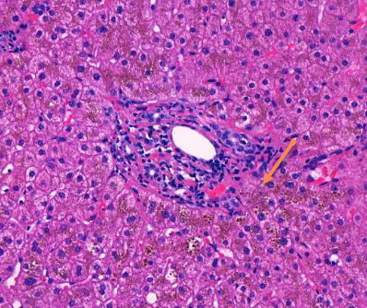
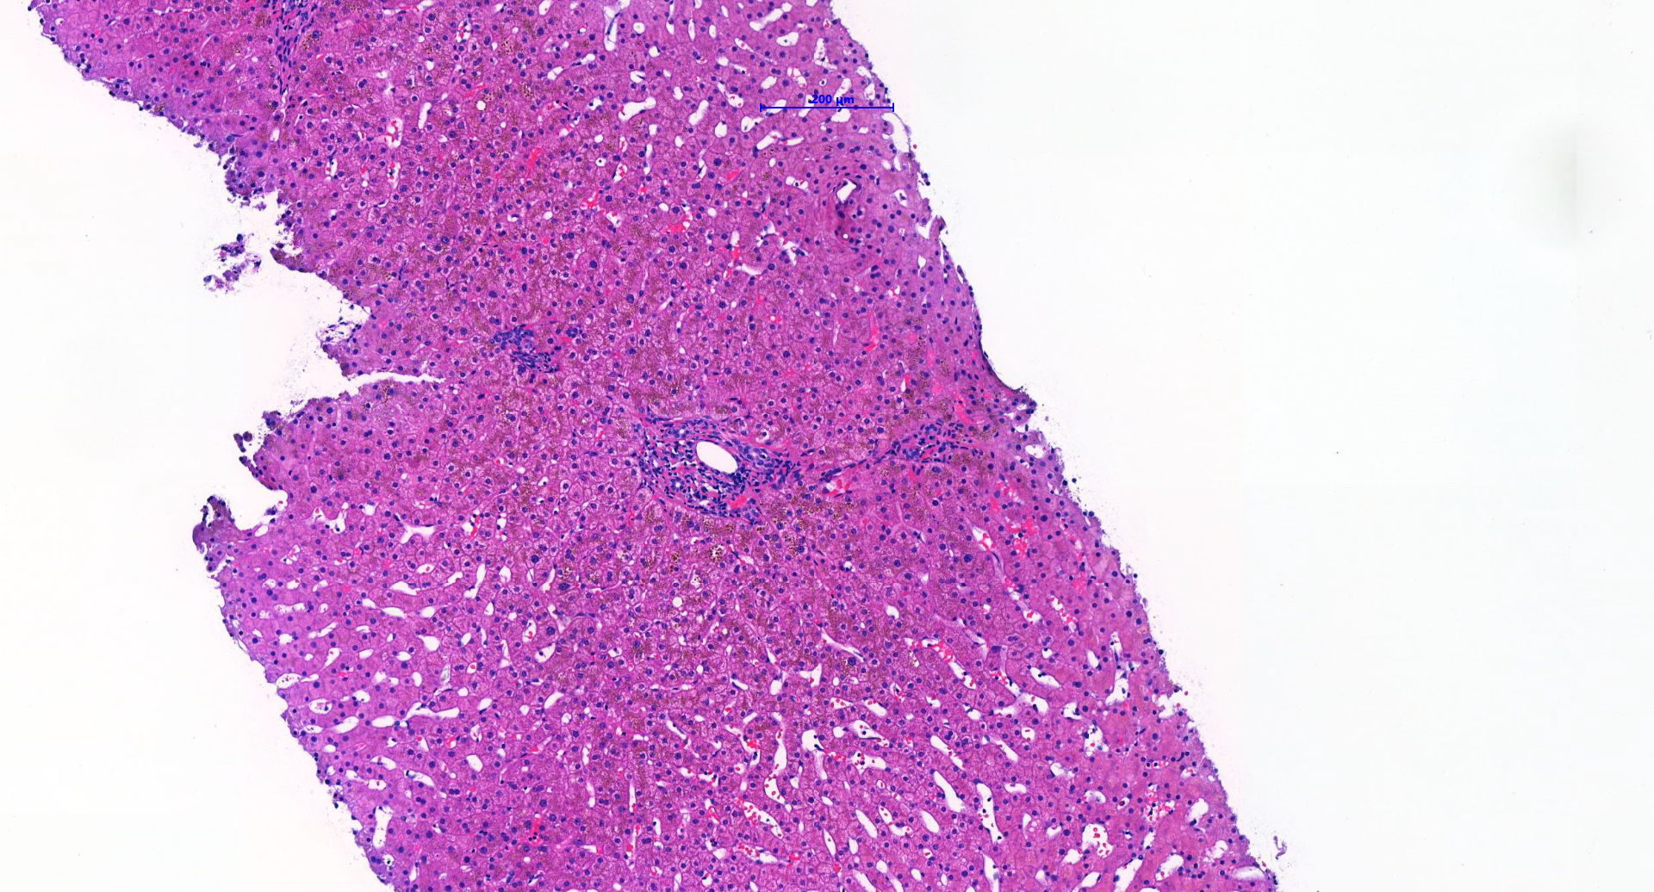
Clinical case
HFE –Gens is Positive for Mutation of Hereditary Hemochromatosis (C282Y homozygotes)
_
Notes:
We conrinue with the cases and the HFE gens was positive.
The Biopsy was performed, AND SHOW minor portal fibrosis without Septa formation, NO significant steatosis, analog METAVIR F1.
AND AROUND DUCTAL PORTAL WE CAN SEE DARK SPOTS,

Slide 13
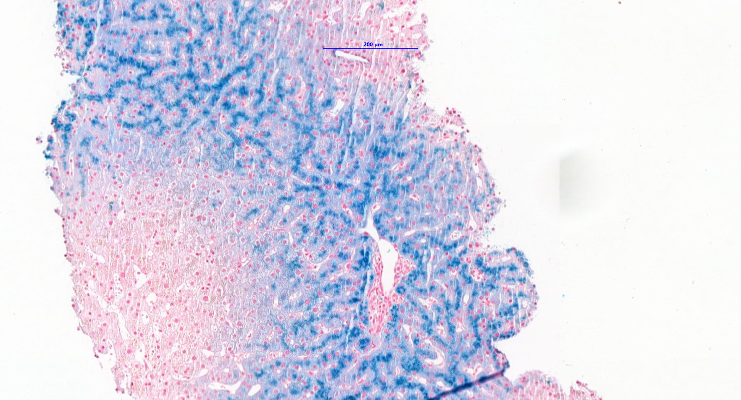
Clinical case
HFE –Gens is Positive for Mutation of Hereditary Hemochromatosis C282Y homozygotes
Hemojuvelin (HJV)
Hepcidin antimicrobial peptide(HAMP)
Transferrin receptor (TR2)
Ferroportin
Notes:
AND WITH IRON STAIN WE SEE THE CLASSIC PATTERN OF CANALICULAR IRON, periportal hepatocellular and pericanalicular siderosis.. The finding is suitable and compatible with a hereditary hemochromatosis.
OJO: If our patiente would be negative for HFE mutations and iron over-load is confirmed, testing of HJV, HAMP, TR2, ferroportin and SLC40A1 for types 2–4 HH should be considered.

Slide 14
Male K.W. Born 07.06.56
Referred Sep 2009 for increased serum ferritin
Asymptomatic
Medical and personal history
  Obese his Adolecens
  2007 Arterial hypertension;
  2009 dyslipidaemia
2 adult children, Landwirt
No alcohol, No smoking, 1 coffe/day.
Medication: candesartan 0.5mg/day.

Slide 15
Physical examination, US and TE
Physical examination:
53 year old 167cms,
90kg BMI 33 kg/m2
Blood pressure 145/115 mmHg,
Waist circumference 117 cm
No spider naevi, no ascitis, no asterixis
No lower edema
Liver Stiffness by TE:
6.7 ± 1.2 kPa, Success rate 83% , CAP 340 ± 49 dB/m
Abdominal ultrasound
Esteatosis, no focal lesión. No ascites, spleen 10cm

Slide 16
Laboratory test
Laboratory | 11.09.09 | Normal Value
Bilirrubin | 16 μmol/L | (<17 μmol/L)
Albumin | 42 g/L | (35-52 g/L)
INR | 1.23 | (0.8-1.2)
ALT | 99 U/L | (<35 U/L)
Alk Phosphatasa | 69 U/L | (35-105 U/L)
GGT | 180 U/L | (5-36 U/L)
Hyaluronat | 45 ug/L | (<60 ug/L)
Creatinin | 76 μmol/L | (45-84 μmol/L)
hemoglobin | 165 g/L | (121-154 g/L)
platelets | 159 g/L | (140-380 g/L)
Cholesterol | 6.5 mmol/L | (<5.2 mmol/L)
Triglyceride | 1.85 mmol/L | (>2.3 mmol/L)
Glucose | 5.13 mmol/l | (3.7-5.6 mmol/l)
Ferritin | 1323 μg/L | (20-250 μg/L)
Transferrin saturation | 60% | (16-45%)

Slide 17
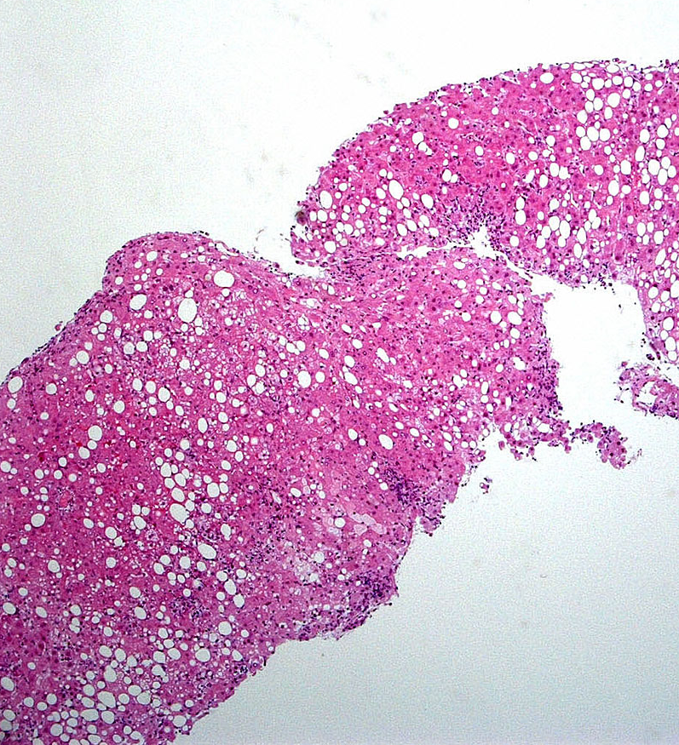
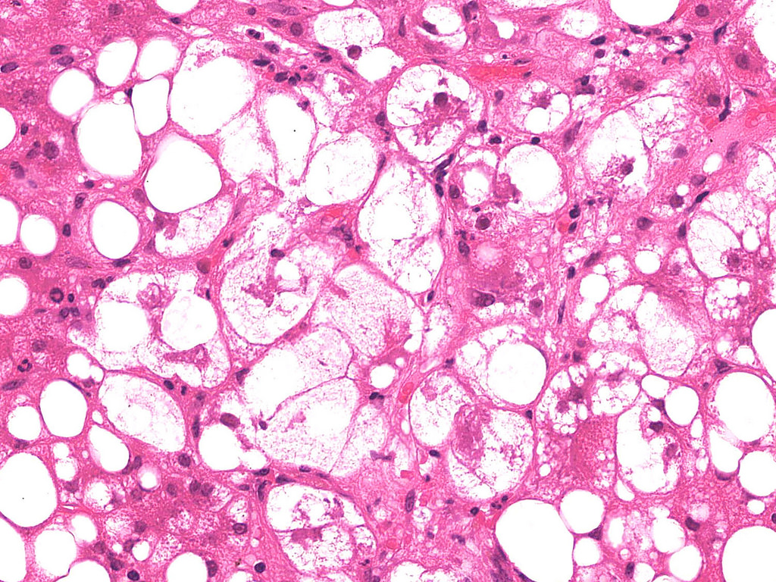
Results and Biopsy
Macrovesicular steatosis (50-60%)
Minimal insignificant perisinusoidal fibrosis
S2A3F1
Metabolic hyperferritinemia
HFE –Gens is Negative for Mutation of Hereditary Hemochromatosis

Slide 18
Diagnosis of hyperferritinemia in the dysmetabolic patient
Dysmetabolic iron overload syndrome (DIOS)≠ Metabolic hyperferritinemia

Slide 19
Dysmetabolic iron overload syndrome (DIOS)
Mild increase
in both liver and body iron stores (MRI or Biopsy)
One or several components of metabolic syndrome
In the absence of any identificable cause of iron excess
Deugnier Y. EASL-ILC.2014
Valenti L, et al. Gastroenterology 2010;138:905–12.

Slide 20
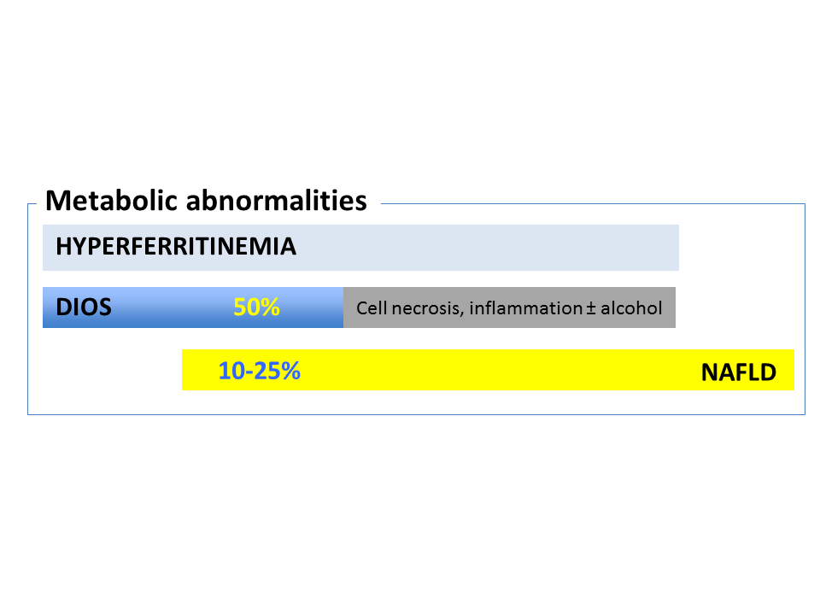
DIOS 50%
30- 50%
Deugnier Y. EASL-ILC.2014
Valenti L, et al. Gastroenterology 2010;138:905–12.

Slide 21
Whether this Hyperferritinemia in metabolic syndrome correspond to iron excess ( DIOS) or not?
Liver Biopsy
Abdominal MRI

Slide 22
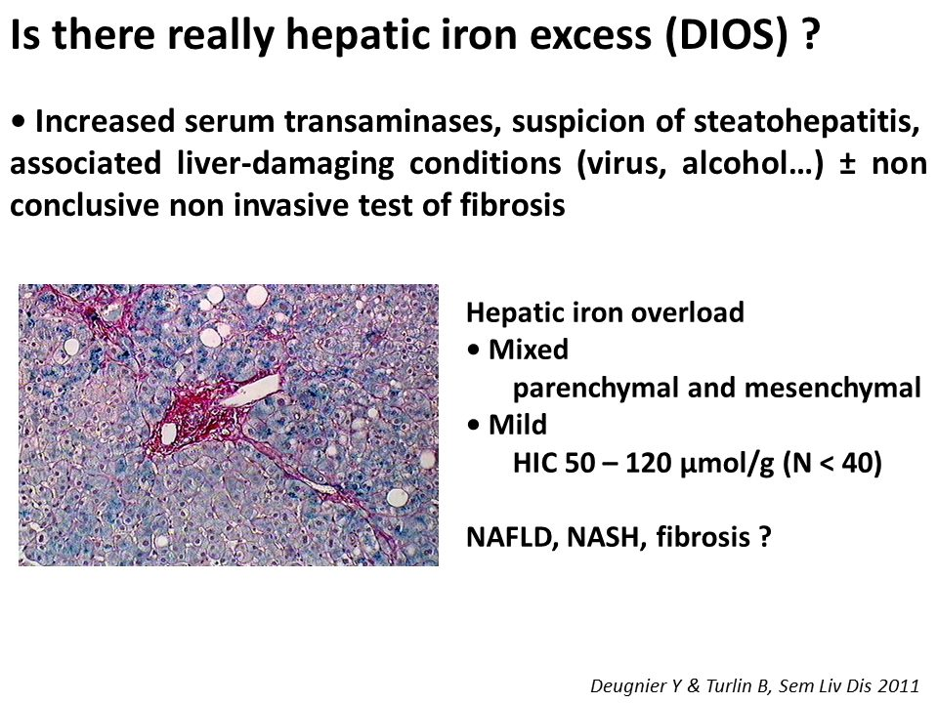
Is there really iron excess (DIOS) ?
Hepatic iron overload (DIOS):
Mixed
Parenchymal and mesenchymal
Mild
hepatic iron excess <150 mmol/g

Slide 23
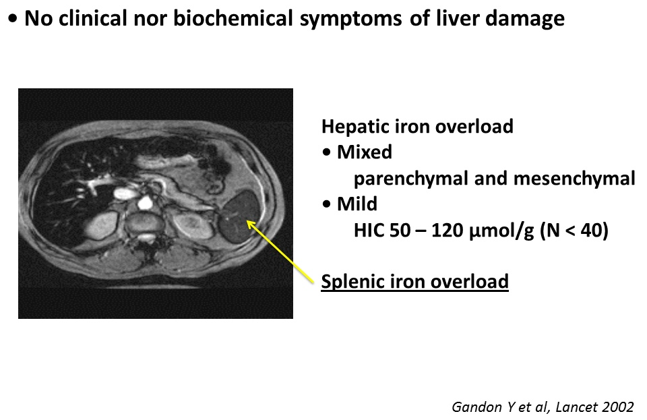
Is there really iron excess (DIOS) ?
No clinical symptoms nor biochemical finding or liver damage
Hepatic iron overload (DIOS):
Mixed
Parenchymal and mesenchymal
Mild
hepatic iron excess <150 mmol/g

Slide 24
Pathophysiology of DIOS
Notes:
What about the patho..

Slide 25
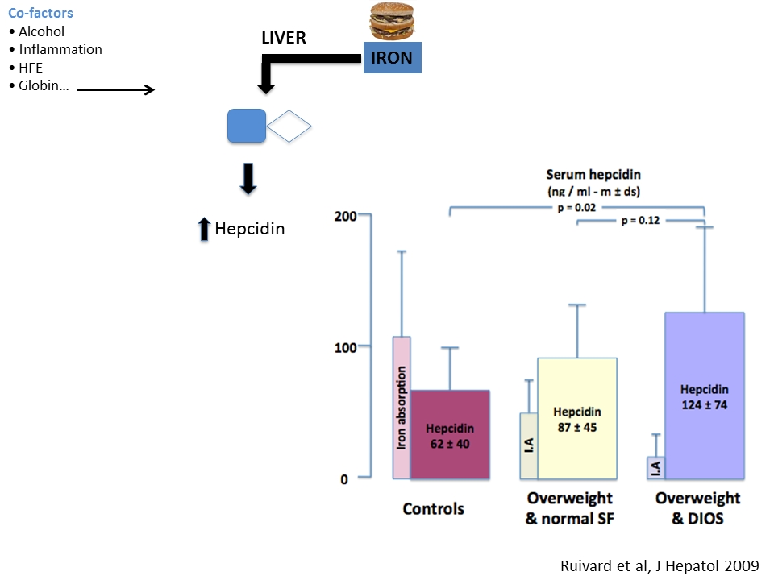
Notes:
síntesis of hepcidin is IN DIOS higher overweight and DIOS compare to overweight and normal ferrtina

Slide 26
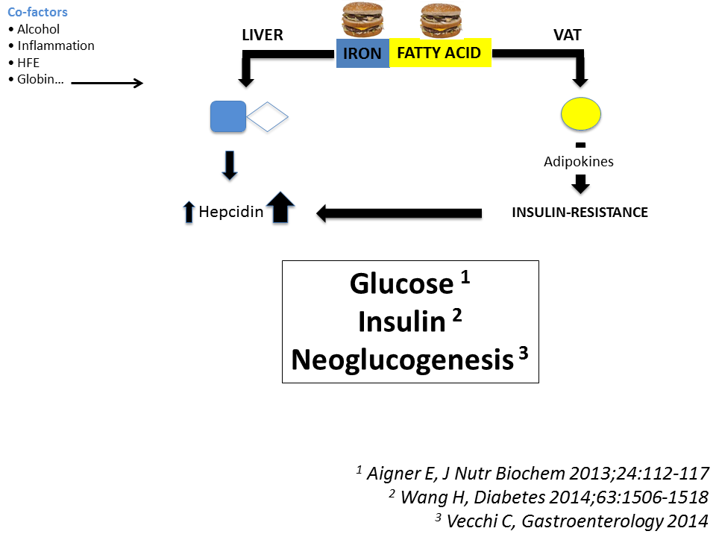
Notes:
And the same time fatty accid acumulate in visceral adipos tissue, iron dysregulates the production of adipokines, This enhances insulin resistance, which
stimulates hepcidin production and increase considerable the sintesi of hepcidin, increase glucosa, insulin, even neuglucogenesis ( animlads)

Slide 27
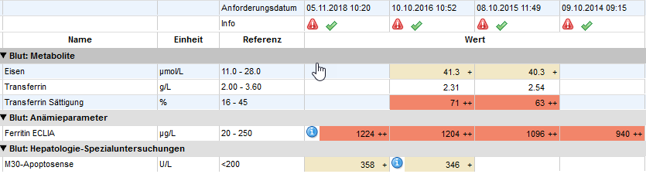
Evolution of Clinical Case in the last 4 years
The patient had lost only 1.5 kg of weight and persist Ferritin, ST and M30 elevated.
Fibroscan 10.10.16: Stiffness 4.2 ± 0.4 kPa, IQR8%, CAP 384 ± 15 dB/m

Slide 28

Management
To bleed ot not to bleed?
Notes:
So the question is to bleed or not to bleed this patient.

Slide 29
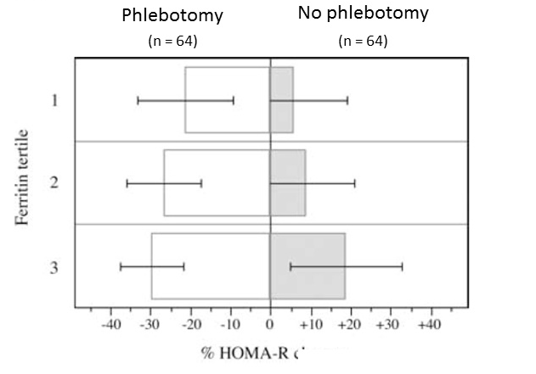
Effect of phlebotomy on Liver histology in NAFLD
study of 128 non- diabetic patients with NAFLD
Improvement in serum insulin, serum glucose and HOMA
Valenti et al. Am J Gastroenterol. 2007
Valenti et al. World J Gastroenterol 2014
Fernandez-Real JM.Diabetes 2002
Houschyar KS, et al. BMC Med 2012

Slide 30
Effect of phlebotomy on Liver histology in NAFLD
Phase II trial in 31 patientes with NAFLD
Blood removal until serum ferritin >50
Improvement in liver histology (NAS score)
Beaton M. Alimentary Pharmacology and Therapeutics. 2013

Slide 31
Effect of phlebotomy on Liver histology in NAFLD
RCT 74 patients with NAFLD (not diagnosed with a biopsy)
phlebotomies to achieve ferritin levels <45 ng/mL x 6months
Not improve liver enzymes, hepatic fat, or IR in subjects
Only 36 patients had increased ferritin.
Adams LA, et al. Hepatology 2015

Slide 32
Effect of phlebotomy on Liver histology in NAFLD
RCT 274 patients with DIOS (hepatic iron >50 lmol/g in RMN)
Phlebotomies (<50 lg/L )1 year vs lifestyle
Not improve metabolic and hepatic features
⬆weight gain and was not well tolerated
Laine F, et al. Hepatology 2017.

Slide 33
Effect of phlebotomy on Liver histology in NAFLD
Meta-analysis 9 studies with 820 patients with DIOS and/or NAFLD
(427 had phlebotomy, 393 lifestyle changes alone).
Murali A. Hepatology Research 2018

Slide 34
Hyperferritinemia
Inflamation, cell necrosis, alcohol, metabolic syndrome
Transferrin Saturation*
N
C282Y HFE Test
Treat and check
Hepatic iron (MRI
or biopsy)
>150μmol/g
50-150 μmol/g
≤50 μmol/g
Dysmetabolic iron
overload syndrome (DIOS)
Ferroportin
ceruloplasmin
L ferritin
Adapted from EASL. J Hepatol 2010 and ^{Powell LW} ^{et al. Lancet. 2016}

