Slide 1
Effects of Long-term Norfloxacin Therapy in Patients with Advanced Cirrhosis NORFLOCIR trial
R Moreau, L Elkrief, C Bureau et al. Gastroenterology. Aug 2018. [Epub]
Journal Club 30.08.2018 - Naomi Lange

Slide 2
Background
A ascitic fluid (AF) protein concentration <15 g/l is generally considered a risk factor for SBP
Daily oral fluoroquinolone prophylaxis reduces the risk of development of first episode of SBP and mortality in cirrhotic patients with low total protein in the ascitic fluid, but its use is hampered by the possibility of increased risk of infection by resistant bacteria
It is unknown whether there are any benefits of fluoroquinolone prophylaxis in patients with AF protein concentrations of ≥15 g/l
Notes:
This association was attributed to a lack of opsonic factors, since AF protein correlates with peritoneal immunoglobulin concentration and complement activity
Ref: 1. Loomba et al.: Role of Fluoroquinolones in the Primary Prophylaxis of Spontaneous Bacterial Peritonitis: Meta-Analysis

Slide 3
Aim of the study
To evaluate whether prolonged Norfloxacin administration resulted in
reduced mortality at 6 months (primary outcome) and
prevention of infections (secondary outcome)
in a large series of patients with advanced cirrhosis Child C without a recent fluoroquinolone administration.

Slide 4
Design
institutionally sponsored, prospective, multicenter, double-blind, randomized, placebo-controlled phase 3 trial
conducted in 18 clinical sites in France
from April 2010 through November 2014

Slide 5
Patients: inclusion criteria
>18 years
Child-Pugh class C cirrhosis
diagnosis of cirrhosis: biopsy proven or clinically suspected, based on the usual clinical, laboratory and radiological criteria
not received fluoroquinolones within past month
AF protein levels were not considered in inclusion criteria

Slide 6
Patients: exclusion criteria
treatment with immunosuppressive drugs
prior solid organ transplantation
HIV infection
hypersensitivity or intolerance to norfloxacin
prior TIPS
Amended exclusion criteria:
severe alcoholic hepatitis were included (07/2010
HCC ► excluded only those who had HCC that did not meet Milan criteria for transplantation (single lesion <5 cm or multiple lesions [maximum of three], the largest of which measures ≤3 cm) (09/2011)
Notes:
because of slow recruitment, it was decided to change exclusion

Slide 7
Outcomes
Primary outcome
mortality at 6 months
Secondary outcomes
mortality rate at 12 months
incidence of liver-related complications at 6 and 12 months
safety at 6 and 12 months

Slide 8
Study treatment
Norfloxacin 400mg/day or placebo for the first 6 months after enrollment
Monthly follow-ups during first 6 months, at 9 and 12 months
Treatment adherence assessed at each visit

Slide 9
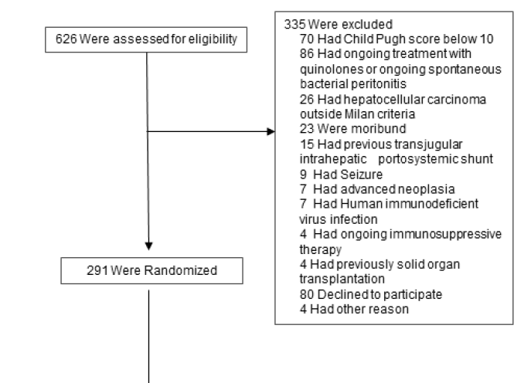

Slide 10
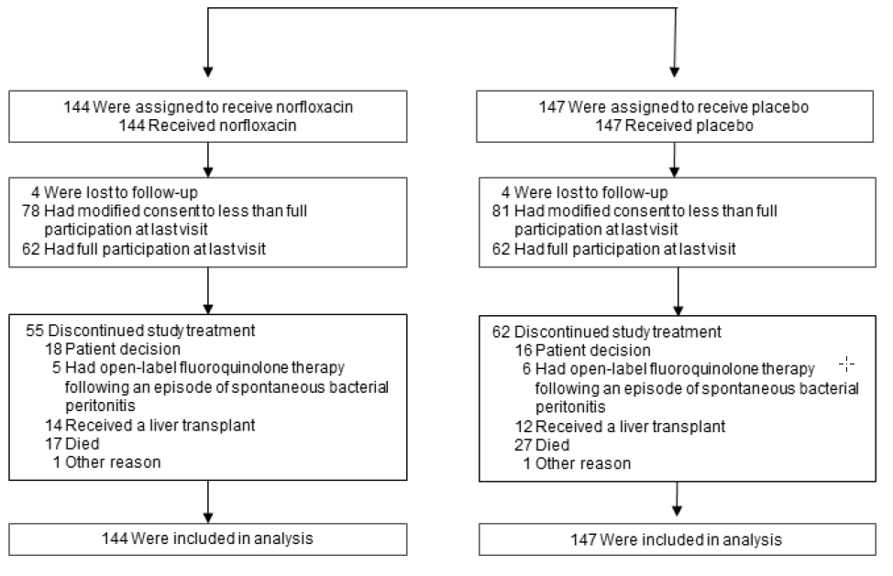

Slide 11
Baseline Characteristics
Characteristic | Norfloxacin (N=144) | Placebo (N=147)
Age – yr | 55.2 ± 8.5 | 56.0 ± 9.5
Male sex – no. (%) | 94 (65.3) | 108 (73.5)
Child-Pugh score | 11.4 ± 1.1 | 11.2 ± 1.0
MELD score | 21.4 ± 5.0 | 21.0 ± 5.3
Etiology of cirrhosis – no. (%)
Alcohol | 115 (79.9) | 108 (73.5)
HCV | 11 (7.6) | 9 (6.1)
HBV | 1 (0.7) | 3 (2.0)
Other cause | 17 (11.8) | 27 (18.3)
Active alcohol use – no. (%) | 55 (38.2) | 64 (43.5)
Waiting list for liver transplantation – no. (%) | 17 (11.8) | 13 (8.8)
Prior gastrointestinal hemorrhage – no. (%) | 28 (19.4) | 35 (23.8)
Notes:
No p-values
More patients in treatment group were female, on the waiting list for transplantation and had prior gastrointestinal hemorrhage.
Child and MELD scores were similar in both groups

Slide 12
Baseline Characteristics
Characteristic | Norfloxacin (N=144) | Placebo (N=147)
Prior episode of SBP – no. (%) | 6 (4.2) | 5 (3.4)
Prior episode of infection unrelated to SBP – no. (%) | 32 (22.2) | 42 (29.6)
Past history of HCC – no. (%) | 6 (4.2) | 3 (2.0)
Esophageal and/or gastric varices – no. (%)
Unknown | 19 (13.2) | 28 (19.0)
Grade 0 | 32 (22.2) | 27 (18.4)
Grade 1 | 31 (21.5) | 33 (22.5)
Grade 2 | 62 (43.1) | 59 (40.1)
History of at least one episode of ascites – no. (%) | 126 (87.5) | 131 (89.1)
Ascites – no. (%) | 116 (80.5) | 116 (79.0)
Mild-to-moderate – no. / total no. (%) | 60/116 (51.7) | 66/116 (56.9)
Large or refractory– no. / total no. (%) | 56/116 (48.3) | 50/116 (43.1)
Notes:
Naturally few patients had a prior episode of SBP as these patients would be likely to receive quinolone therapy as secondary prevention of SBP.
Fewer patients in the treatment group had prior episodes of infection unrelated to SBP
The prevalence of varices was similar in both groups with a relatively large number of unknowns considering the study population
Abput 80% had ascites with almost 90% having a history of at least one episode of ascites

Slide 13
Baseline Characteristics
Characteristic | Norfloxacin (N=144) | Placebo (N=147)
Ongoing treatment at enrollment – no. (%)
Diuretics | 92 (63.9) | 94 (63.9)
Beta-blockers | 60 (41.7) | 67 (45.6)
Corticosteroids | 30 (20.8) | 32 (21.8)
Non-quinolone antibiotics – no. / total no. (%) For secondary prophylaxis | 1/6 (16.7) | 2/5 (40.0)
For other reasons | 41/134 (30.6) | 40/136 (29.4)
Notes:
2/3rds received diuretics and 40-45% beta-blockers
Of the 11patients with prior SBP 3 received non-quinolone antiboitics for secondary prophylaxis of SBP. Around one third received non-quinolone antibiotics for other reasons.

Slide 14
Results
Mean (±SD) durations of treatment and follow-up during the double-blind treatment period:
82.7±77.3 and 157.1±4.6 days in the norfloxacin group and 71.7±73.4 and 155.2±4.6 days in the placebo group
42.6% completed the trial according to the protocol (full participation)
54.6% modified their consent to less than full study participation (reduced number of study visits and/or transiently forgot to take study treatment)
2.7% were lost to follow-up
treatment was discontinued in 40.2% (death in 15.1%, prespecified reasons (occurrence of an episode of SBP/liver transplantation) in 12.7%, consent withdrawal in 11.7%, and other reasons in 0.7%
Notes:
Mean duration of treatment was around 2.7 months in treatment group and 2.3 months in placebo qroup. In the treatment period, follow up was around 5.2 months in both groups.

Slide 15
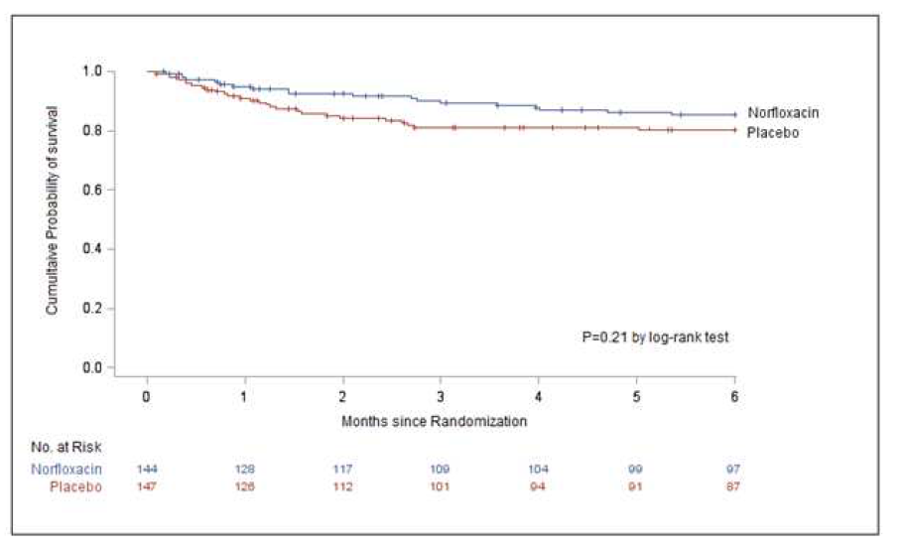
Results: primary analysis of primary outcome
Outcome | Norfloxacin (N=144) | Placebo (N=147) | P value | Hazard Ratio (95% CI)
Death
No. of patients Estimated rate – % (95% CI) | 19 14.8 (9.3-21.6) | 27 19.7 (13.5-26.8) | 0.21 | 0.69 (0.38-1.23)
Notes:
The primary analysis of the primary outcome showed no significant difference in the six months mortality between the treatment group and the placebo group.
The hazard ratio for six-month mortality was 0.69 (nonsignificant
reduction in mortality in the norfloxacin group compared to that in the
placebo group)

Slide 16
Results: post hoc analyses of primary outcome
Prespecified decision to censor SBP: expectation that secondary prophylaxis would be routinely used
► open-label use of fluoroquinolones following an episode of SBP were used in less than 50% of patients (27 developed SBP/11 received open-label norfloxacin)
► 26 patients were censored for liver transplantation
► Post hoc analyses: liver transplantation as a competing risk of death, survival data of patients with SBP not censored (12 deaths)
Notes:
Besides the primary analysis, Post hoc analyses of the primary oucome were performed.
Firstly, the authors state that the prespecified decision to censor patients who developed SBP was based on the assumption that these patients would receive secondary prophylaxis.
In reality, of the 27 patients who developed SBP during treatment period, only 11 received open label norfloxacin.
Furthermore, 26 patients were censored for liver transplantation.
Therefore the authors decided to perform post hoc analyses, accounting for liver transplantation as a competing risk of death. Survival data of patients with SBP were not censored

Slide 17
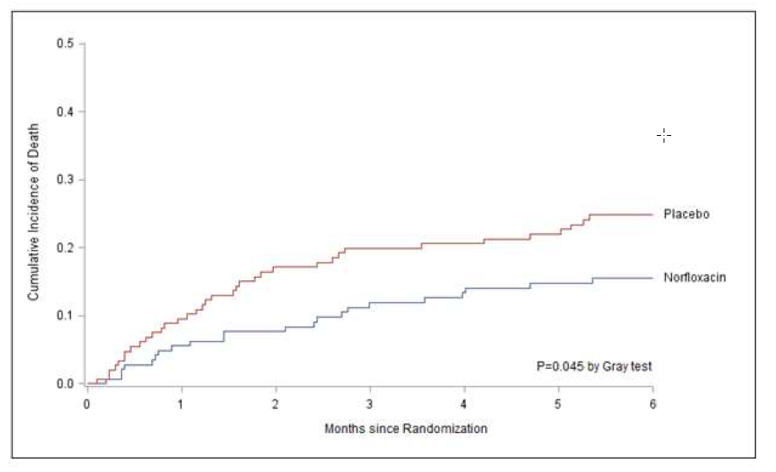
Results: post hoc analyses of primary outcome
Outcome | Norfloxacin (N=144) | Placebo (N=147) | Sub-hazard Ratio (95% CI)
Death
Cumulative incidence - % (95% CI) | 15.5% (10.1- 21.9) | 24.8% (18.1- 32.1) | 0.59 (0.35-0.99)
Notes:
So, in the competing risk analysis, the cumulative incidence of death in the norfloxacin group was significantly lower than in the placebo group with a subdistribution hazard ratio 0.59.

Slide 18
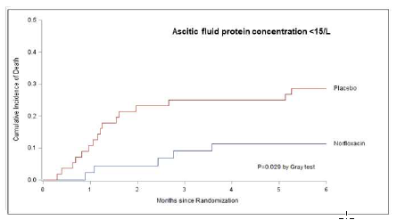
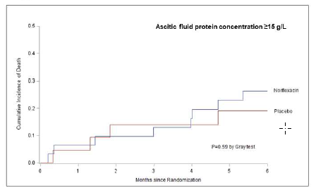
Results: post hoc analyses of primary outcome
66.8% (155/232) with baseline AF protein levels
cumulative incidence of death at 6 months
► 102 with AF protein levels <15 g/l: SHR 0.35 (95% CI, 0.13-0.93)
► 53 with AF protein levels ≥15 g/l: SHR 1.39 (95% CI, 0.42-4.57)
Notes:
Baseline ascitic fluid protein levels were available in 66.8% of patients.
Out of these 102 had a baseline AF level under 15 g/l. The competing risk analysis in this group showed a significant reduction of mortality in the norfloxacin group with a sub hazard ratio of 0.35.
53 patients had ascitic fluid protein levels over 15 g/l. Here, there was no significant reduction of mortality at 6 months observed.

Slide 19
Results: post hoc analyses of primary outcome
124 patients with full participation at last visit (62 in each group)
► cumulative incidence of death at 6 months: SHR 0.54 (95% CI, 0.28-1.05), P= 0.069
74 patients with prior episode of infection (32 in norfloxacin group)
► cumulative incidence of death at 6 months: SHR 0.83 (95% CI, 0.27-2.50), P= 0.74

Slide 20
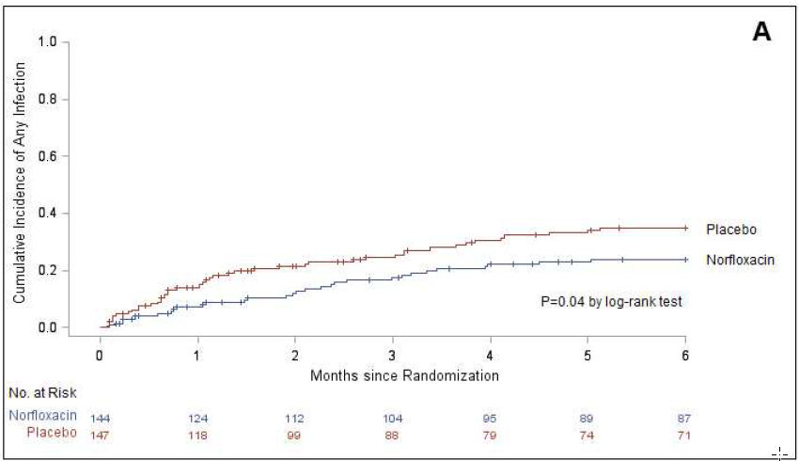
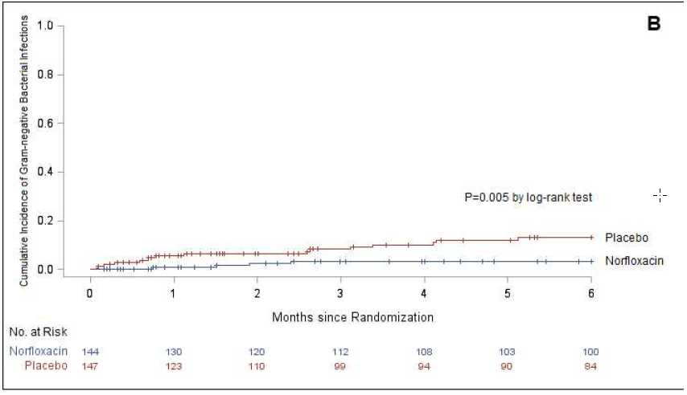
Results: secondary outcomes
Outcome | Norfloxacin (N=144) | Placebo (N=147) | P value | Hazard Ratio (95% CI)
Any infection
No. of patients Cumulative incidence – % (95% CI) | 31 23.9 (16.9-31.6) | 46 35.0 (26.8-43.3) | 0.04 | 0.62 (0.39-0.98)
Gram negative bacterial infection
No. of patients Cumulative incidence – % (95% CI) | 4 3.2 (1.0-7.4) | 17 13.0 (7.7-19.7) | 0.005 | 0.24 (0.08-0.70)
Multi-drug resistant bacteria No. of patients Cumulative incidence – % (95% CI) | 2 1.5 (0.3-4.9) | 1 0.7 (0.1-3.7) | 0.56 | 2.01 (0.18-22.20)
Notes:
In a time-to-event analysis, the cumulative incidence of any infection was significantly lower in the norfloxacin group than in the placebo group.
The incidence of Gram-negative bacterial infections was also significantly lower in the norfloxacin group than in the placebo group.
The incidence of other infectious outcomes, in particular infection caused by multi-drug resistant bacteria, was similar between the two study groups

Slide 21
Strengths and limitations
Strengths
Multicenter design and double-blind randomization to assigned treatment
Prespecified criteria for liver-related complications
Intention-to-treat analysis
Secondary analyses
Limitations
Lacking statistical power
Low adherence
Ascitic fluid protein levels lacking

Slide 22
Conclusions
6-month norfloxacin therapy did not reduce mortality rate at six months with censoring of data at the time of SBP or of liver transplantation
Norfloxacin therapy could reduce the incidence of death among patients with ascitic fluid protein concentrations of less than 15 g/L but not among those with 15 g/L or more
Norfloxacin prevents some infections, especially Gram-negative bacterial infections, but not the development of SBP and other non-infectious, liver-related complications

Slide 23
Thank you for your attention

