Slide 1
Journal Club
February 2019
M. Thormann
﻿Gastroenterology 2018;155:705–718

Slide 2
Thrombocytopenia in CLD patients
Common finding
Causes
Splenic sequestration
Increased destruction
Decreased production of thrombopoietin
Myeloid suppression
Platelet transfusions to prevent bleeding?

Slide 3
Avatrombopag
TPO-R agonist (Mpl binding protein)
Binding the transmembrane domain of TPO receptor
First data 2004
orally administered, for 5 days
Platelet adjusted dose
Similar: Eltrombopag, Romiplostim
Eltrombopag studied in CLD patients
Lusutrombopag (7 days)

Slide 4
ADAPT-1 & ADAPT-2

Slide 5
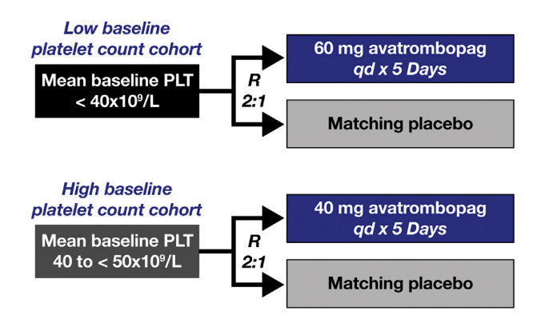

Slide 6
ADAPT-1 & ADAPT-2
Primary endpoint
﻿Proportion of patients not requiring
Platelet transfusion
Rescue procedure for bleeding
﻿Secondary efficacy endpoints
﻿the proportion of patients achieving target platelet count of > 50 on procedure day
﻿the change in platelet count from baseline to procedure day
Up to 7 days after procedure

Slide 7
Selected procedures

Slide 9
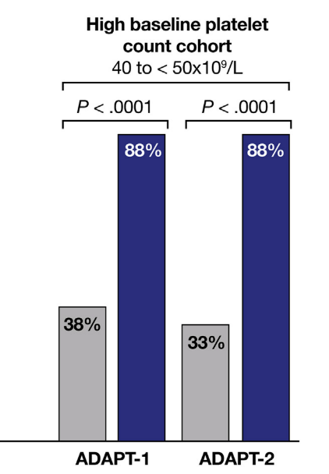
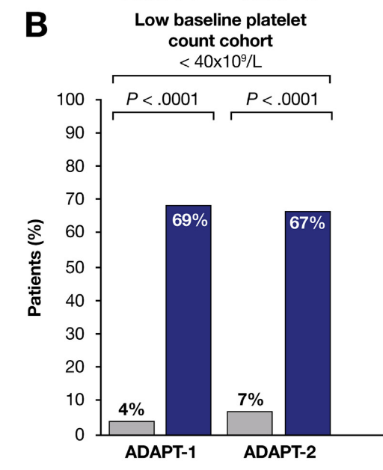
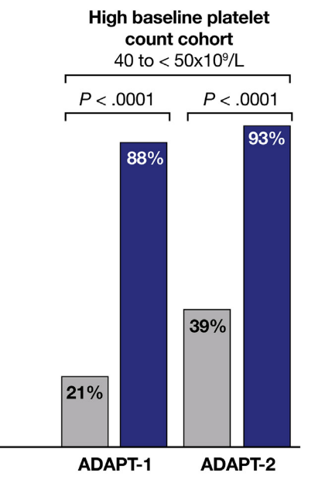
Results
﻿Proportion of patients not requiring a platelet transfusion or any rescue procedure for bleeding
﻿Proportion of patients who achieved platelet counts > 50 on procedure day

Slide 10
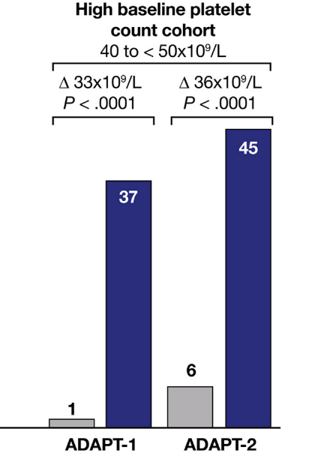
Results
But: no difference in bleeding events
﻿Magnitude of change in platelet count from baseline to procedure day.

Slide 11
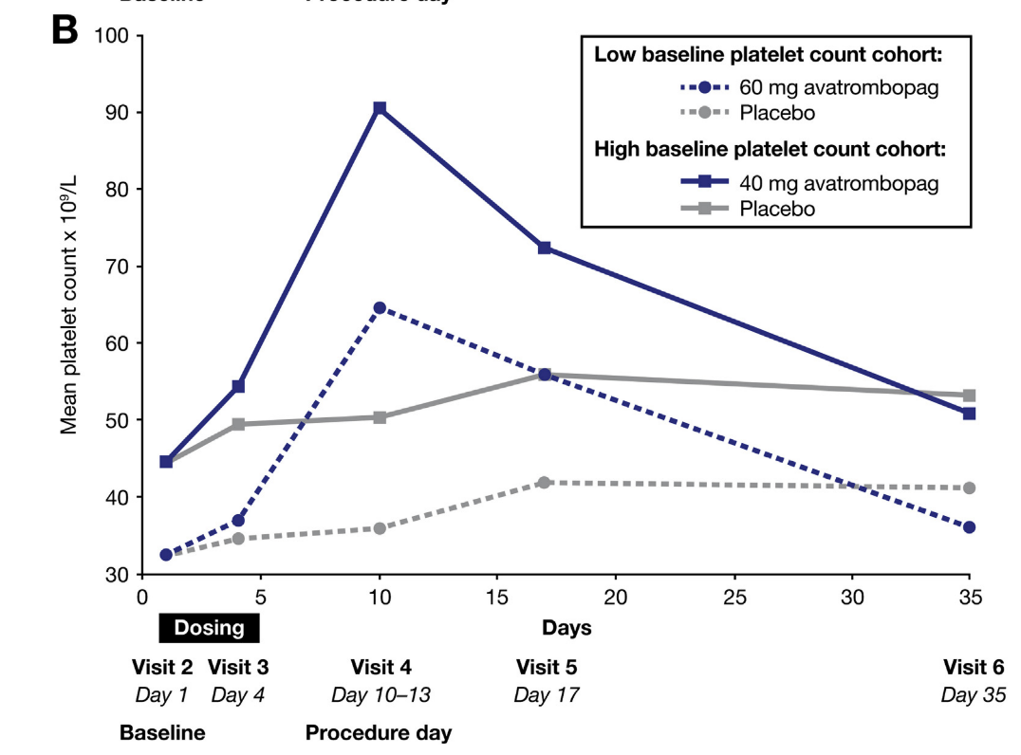
ADAPT-1
ADAPT-2

Slide 12
Complications
Overall safety profile similar to placebo
ADAPT-1 (high baseline): 2 deaths (not study related)
ADAPT-2 (high baseline): 1 partial portal vein thrombosis, day 13 (possibly related)
ADAPT-1 (low baseline): 1 portal vein thrombosis, day 31, received transfusion (not related)
(1 portal vein thrombosis in phase II)

Slide 13
Conclusions
Efficacy
Safety
Treatment window 10-13 days after first dose
Shortfalls
Study design
only one application
no prospective imaging included in protocol
No decrease in bleeding
quality of thrombocytes
study design related?

