Slide 1
Journal Club
Hepatology, University Clinic for Visceral Surgery and Medicine, Inselspital
Department for Clinical Research, University of Bern
1.6.2017

Slide 2
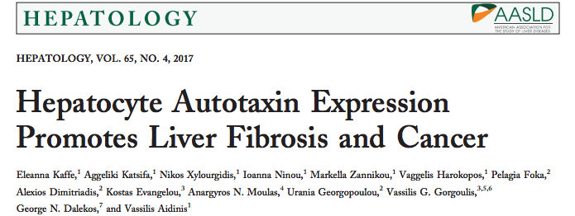

Slide 3
Introduction
Autotaxin (ATX) is a secreted lysophospholipase D catalyzing hydrolysis of lysophosphatidylcholine (LPC) to lysophosphatidic acid (LPA)
LPA is a pleiotropic growth factor-like phospholipid
LPA has numerous effects through G-protein coupled receptors, in almost all cell types
ATX expression is upregulated in chronic inflammatory disorders and cancers
Notes:
GPCR, LPAR1-6

Slide 4
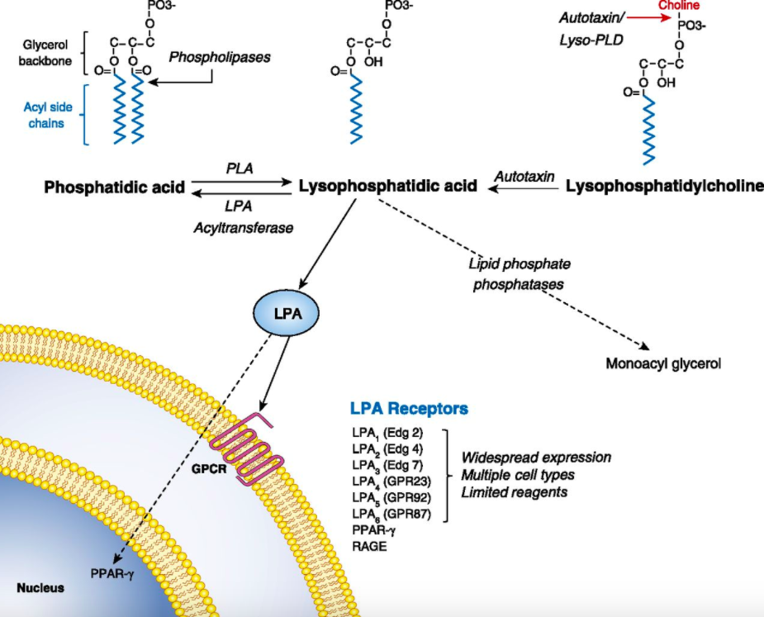
Autotaxin = Lyso PLD
Knowlden S et al. J Immunol 2014

Slide 5
Introduction
ATX has a decisive role in the development of pulmonary fibrosis
Serum ATX is increased in pruritus of cholestasis, but not of other origin, and responds to therapeutic interventions
Serum ATX is a parameter for the severity of liver cirrhosis and overall survival in patients with liver cirrhosis
ATX-LPA receptor signalling regulates hepatitis C virus replication
Oikonomou N et al. Am J Respir Cell Mol Biol 2012
Kremer AE et al. Hepatology 2012
Pleli T et al. PLoS One 2014
Farquar MJ et al. J Hepatol 2017

Slide 6
Introduction
LPA stimulates hepatic stellate cell proliferation and contraction and inhibits apoptosis

Slide 7
Objectives
Determine levels of serum ATX in chronic liver diseases (CLD) of different etiologies, ATX mRNA expression in CLD and hepatocellular carcinoma (HCC) patients and correlation with survival
Evaluate ATX and liver LPA expression in animal models of experimental toxic hepatitis and HCC
Genetic and pharmacological interventions in vivo, with ex vivo studies to evaluate role of ATX in lipid homeostasis and development of fibrosis and cancer

Slide 8
Materials & Methods
Human subjects
Animal experimentation: all experimental mice were bred and maintained in a C57B16/J genetic background
Acute and chronic intoxication with diethylnitrosamine (DEN) and/or carbon tetrachloride (CCl4-), liver histology, hepatic cell isolation and HCV infection, HPLC-ESI/MS/MS, ATX activity assay (TOOS), ELISA and western blot, and RNA Extraction and Real-time RT-PCR

Slide 9
Results
20
59
35
12
12
17 with cirrhosis

Slide 10
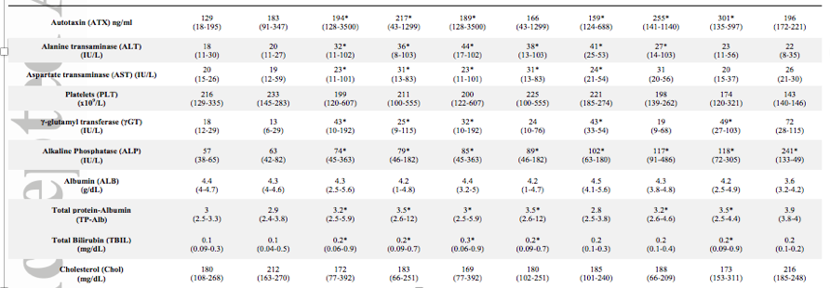

Slide 11
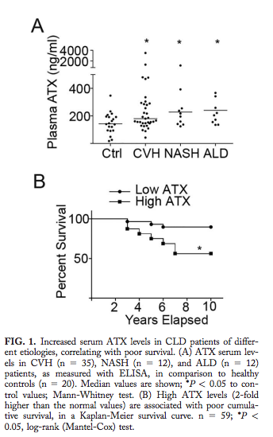
Results
Chronic viral hepatitis (CVH): 18 values close to normal *, as a result of appropriate antiviral treatment
ATX levels in these patients were significantly lower than those with active disease
Low serum ATX levels were significantly associated with longer survival (10y)
*

Slide 12
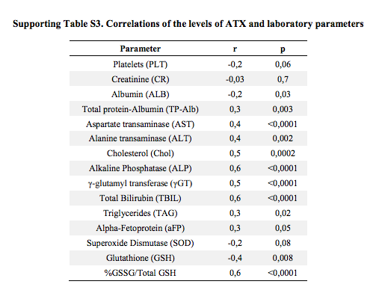
Results

Slide 13
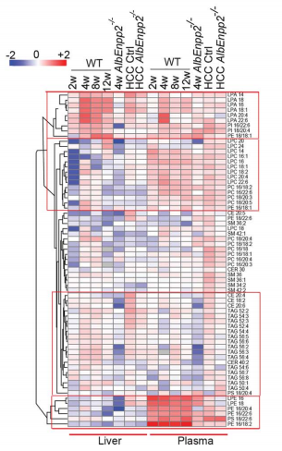
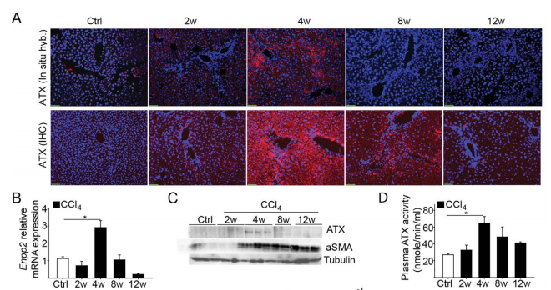
Results – Increased, well-timed liver ATX expression
Increased
Apoptosis
Apoptosis
Initial increase inflammatory gene expression profile: TNF, IL-1b, IL-6
Gradual fibrotic gene expression: TGF-b, aSMA/Acta2, Col3al

Slide 14
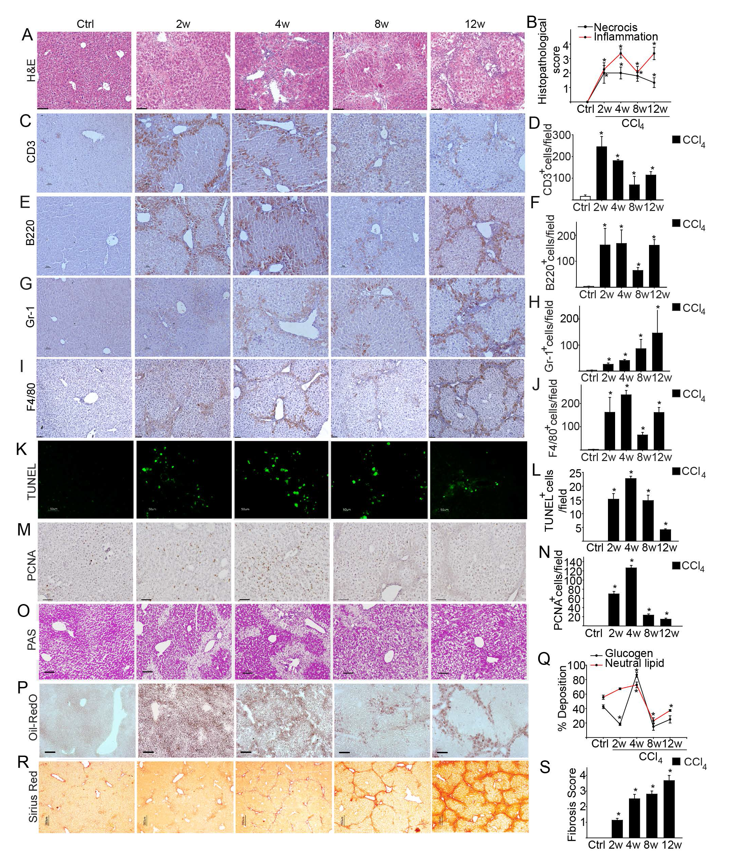
Results

Slide 15
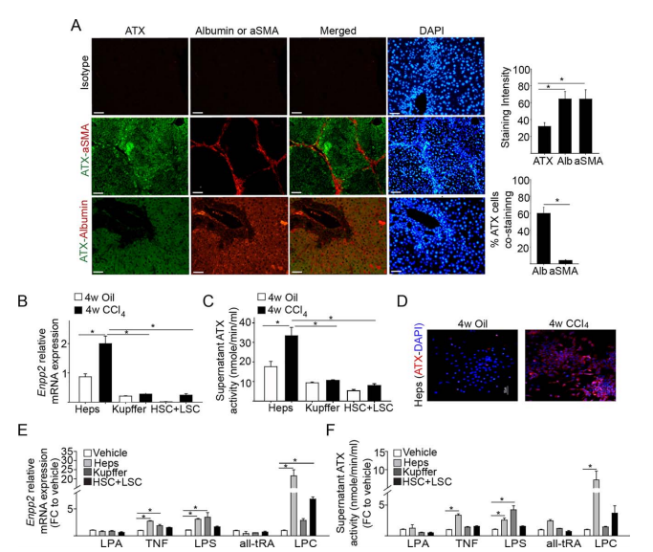
Results
Distorted phospholipid homeostasis in experimental toxic hepatitis:
Lipidomic analysis of CCl4-induced disease progression with HPLC-MS/MS. Clustering of lipid expression levels identified four major groups of lipids with deregulated expression
Hepatocyte injury or infection stimulates ATX expression:
aSMA-expressing myofibroblasts are not major producers of ATX
LPC as a potent ATX inducer in the liver. On the contrary, no major LPA effect in hepatocyte ATX expression was observed

Slide 16
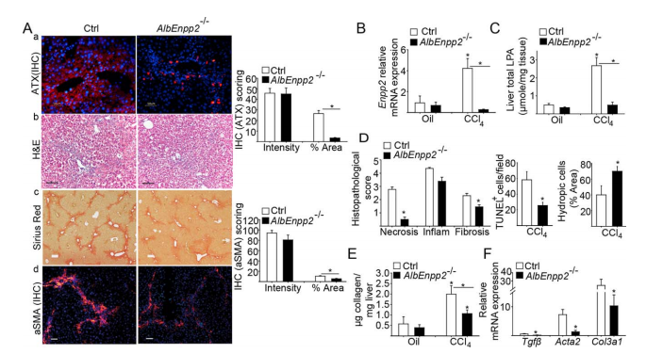
Results – Liver Fibrosis
Hepatocyte-specific ATX expression activates hepatic stellate cells and amplifies the fibrotic response:
ATX ablation led to a diminished histopathological fibrotic score with a decrease in collagen production, profibrotic gene expression, aSMA expression, as well as liver damage

Slide 17
Results
Pharmacological inhibition of ATX attenuates CCl4-induced fibrosis
Pharmacological ATX inhibition attenuated CCl4-induced fibrosis, confirming the genetic results and suggesting ATX as a potential therapeutic target in liver fibrosis

Slide 18
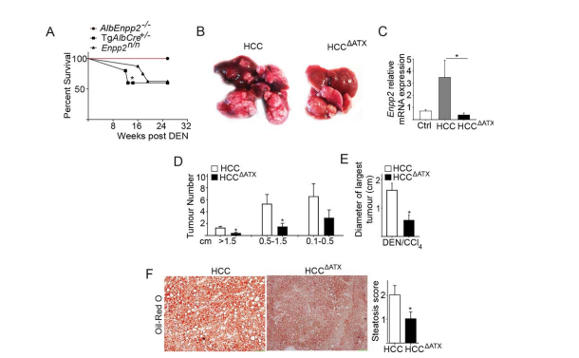
Results
Hepatocyte-specific ATX genetic deletion attenuates HCC development

Slide 19
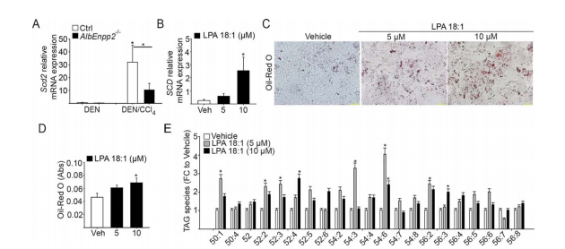
Results
ATX distorts HCC-related fatty acid metabolism

Slide 20
Conclusions
Increased ATX levels are associated with shorter overall survival and may represent a surrogate marker of hepatic damage and loss of function
ATX and LPA are detected in CCl4- intoxicated mouse livers. ATX expression localized mainly to hepatocytes, stimulated by HCV infection, TNF, LPC exposure. ATX expression in the inflammed liver partly controlled by NF-kB
Although ATX expression coincided with proliferative peak of hepatocytes, no major effect of ATX/LPA in hepatocyte proliferation in vitro.
ATX/LPA contribution to fatty acid synthesis and TAG deposition undetermined
ATX expression coincided with upregulated aSMA protein expression, Cyp2S1 mRNA expression and RA levels → markers of HSC activation. CXCR4 predominance → HSC proliferation, pro-fibrotic vascular effect
LPC and ATX/LPA could mediate diet and/or obesity effects in the liver; LPC de novo synthesis upon liver damage
Conditional gene deletion of ATX from Heps and abrogation of liver LPA production modulated inflammation and diminished fibrosis

Slide 21
Conclusions (2)
ATX deletion in DEN/CCl4-induced HCC, promoted mice survival and attenuated liver tumor number and size
ATX, due to its late onset, is not sufficient to promote carcinogenesis, but may amplify oncogenic age-related signals
LPA effects include proliferation, resistance to cell death, angiogenesis, as well as invasion and metastasis
The most prominent histopathological effect of ATX deletion in DEN/CCl4-induced HCC: decrease of neutral lipid deposition, perturbations in FA metabolism
Scd2 expression, essential for FA synthesis during early liver development, re-activated in DEN/CCl4-induced HCC, by LPA stimulation correlating with increased TAG accumulation
ATX/LPA stimulated lipase genes such as Patatin-like phospholipase domain containing 5 (PNPLA5), associated with TAG mobilization and autophagy
Pharmacological inhibition of ATX with PF8380 attenuated CCl4-induced fibrosis

Slide 22
Future Perspectives
ATX as a marker of CLD severity and prognosis?
Potential therapeutic target in CLDs and possibly HCC?

