Slide 1
An open-label randomised-controlled trial of azathioprine vs. mycophenolate mofetil for the induction of remission in treatment-naive autoimmune hepatitis
Snijders RJALM et al.; Dutch Autoimmune Hepatitis Working Group. J Hepatol. 2024; 80:576-585
Journal Club 09.04.2024 by Lisa-Maria Lunardon

Slide 2
Content
Introduction
Aim of the study
Study design
Clinical characteristics
Outcomes
Discussion

Slide 3
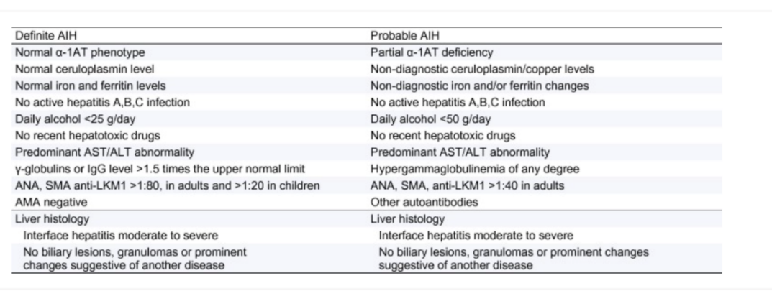
Introduction Autoimmune hepatitis diagnostic criteria
Calculators: Autoimmune Hepatitis Diagnostic Criteria - MSD Manual Professional Edition (msdmanuals.com)
European Association for the Study of the Liver. EASL Clinical Practice Guidelines: Autoimmune hepatitis. J Hepatol. 2015 Oct;63(4):971-1004. doi: 10.1016/j.jhep.2015.06.030. Epub 2015 Sep 1. Erratum in: J Hepatol. 2015 Dec;63(6):1543-4. PMID: 26341719.

Slide 4
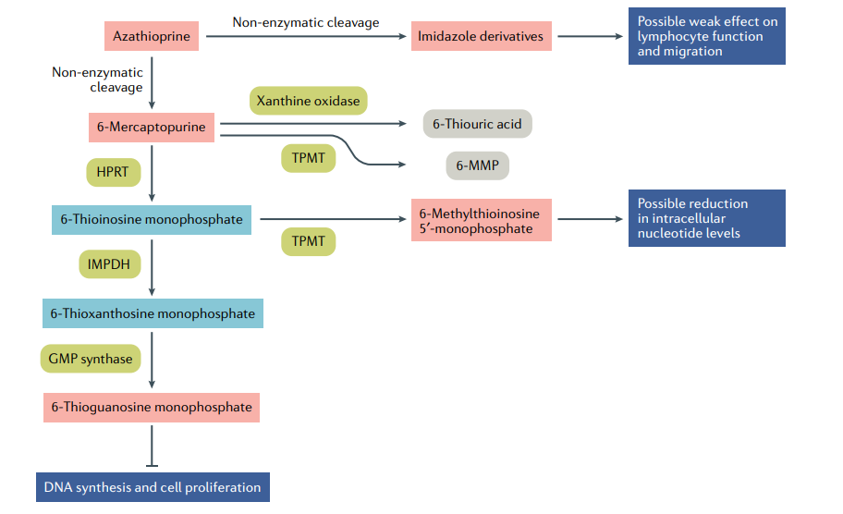
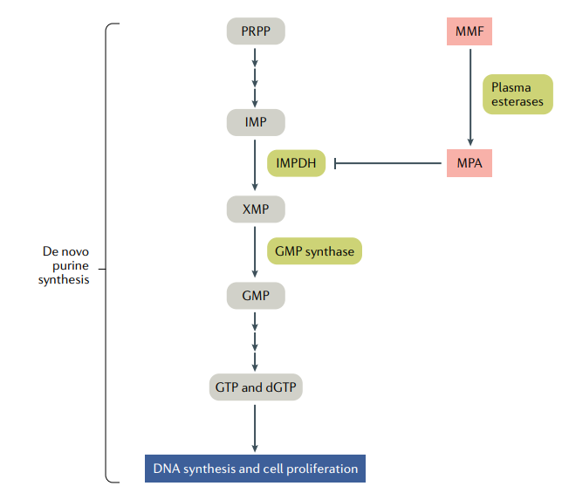
Introduction Azathioprine vs. Mycophenolate mofetil
Broen JCA, van Laar JM. Mycophenolate mofetil, azathioprine and tacrolimus: mechanisms in rheumatology. Nat Rev Rheumatol. 2020 Mar;16(3):167-178. doi: 10.1038/s41584-020-0374-8. Epub 2020 Feb 13. PMID: 32055040.

Slide 5
Aim of the study
To compare the biochemical efficacy and clinical tolerabilitiy of MMF and azathioprine, both in combination with prednisolone, as induction therapy in treatment-naive patients with AIH

Slide 6
Study design
Inclusion criteria: probable or definite diagnosis of autoimmune hepatitis (simplified AIH-Score >= 6, probable AIH / >= 7, points definite AIH), first presentation of AIH, age >= 18 years
Sample size with a power calculation of 80%: n= 64 (n=32 in each group)
Randomisation: computer-generated
Treatment: all patients received concomitant prednisolone (<80kg: 40mg PDN/day, >80kg 60mg PDN/day) and azathioprine or MMF
Duration: 24 weeks
Primary endpoint: biochemical remission at 24 weeks of treatment (normalisation of ALT and IgG levels)

Slide 7
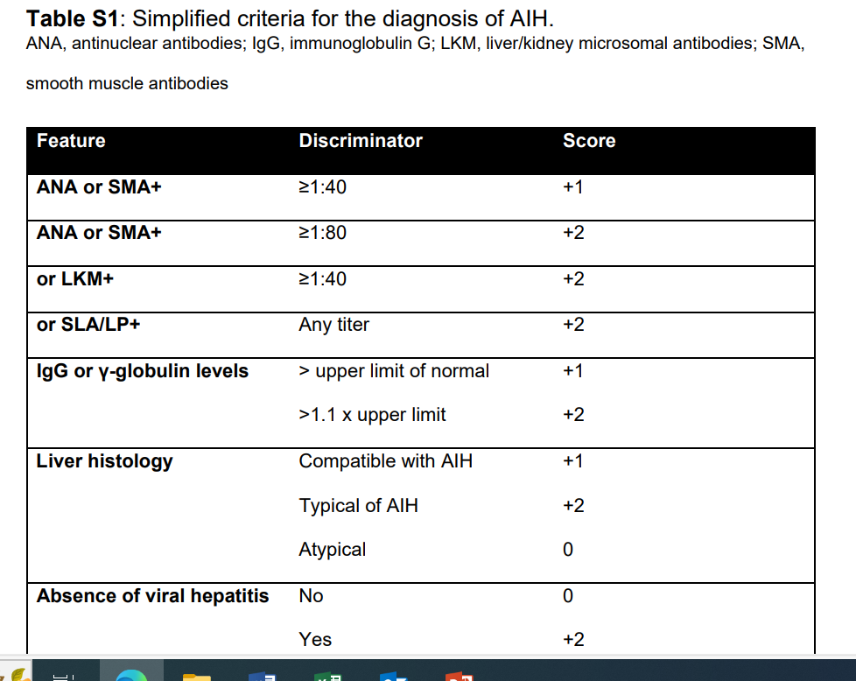
Study design

Slide 8
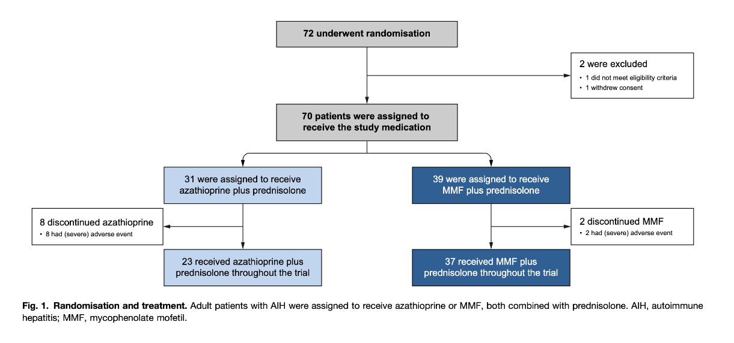
Study design

Slide 9
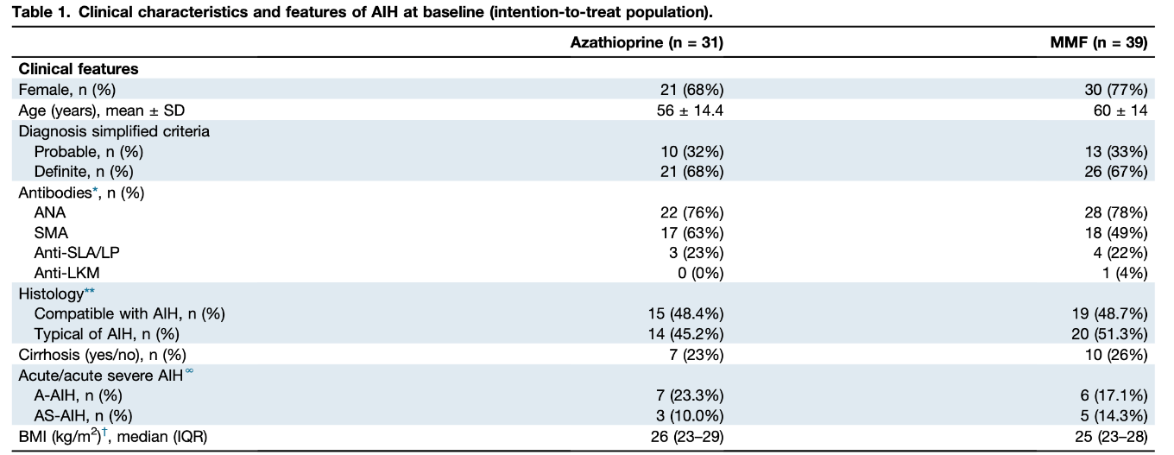
Clinical characteristics

Slide 10
Clinical characteristics

Slide 11
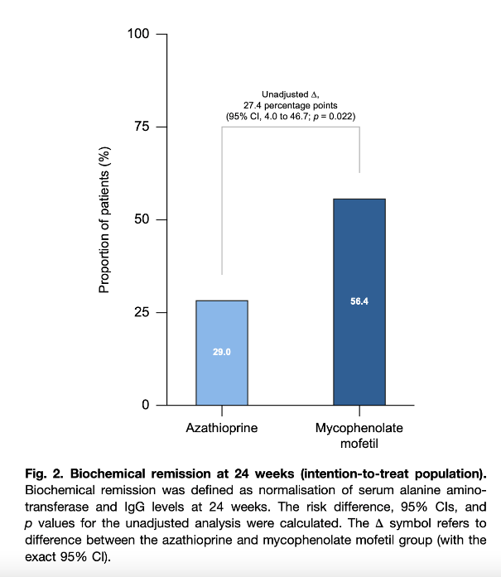
Outcomes
Intention-to-treat: 27% difference in the proportion
Per-protocol analysis: 20% difference in the proportion (ns)

Slide 12
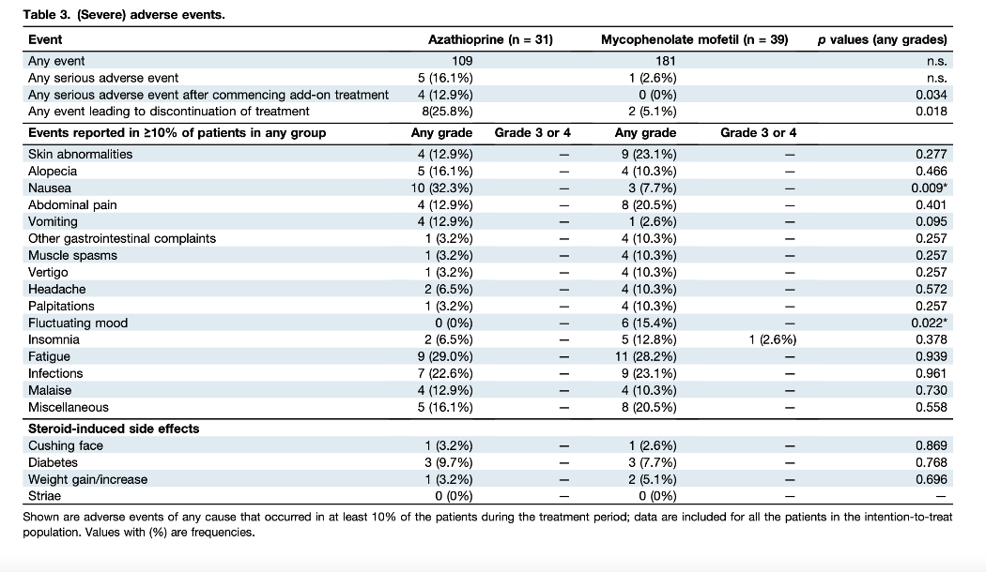
Outcomes

Slide 13
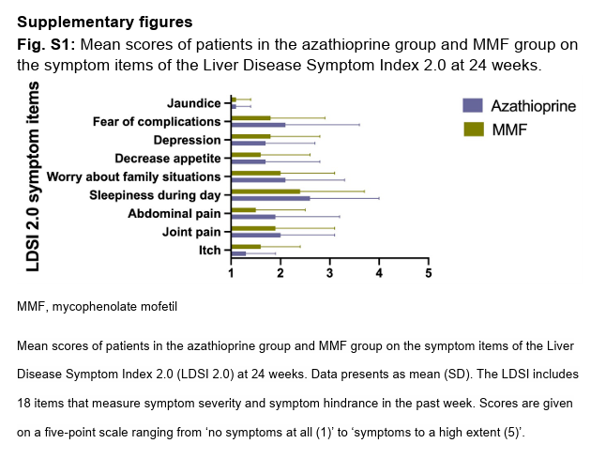
Outcomes

Slide 14
Discussion
Strengths
First randomised-controlled trial of azathioprine vs. MMF in AIH
Lower adverse event rate of MMF compared to azathioprine
Limitations
Small sample size
No long term follow-up
Histological remission was not assessed
Biased patient reported outcomes and reported adverse events due to open-label design
No analysis of cost-effectiveness

Slide 15
Discussion
Will MMF be the next first-line treatment of AIH?
What about teratogenicity of MMF?
Is MMF also safe in severe AIH cases?
Does long-term data exist? Is more data coming?

Slide 16
Thank you for your attention ☺

